Slide 1
Teaching and Learning with
ICT
Erasmus+
Strategic Partnerships for Schools

Slide 2

Τουρκία
Turecko
Törökország
TÜRKİYE
Turcja
Şehit Hamide Sibel Çetinkaya Anadolu Lisesi
Şehit Hamide Sibel Çetinkaya
Secondary School

Slide 3
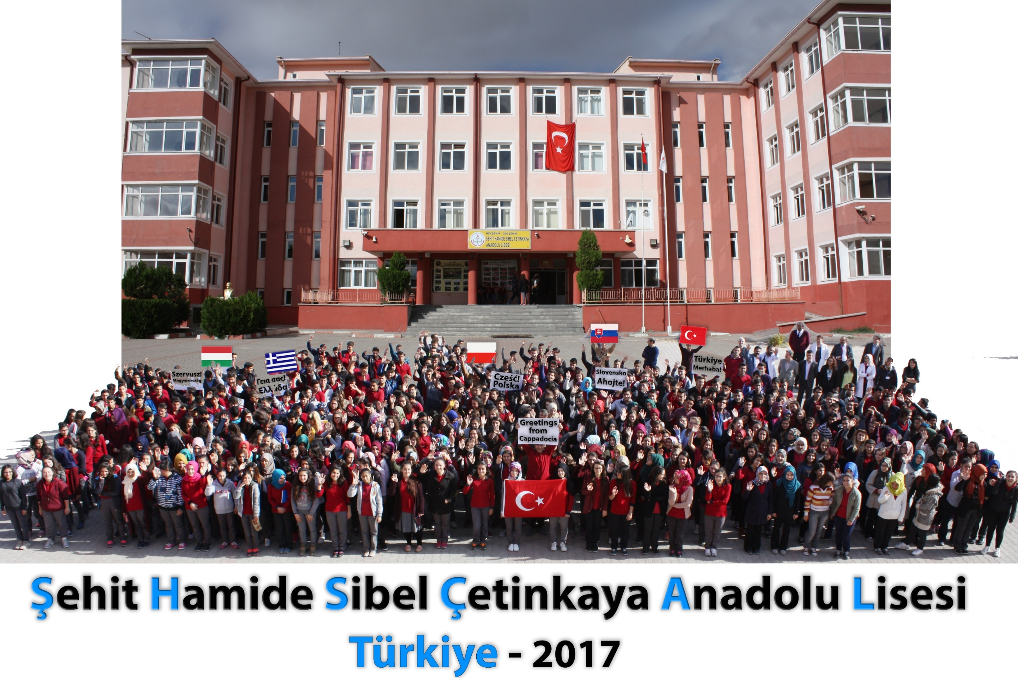

Slide 4
Cooperation for Innovation and the Exchange of Good Practices
01
POLAND
Polska
02
GREECE
Ελλάδα
03
TURKEY
Türkiye
04
HUNGARY
Magyarország
05
SLOVAKIA
Slovensko

Slide 5
Partner
Coordinator
Partner
Partner
Partner
Slovakia
Poland
Turkey
Greece
Hungary
Partnership Chart :

Slide 6
Partner Schools
Open
P
II Liceum Ogólnokształcące im. G. Gizewiusza.
Innovative
T
Şehit Hamide Sibel Çetinkaya Anadolu Lisesi
Education
4ο (Εσπερινό) ΕΠΑΛ Ηρακλείου Κρήτης
with ICT
G
S
Stredná odborná škola elektrotechnická, Sibírska 1, Trnava
H
Szolnoki Műszaki SZC Klapka György Szakkozep és Szakiskolaja

Slide 7
School
Administration
16 Classrooms
455 Students
9th,10th, 11th, 12th
293 Girls – 162 boys
30 Teachers
Yearbook 9 and 10 are taught all subjects, and in the 11th and 12th grade students make choices from among the class profile, such as science and mathematics, mathematics and social studies, English as a foreign language.
There are 455 students studying in our school.
of Different Subjects
The Principal and
The Vice Principal
Our team excels at combining creative thinking with digital innovation.
Our team excels at combining creative thinking with digital innovation.
School Library
2 multi-use
school halls
Counselling Service
2 Science Labs
Chess and Music Class
Archery and Other Sports
Guidance for our school about setting up and improving counselling services for pupils
The School has well equipped
laboratories For Physics, Chemistry
and Biology. Students are encouraged
to use these laboratories to learn
through experiments.
Conference facilities,
exhibitions

Slide 8

Hamide
Çetinkaya
Şehit
Sibel
Anadolu
Lisesi
i
Gülşehir Anadolu Lisesi
Our school is a secondary school located in the region Cappadocia - County Gülsehir. Our city center is only 5 minutes from the Cappadocia Airport. We are in the central Anatolia. We are only 2.5 hours away from the capital - Ankara or 45 minutes from Kayseri – the industrial city. Our region is in the list of World Heritage, not only because of its famous historical places but also spectacular views.
Gülsehir Anadolu Lisesi is a public, four-year, co-educational school founded in 2009. The language of instruction in our school is Turkish. The second offered foreign languages are English and German. Recruitment to the school is based on the National Preliminary Examination, the result of which determines admission to our facility.

Slide 9
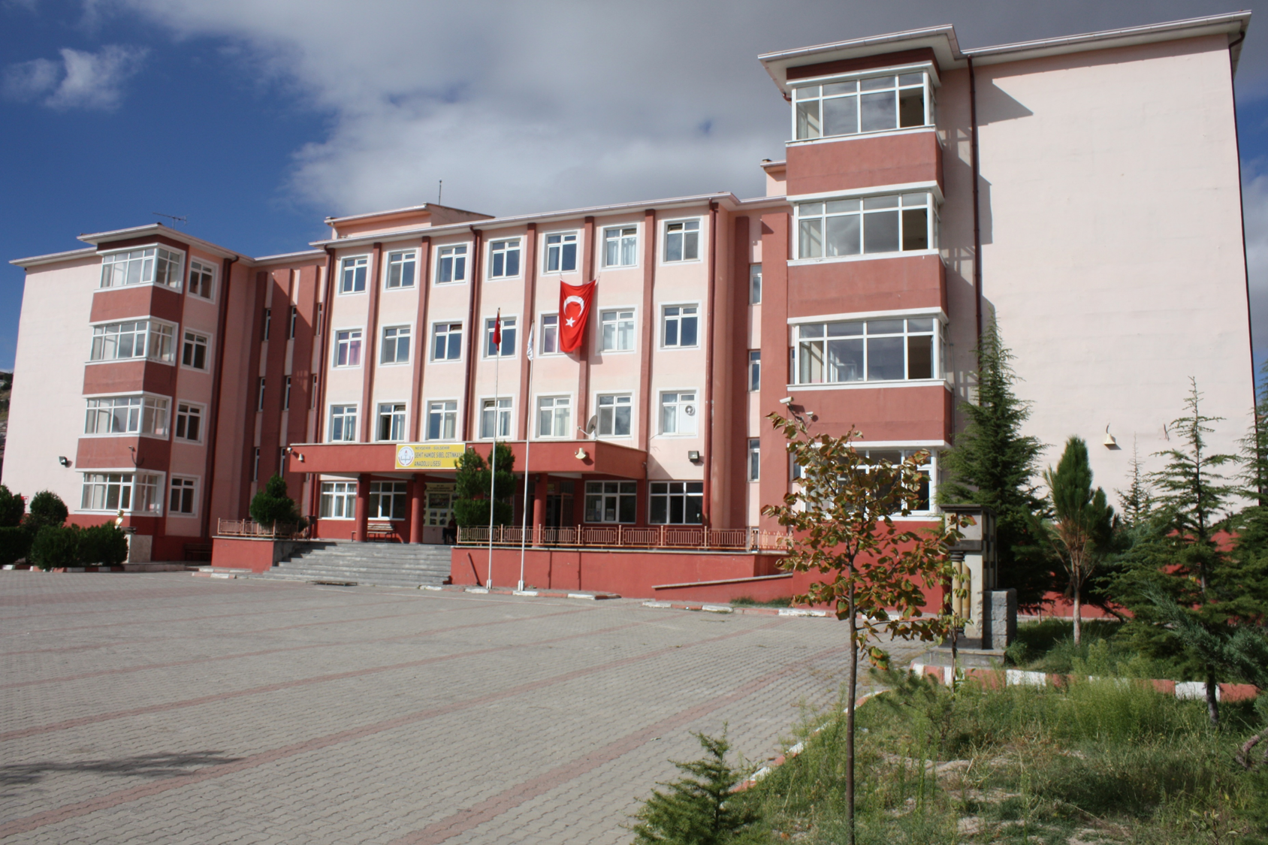

Slide 10
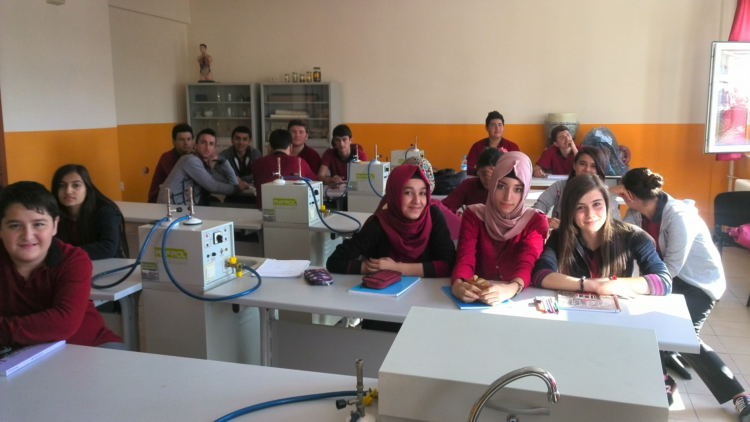

Slide 11
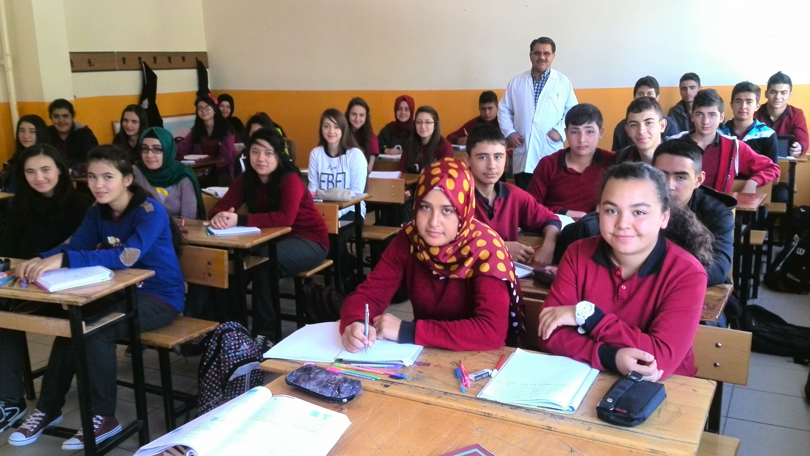

Slide 12
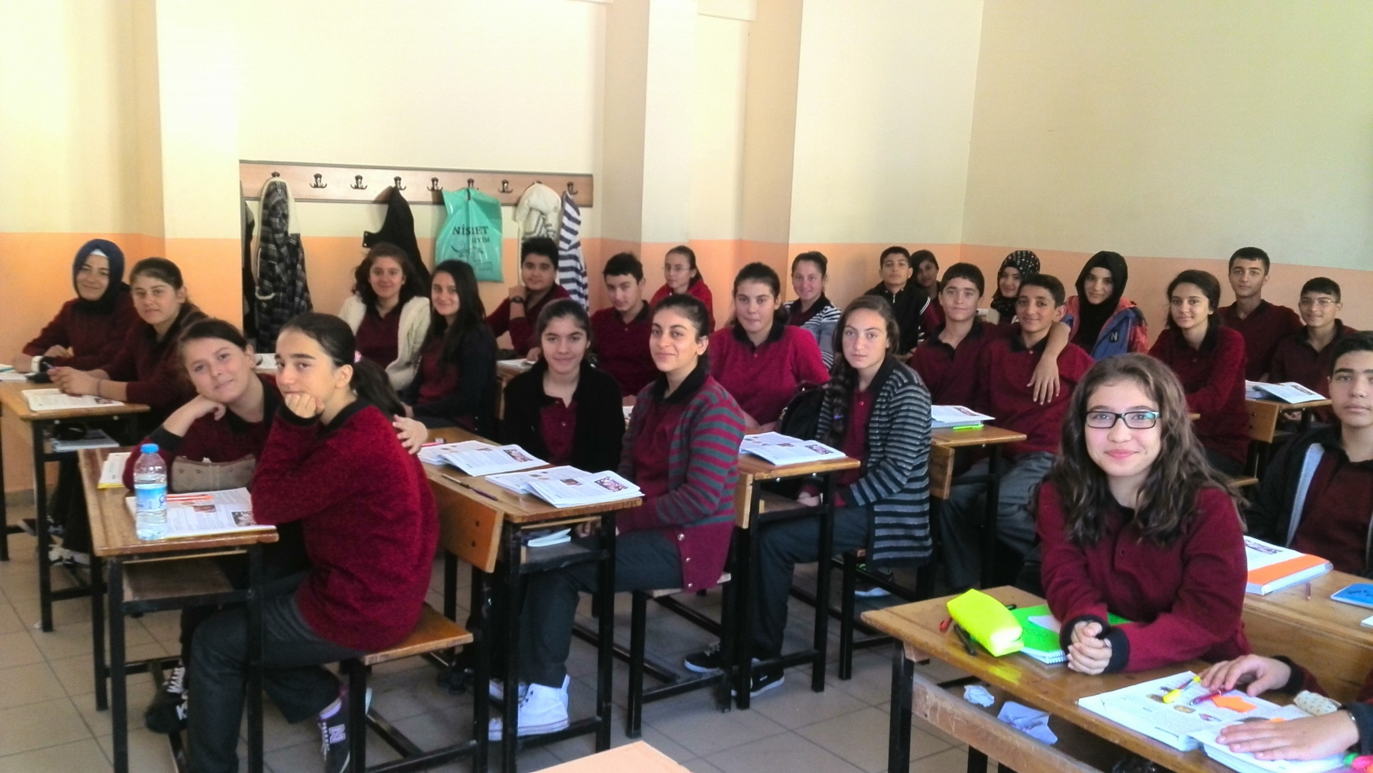

Slide 13
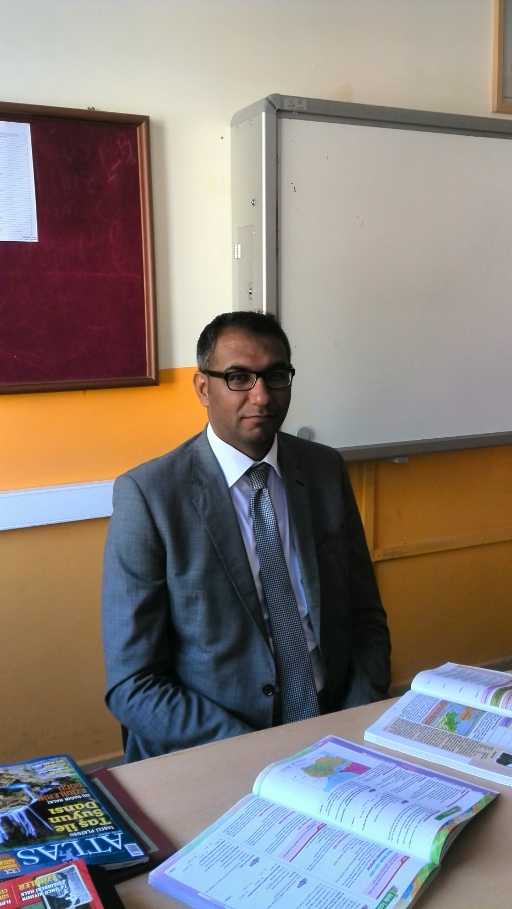
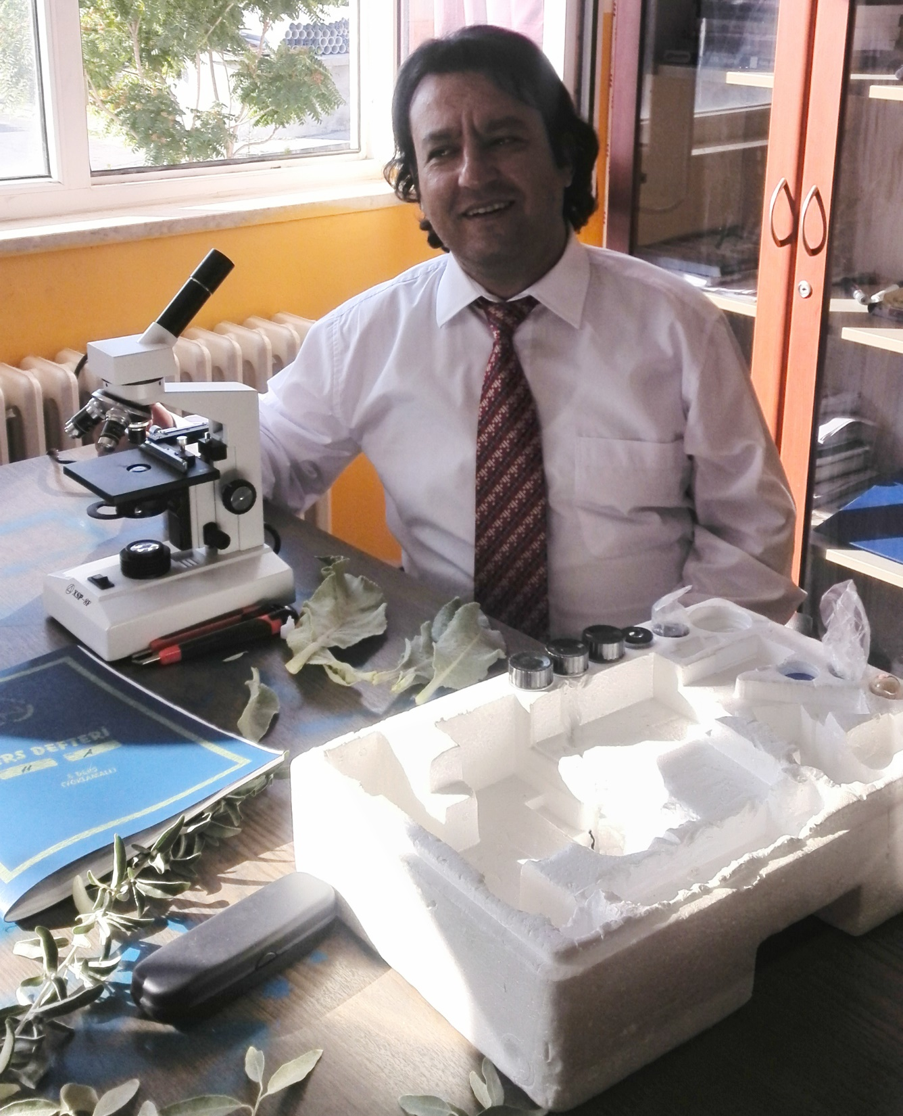
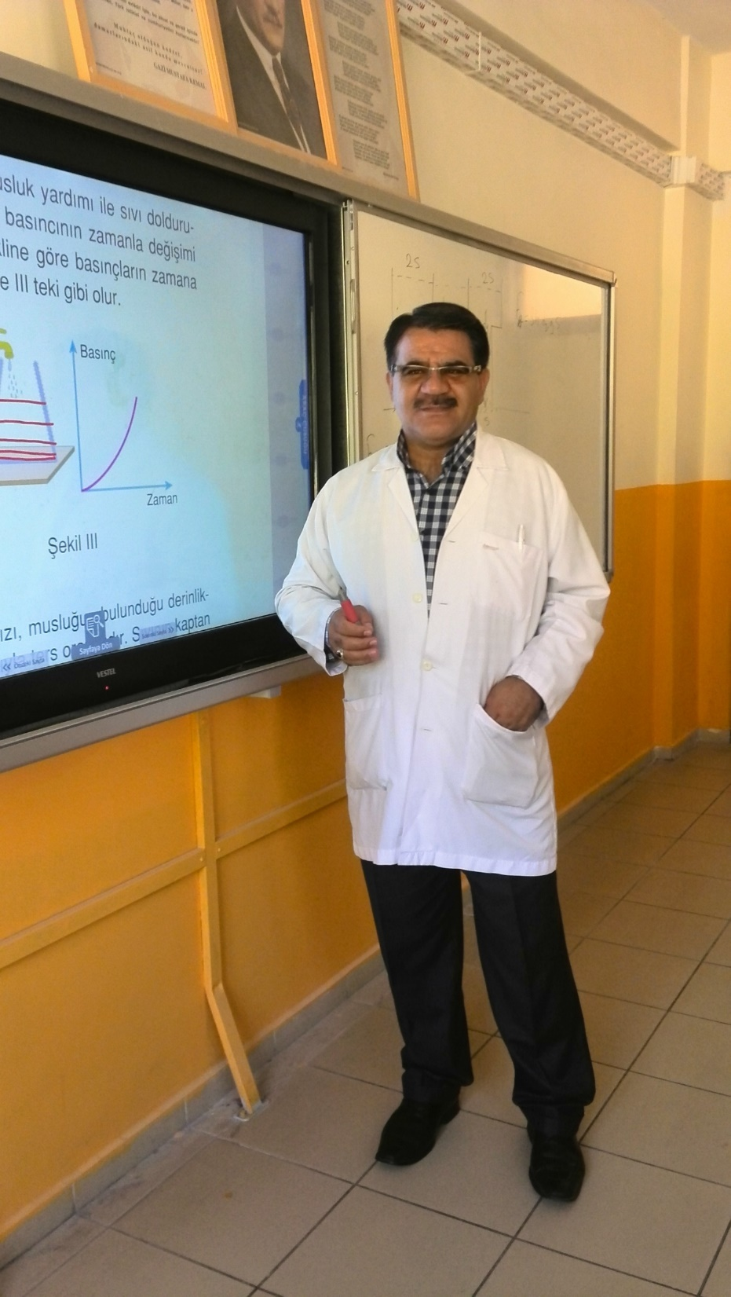

Slide 14
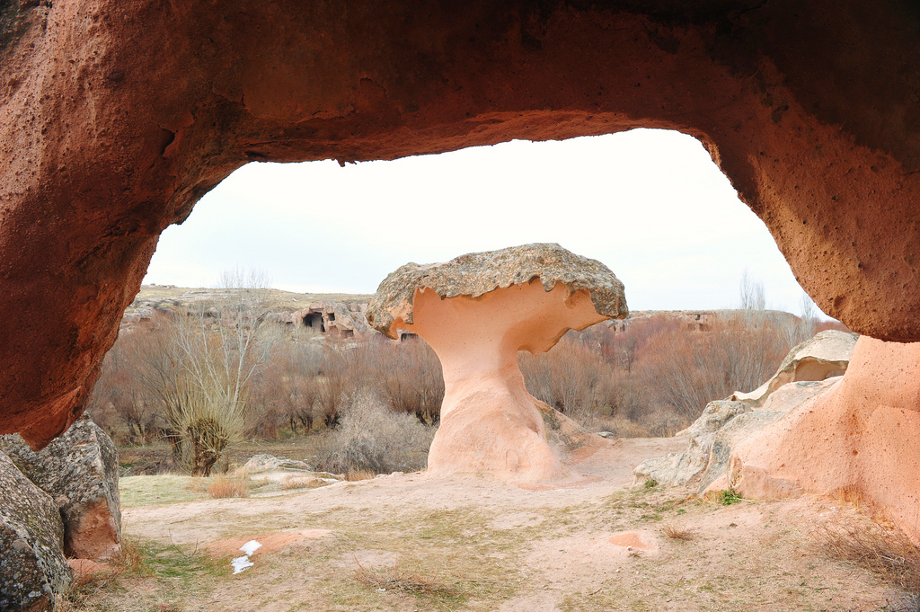

Slide 15
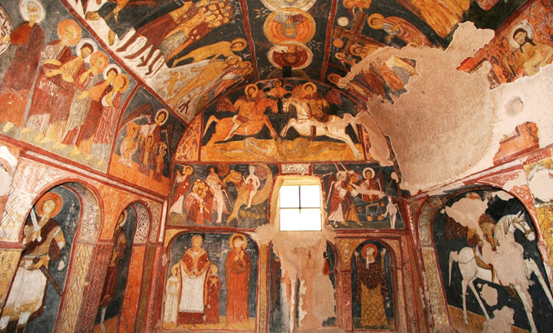

Slide 16
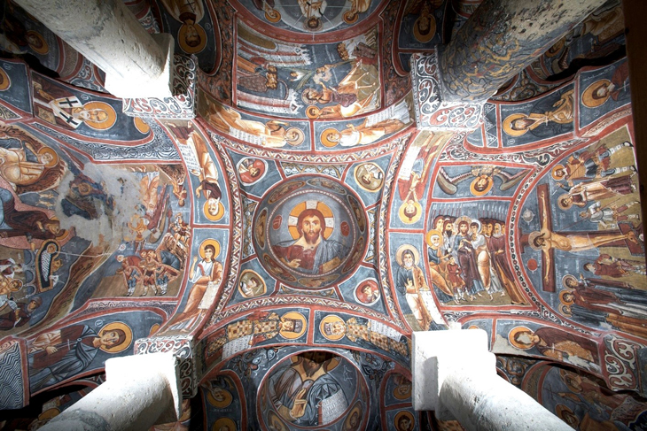

Slide 17
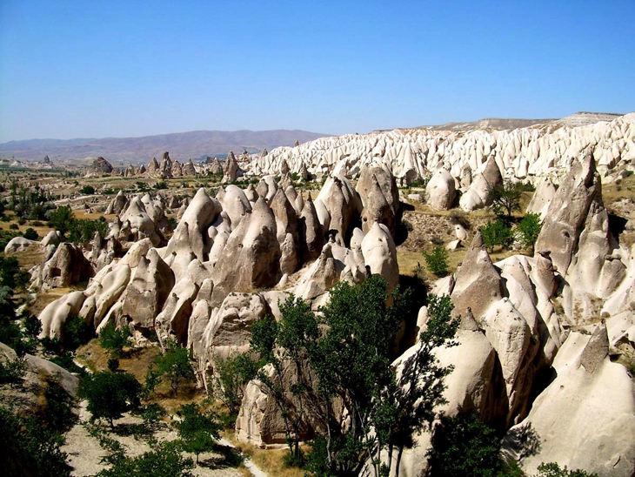

Slide 18
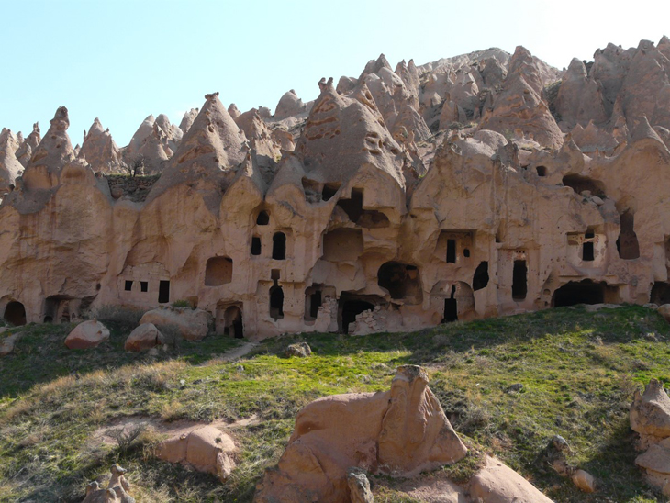

Slide 19
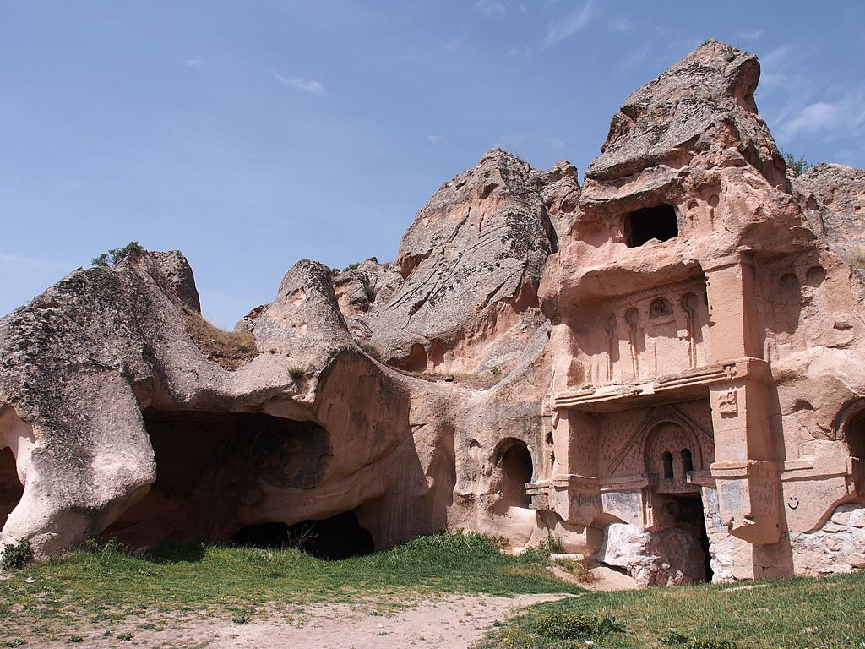

Slide 20
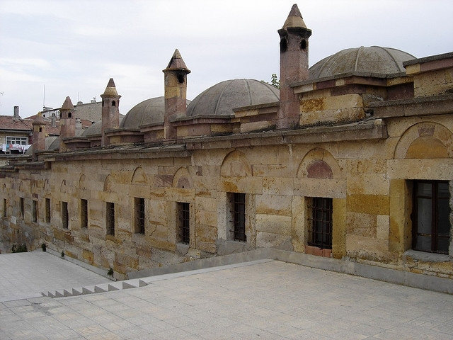

Slide 21
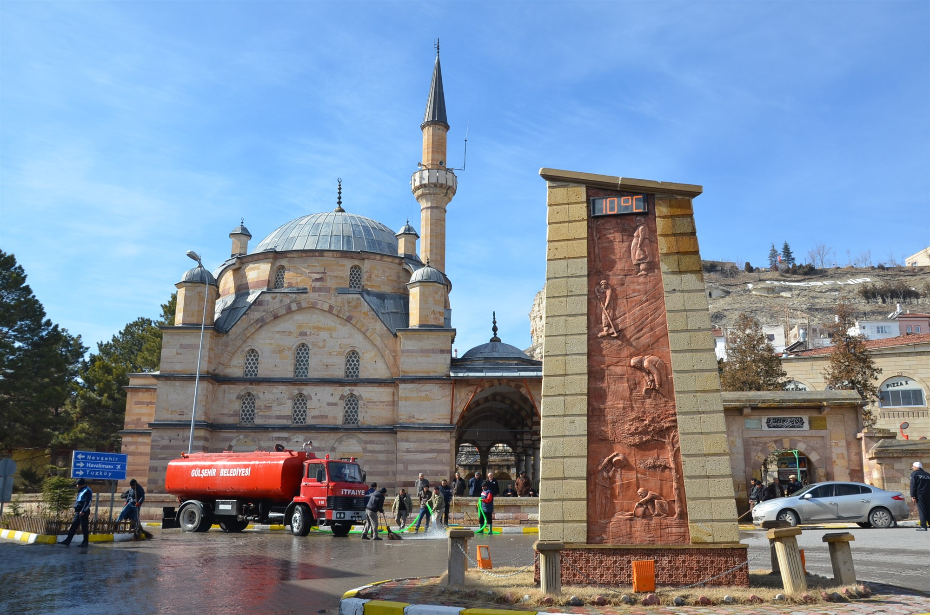

Slide 22
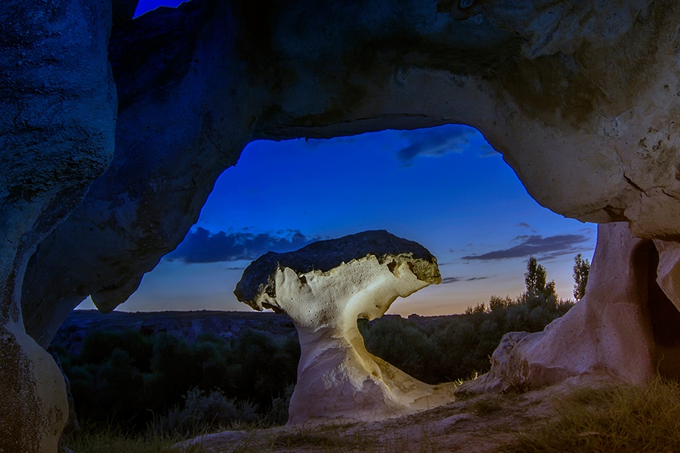

Slide 23


Slide 24
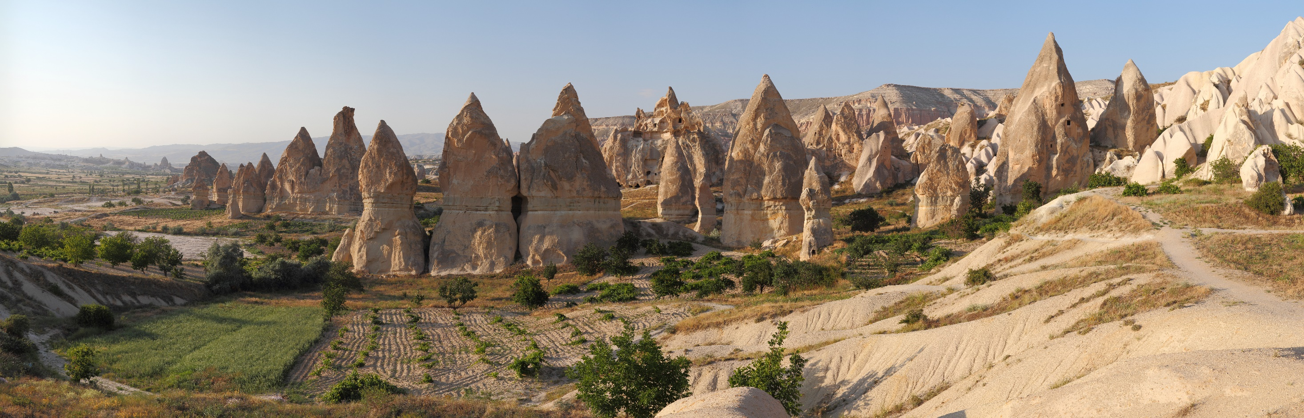

Slide 25
