Slide 2
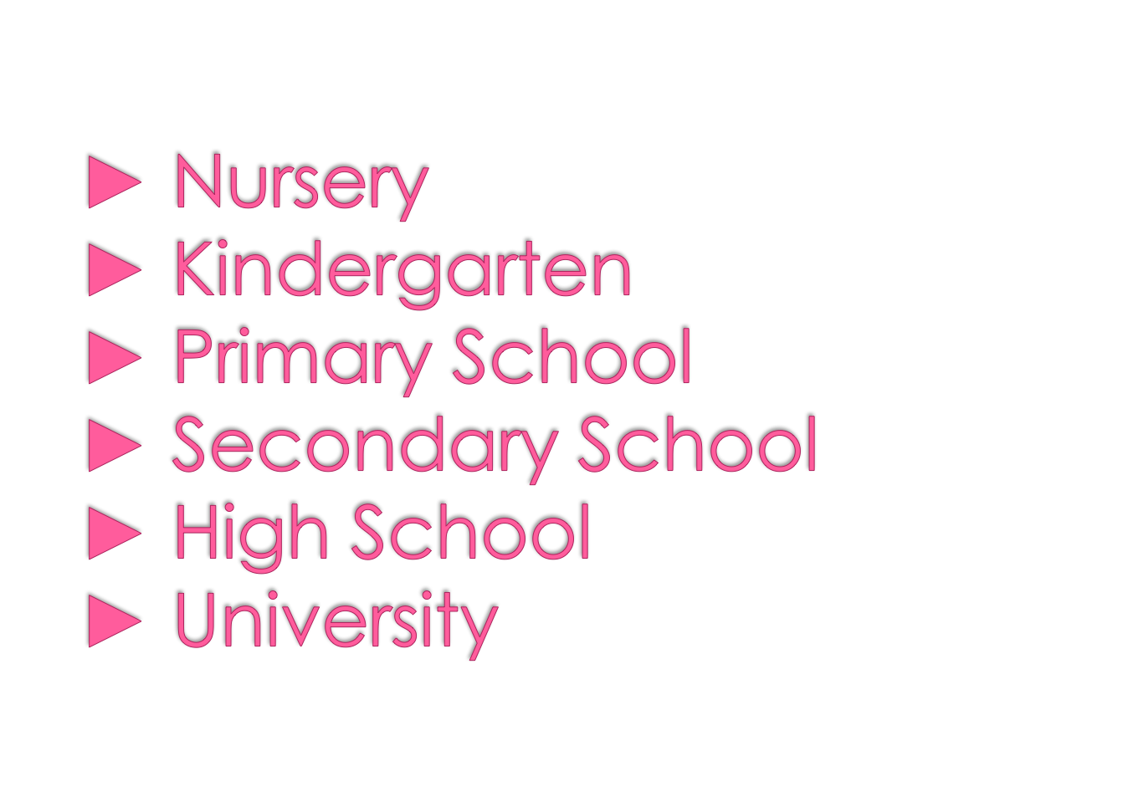

Slide 3
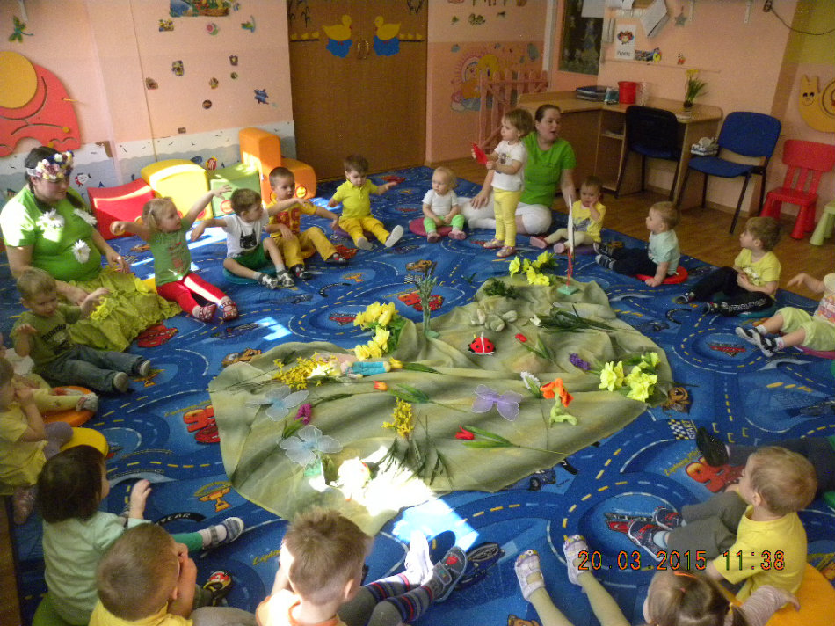
It’s a place where food and care is provided for the youngest children.

Slide 4
Children are preparing to a school life by games and fun.

Slide 5
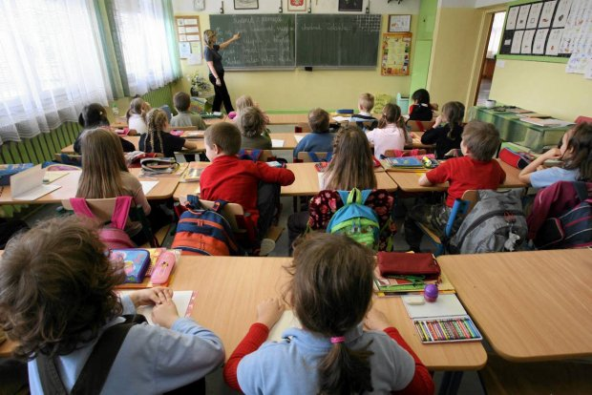
The first cycle is integrated learning and lasts for 3 years.
The second cycle offers subject-based teaching
At the end, pupils take a compulsory competence test.

Slide 6
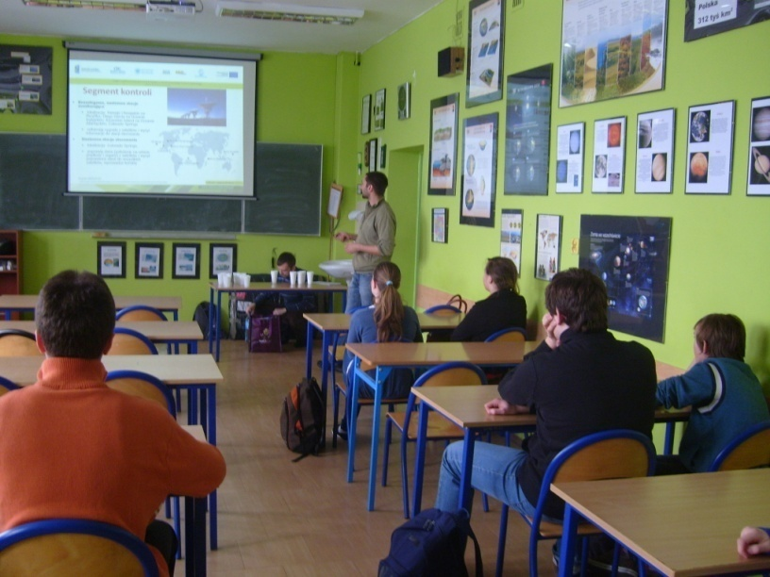
It covers lower secondary education and lasts for 3 years.
Pupils are introduced into new subjects like: biology, chemistry, geography, physics.
The final year of the school is finished with exams in Humanities, Science and foreign language

Slide 7
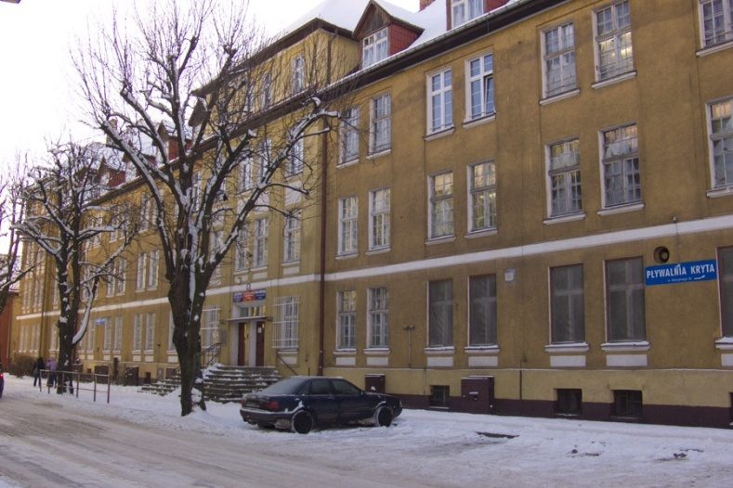
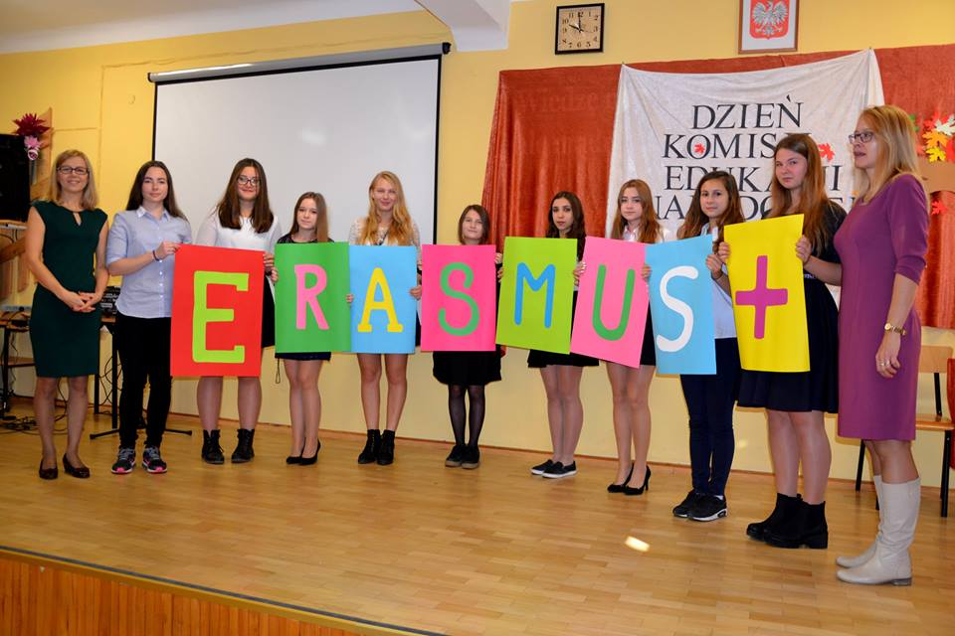
General Secondary School lasts for 3 years, Technical School - 4 years, Basic Vocational – 2 years.
From the second grade, students choose extended subjects
It prepares students for entry into higher education.
Notes:
7

Slide 8
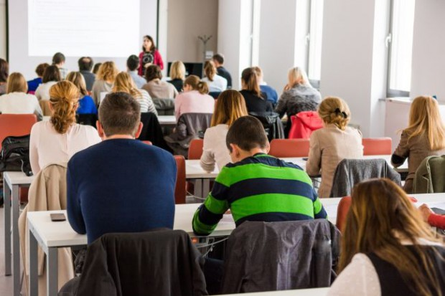
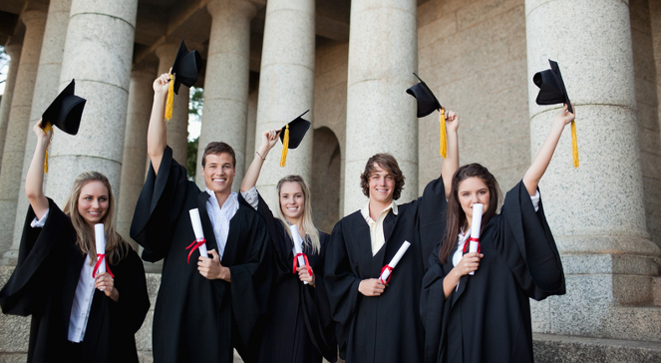
Education lasts for 3-5 years and consists of 2 cycles: a three-year Bachelor's degree followed by a two-year Master's degree. Only medicine lasts 6 years.
Universities and medical academies are public and financed fully or partially by the state.

Slide 9
THANK YOU FOR YOUR ATTENTION ☺

