Slide 1
OUR SCHOOL
The Gustaw Gizewiusz
II Secondary School in Giżycko

Slide 2
Our school was named after a local Polish pastor, folklorist and a political activist:
GUSTAW GIZEWIUSZ
He encouraged local people to maintain Polish language and culture by publishing Polish-language texts for use in schools.
In his honor, our town Łuczany - his ancestors hometown, was renamed to Giżycko.

Slide 3
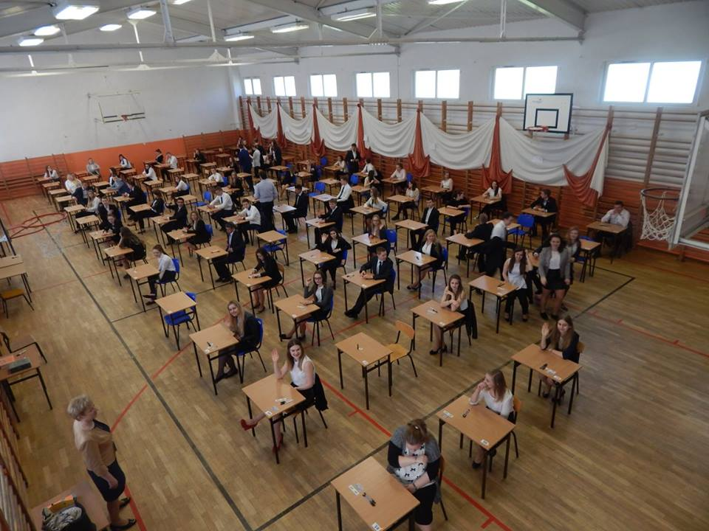
GRADES AND EXAMS
Our school lasts for three years.
In the first year we study a little bit of everything because we haven’t decided yet what we want to do in the future.
From the second grade we choose 2-3 extended subjects.
We start to gain knowledge and skills required for our future studies at universities.
To apply for admission to a school of higher education, a successful graduate has to pass state exams called „MATURA”. It’s extremely important to get good results because they will decide about our future university and a job.
Notes:
3

Slide 4
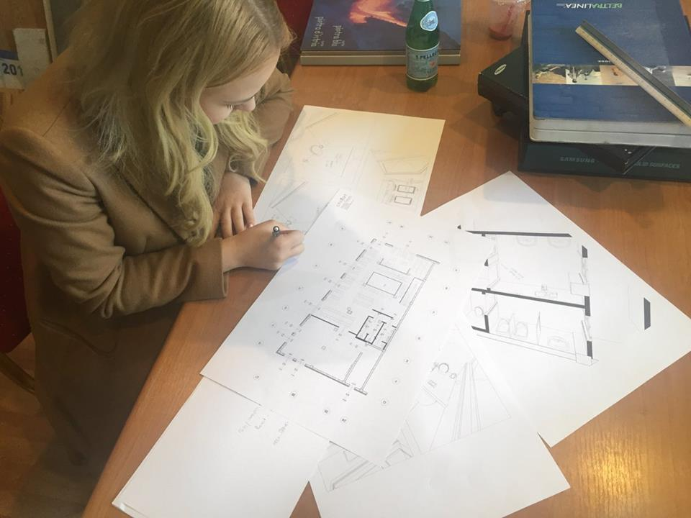
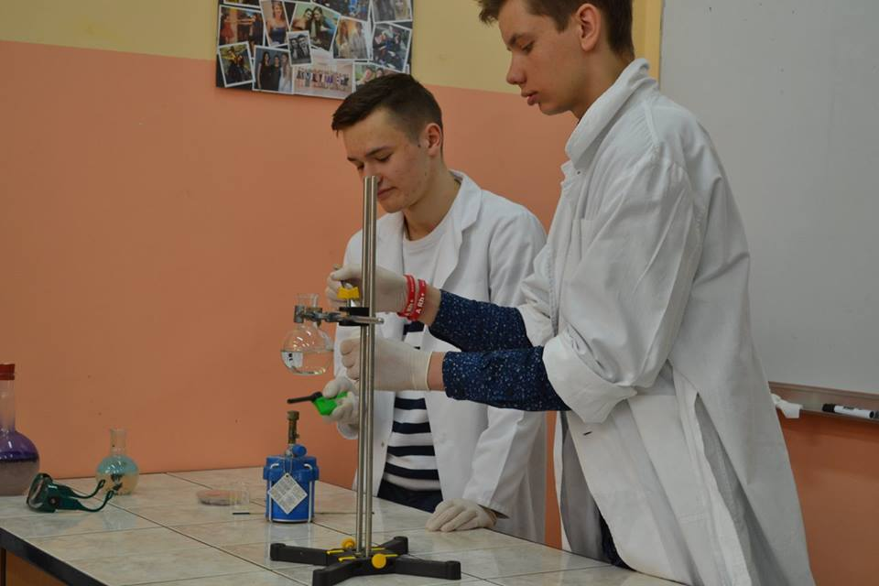
EXTENSION
In our school you can extend subjects like:
Biology
Chemistry
Physics
Geography
Math
History
Polish language
English language
Social Studies
Notes:
4

Slide 5
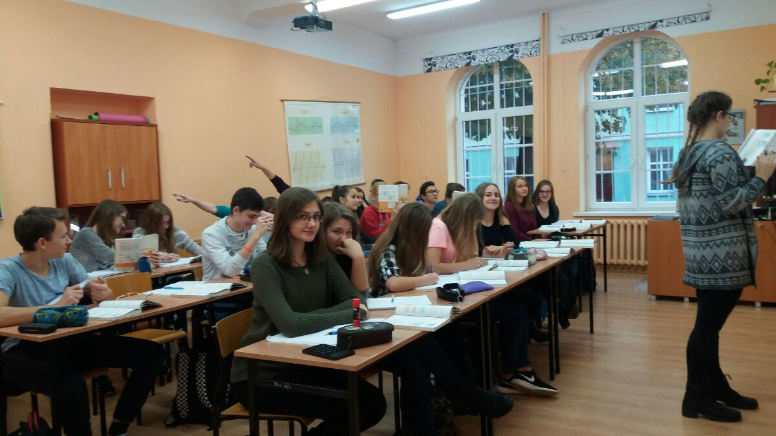
LESSONS
Teachers are helpful and they will always explain you everything.
I would say they are very student-friendly! :D Every lesson is in a well-equiped classroom suitable for the subject we are learning. There is a computer and a projector in all the classrooms to help us learn. This is how it looks like:

Slide 6
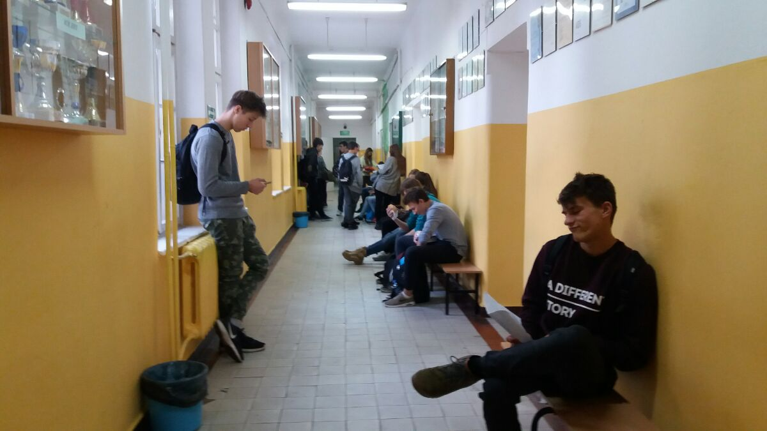
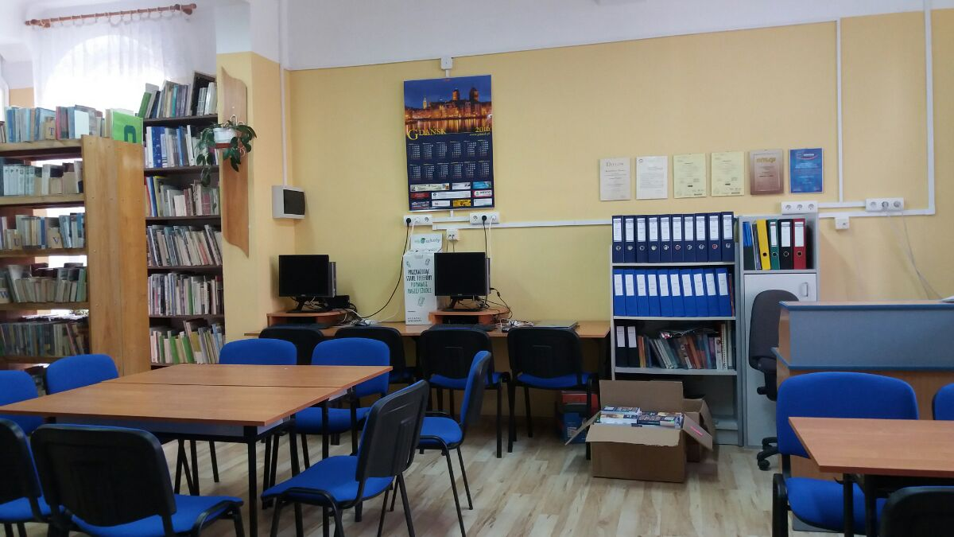
BREAKS
In our school you can spend breaks beetwen lessons as you want.
Here are some examples:
You can chill out and talk with friends in school corridors.
If you need some peace you can read a book or prepare for lessons
at our school library

Slide 7
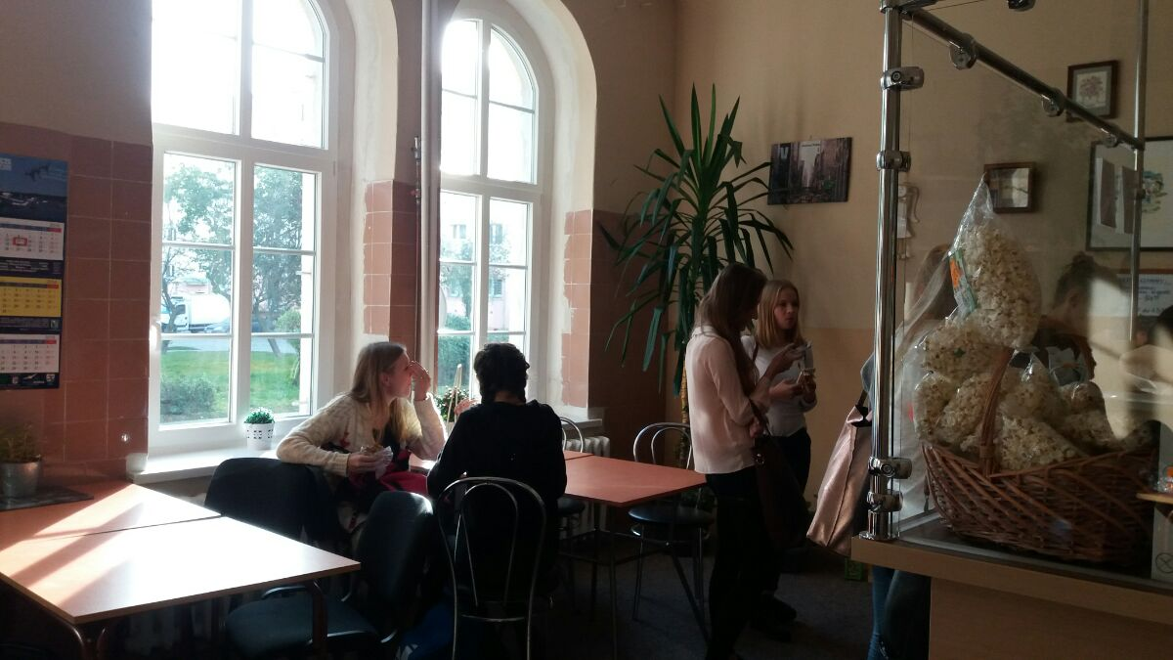
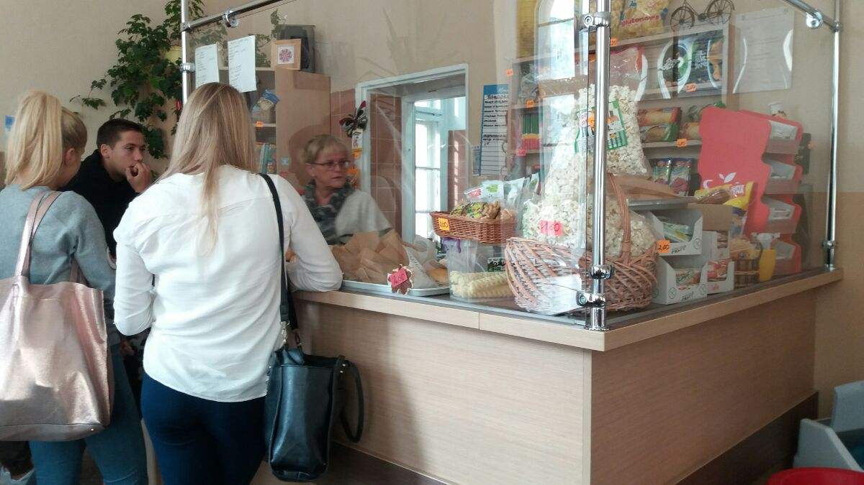
The best at last! If you are hungry there is a small cafeteria in our school. The food here is very tasty and healthy. Everyone can find something he likes!

Slide 8
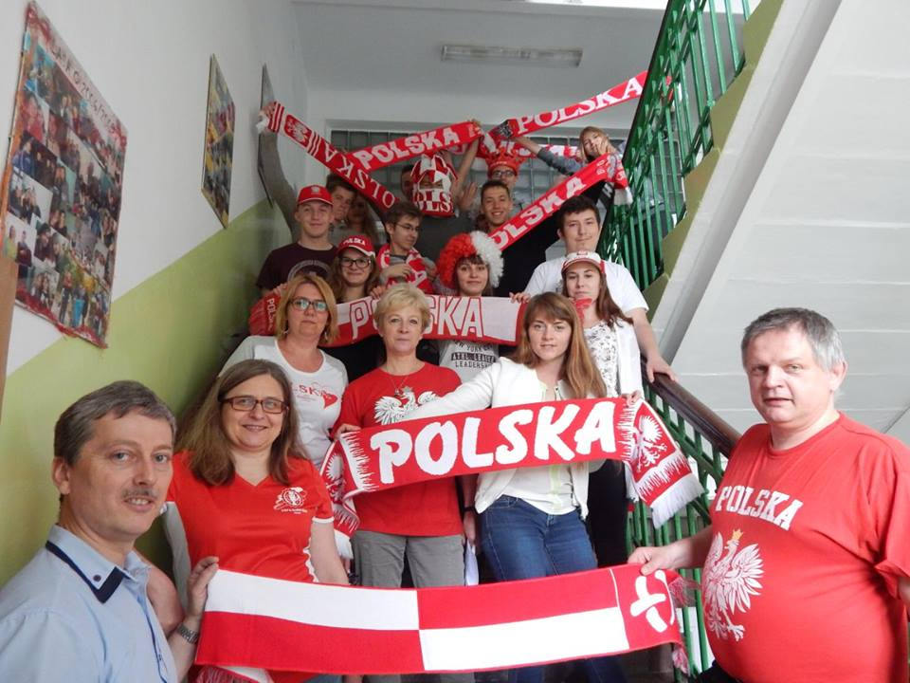
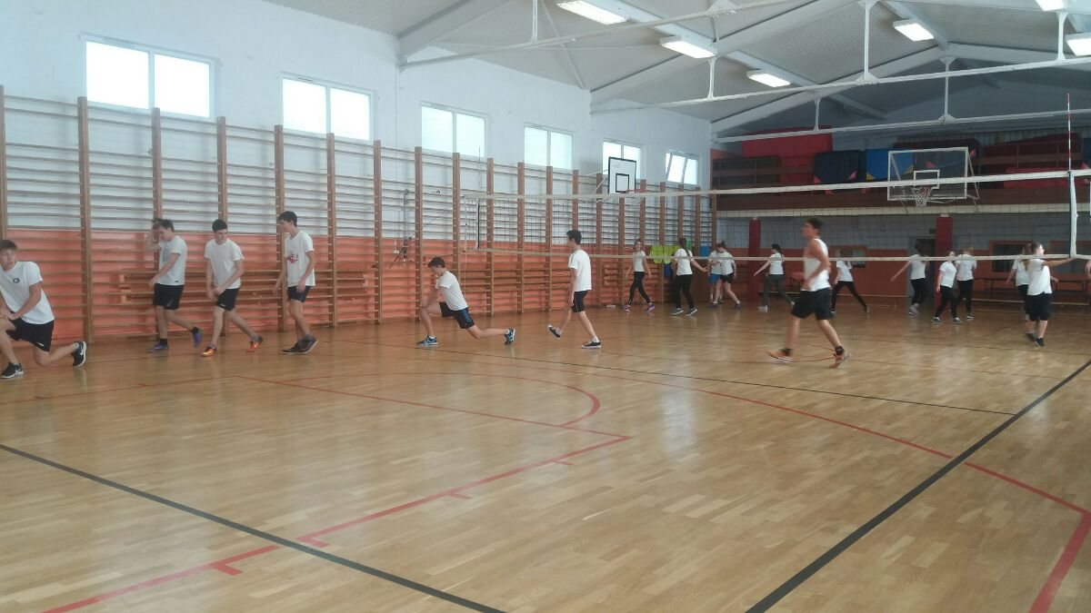
SPORT
Our school is very active and we take part in a lot of competitions in different sports. We even won an award for the best school in sport in the whole region!

Slide 9
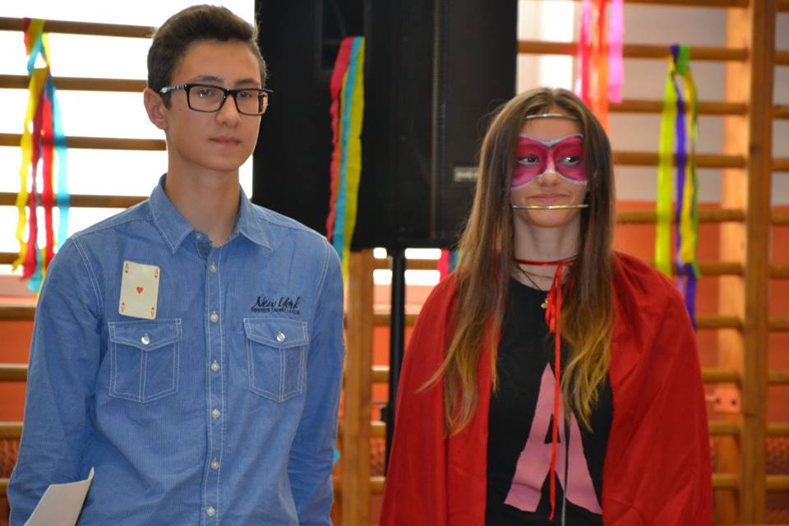
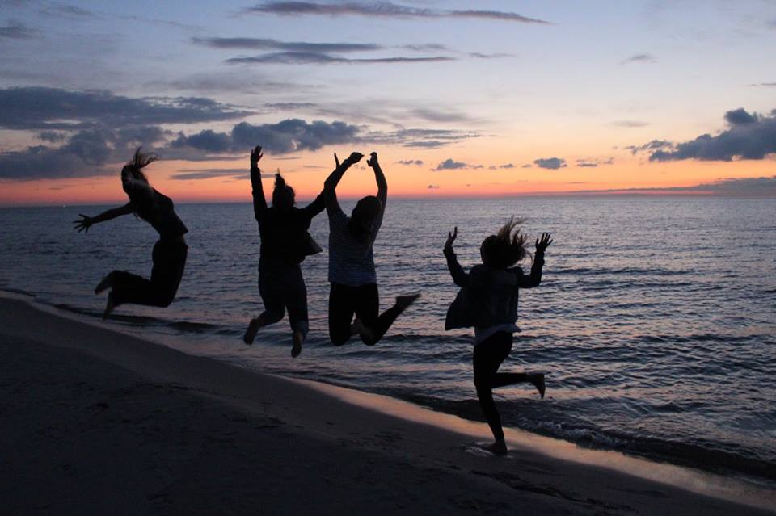
SCHOOL EVENTS
School is not only education, it’s people and spending spare time with them as well. In our school we participate in a lot of different events to rest from everyday life and we celebrate various holidays.
This year at a BOY’S DAY we had to create our own superhero's costume.
We like learning about other cultures and countries so we organise many interesting TRIPS.

Slide 10
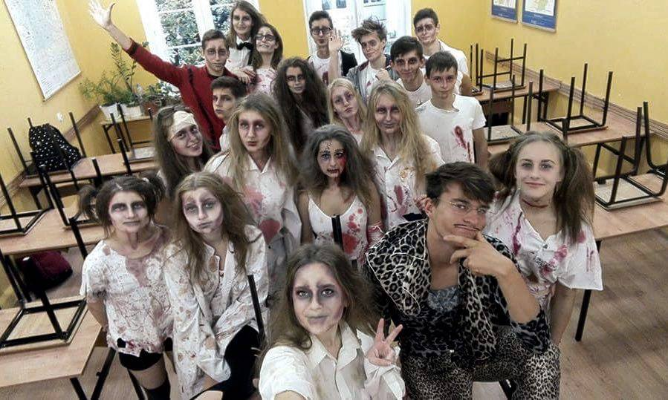
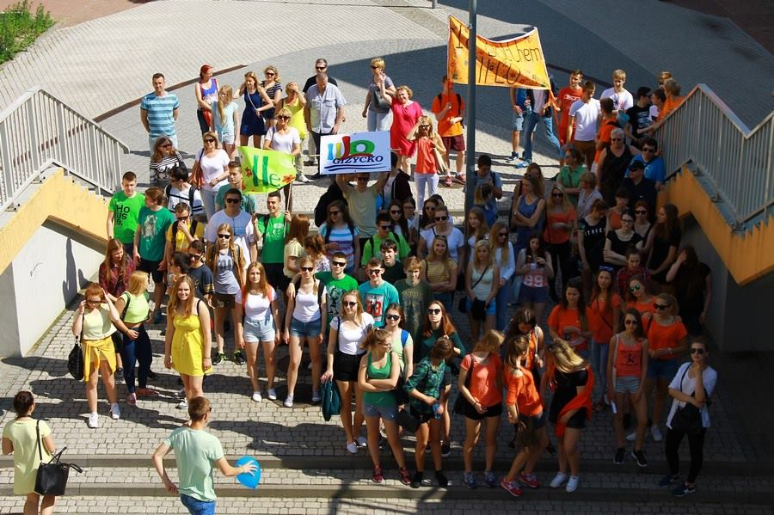
HAZING is a traditional event to greet first classes in their new school. This year they had to recreate a music video. In the photo you can see the recreation of „Thriller” by Michael Jackson.
We celebrated CHILDREN’S DAY like this:

Slide 11
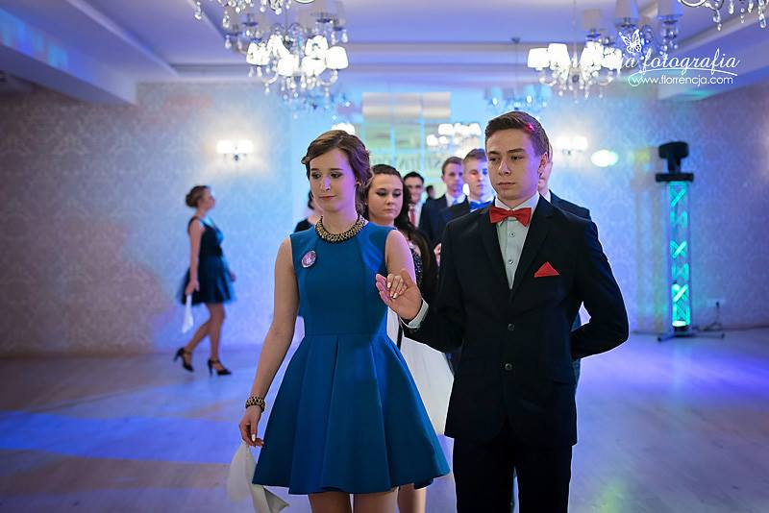
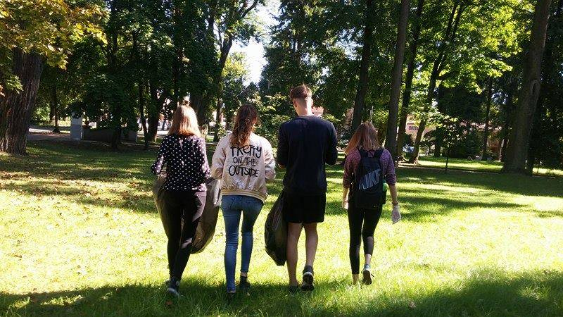
A hundred days before the school-leaving exams there is a prom called „STUDNIÓWKA”.
Recently we have been taking part in Clean up the World action to save our neighbourhood from pollution
And these are only some of the events,
if you want to find out more, go to our school website:http://www.lo2.eu/

