Slide 1
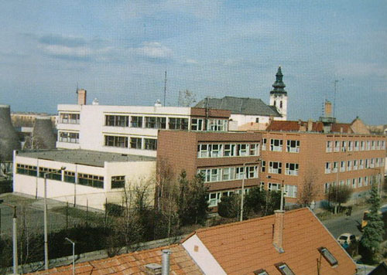
Hungarian School System
Jászberény

Slide 2
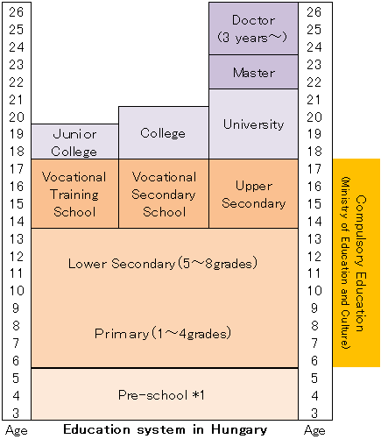

Slide 3
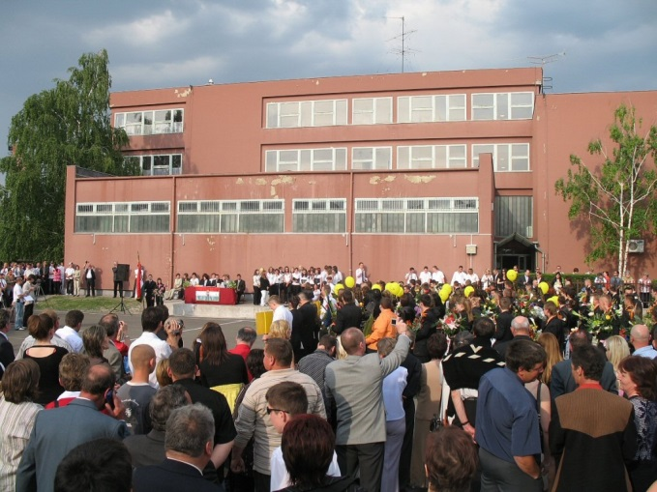
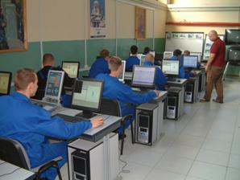
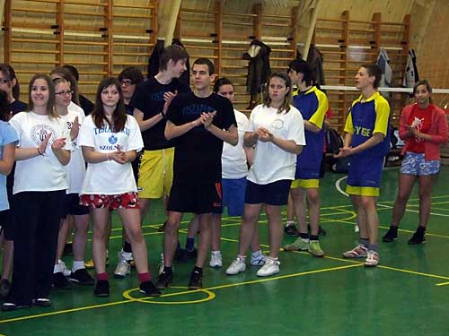
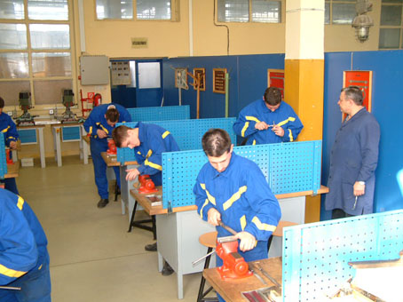
Some facts
Public education is free
The school year consists of 185 days
The school year stars on 1st of September
There are 3 shorter school breaks and a longer one in summer
There are 5 working days every week

Slide 4
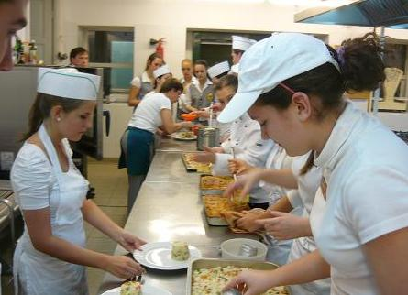
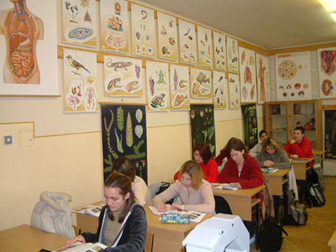
A lesson lasts for 45 minutes
The students are assessed by the teachers (written or oral test) and get a mark from 5 to 1
Education is compulsory up to the age of 16
A class size in a vocational school: between 30 and 40 students

Slide 5
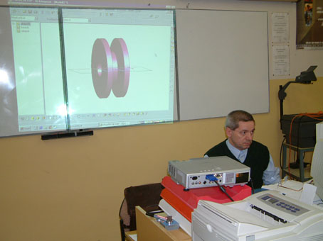
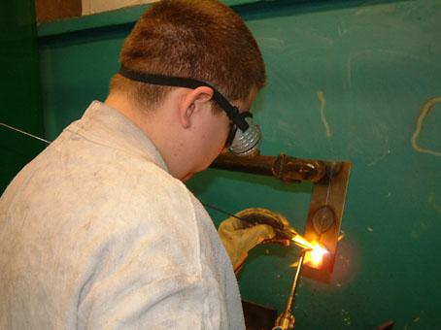
Secondary Education
Three types:
General secondary school
Vocational school
Technical school

Slide 6
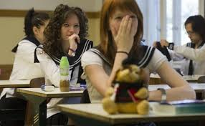
General secondary school
Lasts for 4 years
Concludes with a school –leaving exam (matura or final exam)
It consist of 5 subject-Math, Literature and Grammar, History, a foreign language, 1 subject of the students’ choice

Slide 7
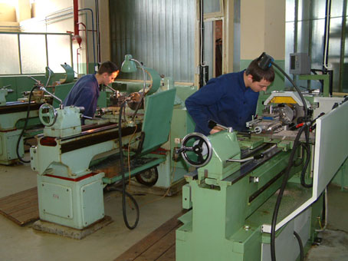
Vocational School
Lasts for 3 years
Offers training in about 200 professions
Gives a skilled worker’s certificate
Students usually spend 4 days at school, 6 days in a workshop

Slide 8
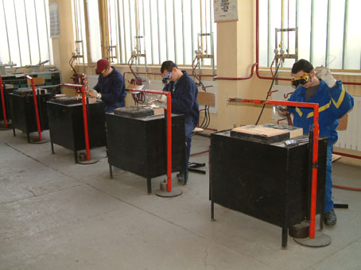
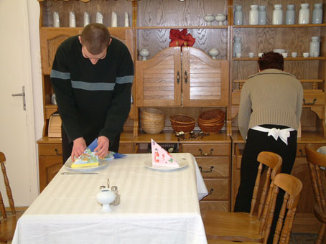
Technical School
Lasts for 4-6 years
Offers general and special education as well
Gives certificate of Matura exam and skilled worker’s cerificate
Prepares students for further studies

Slide 9
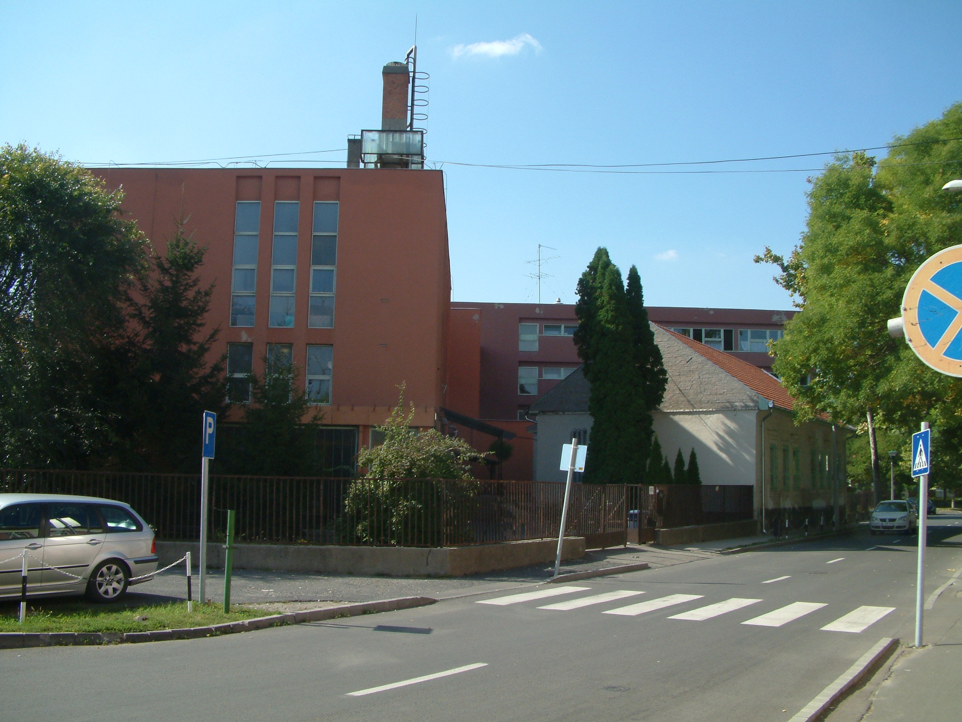
‘Klapka György’ Technical and Vocational School of SZMSZC

Slide 10
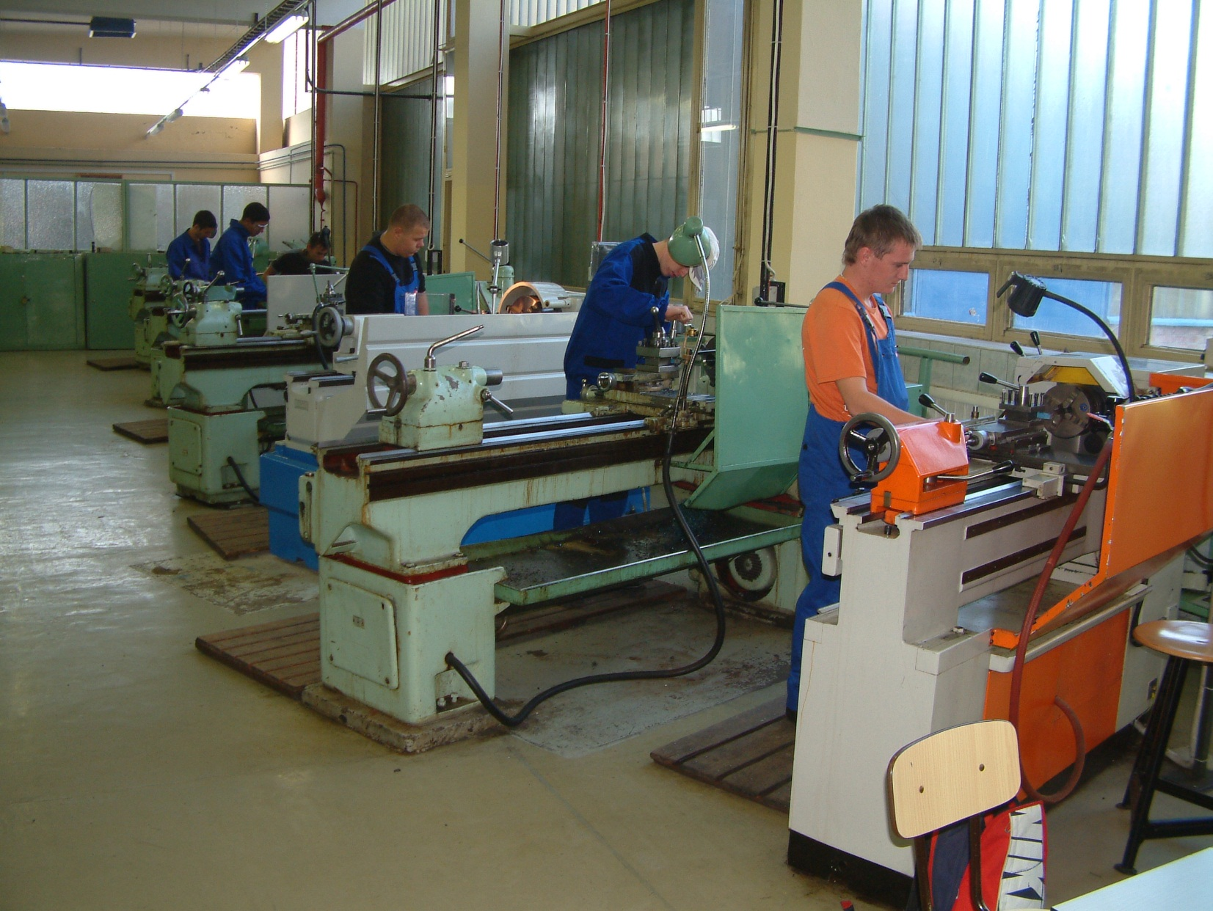
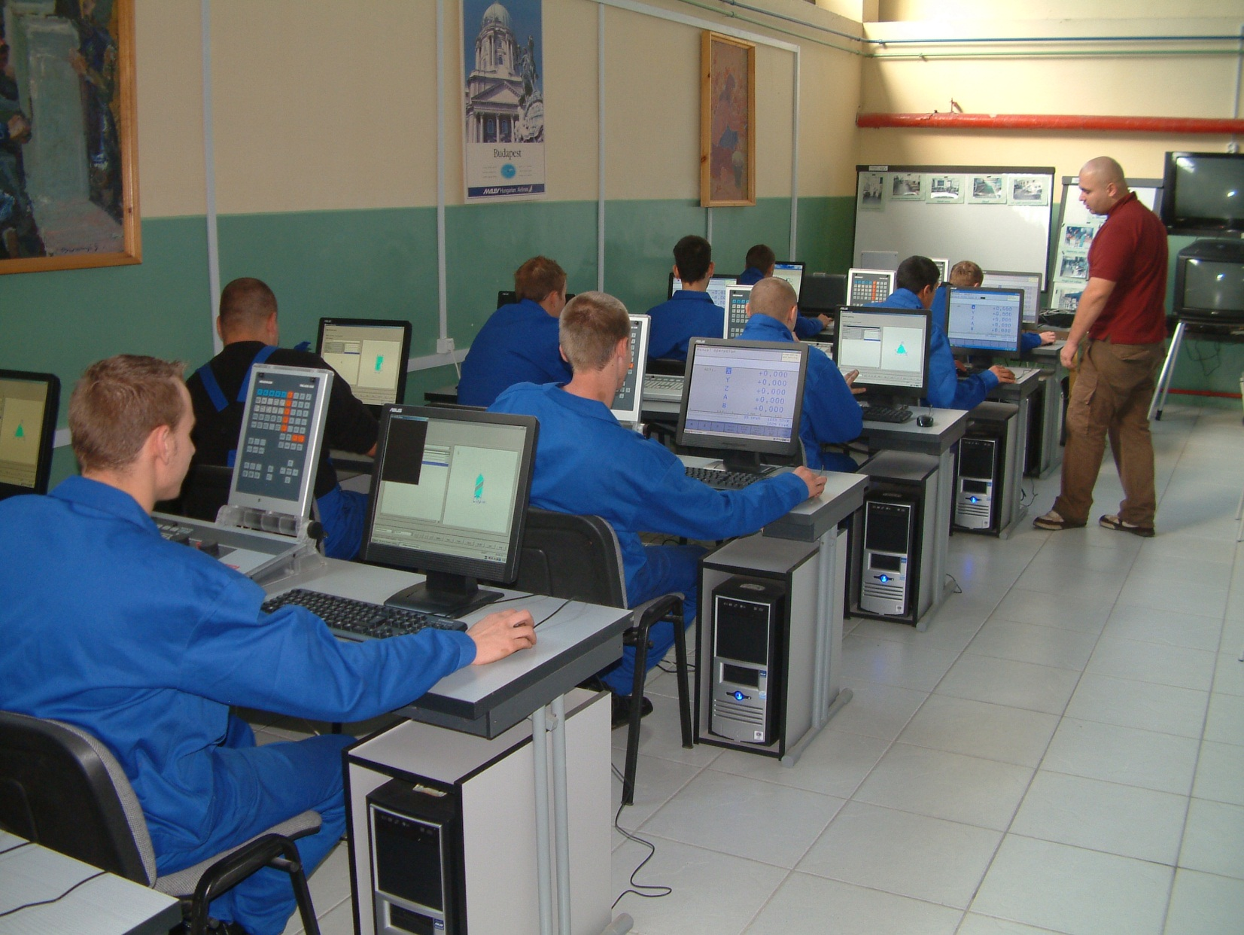
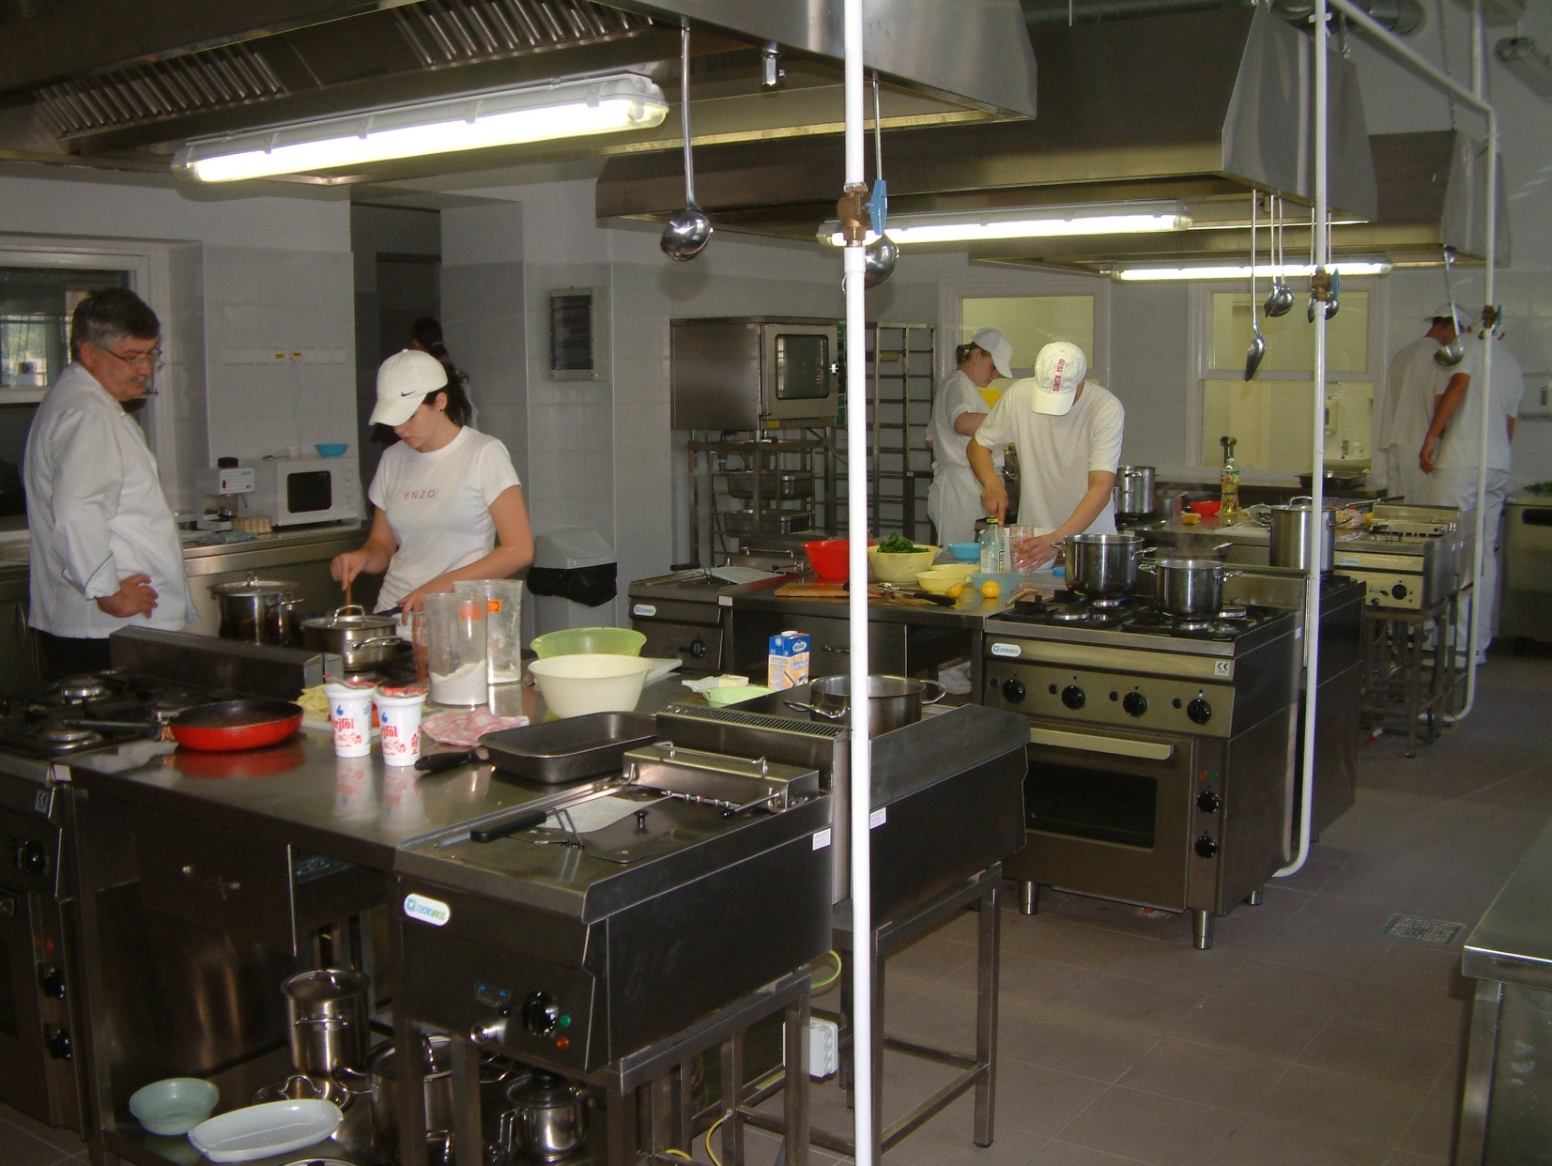
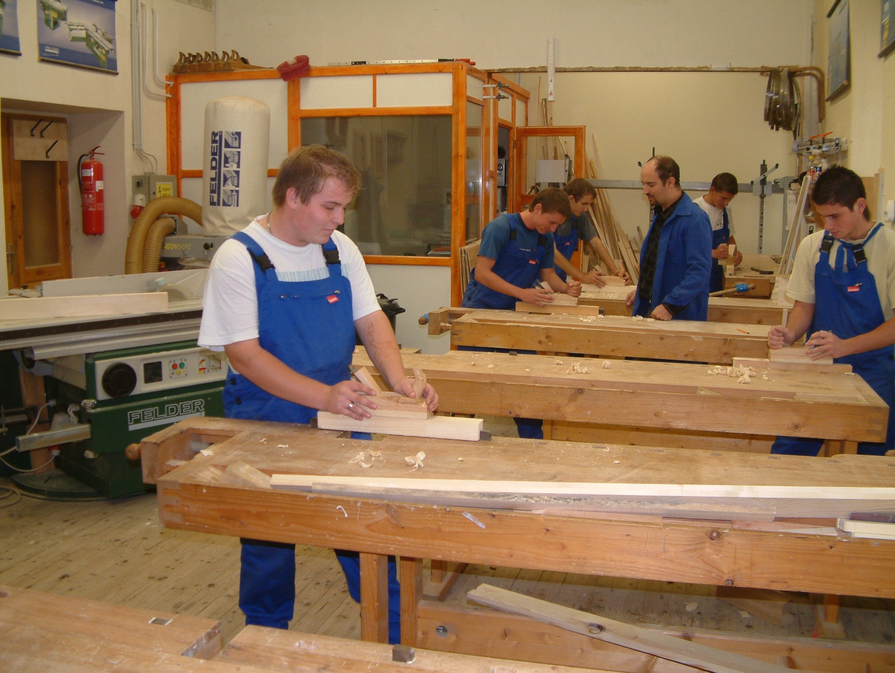
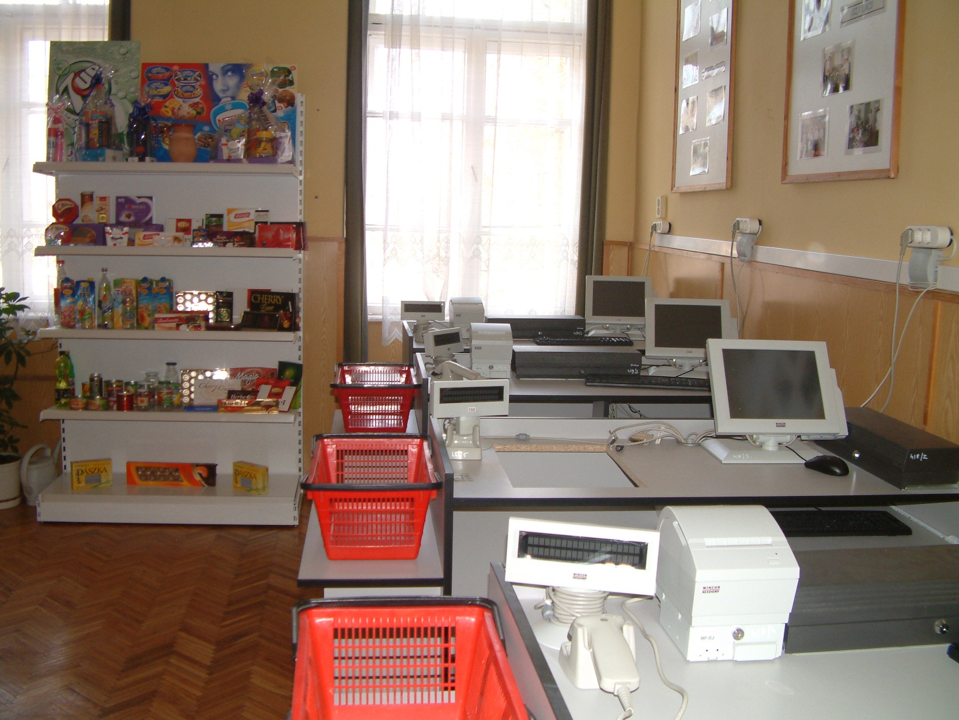
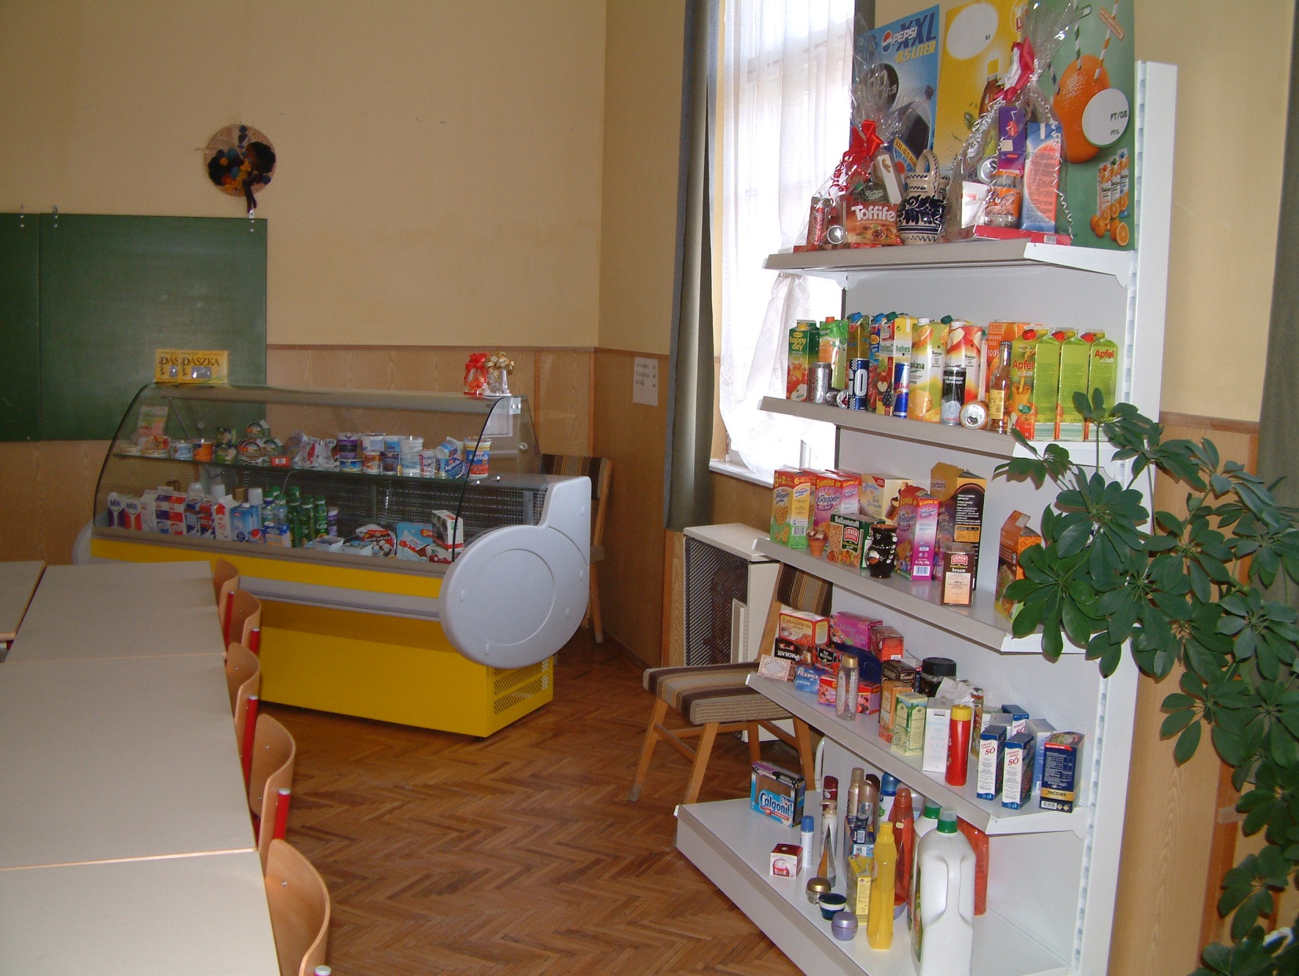
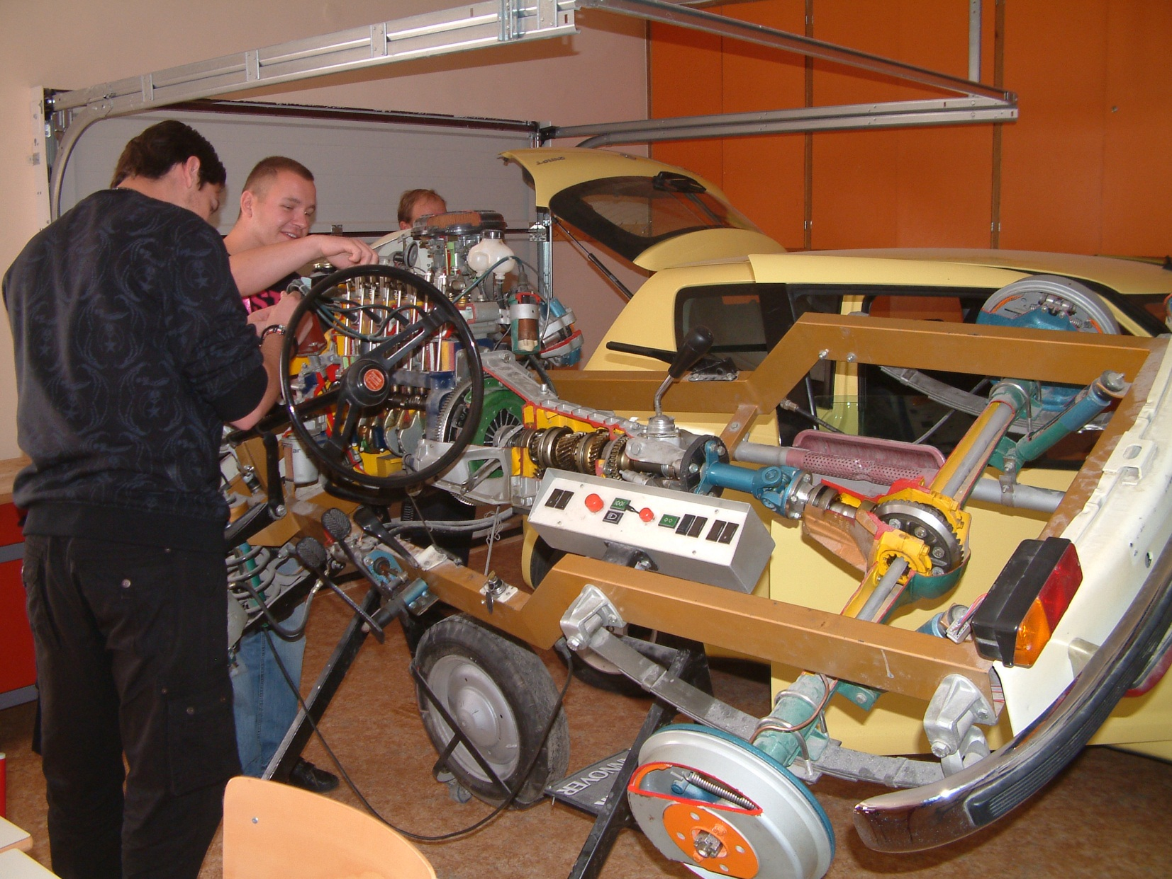
Our workshops
Workshop for students at metal industry at Electrolux Lehel Factory
School restaurant for waiters/waitress
Kitchen for cooks
Workshop for cabinet makers
Workshop for shop assistant
Workshop for hairdressers
Workshop for car mechanics
Private enterprises

Slide 11
Training Forms
Tecnical secondary school
Transportation
Trade and marketing
Catering industry and Tourism
Adult education
Vocational school
Engineering industry
Electronics-electricity
Light industry
Metal industry
Wood industry
Agriculture
Food industry
Social service

Slide 12
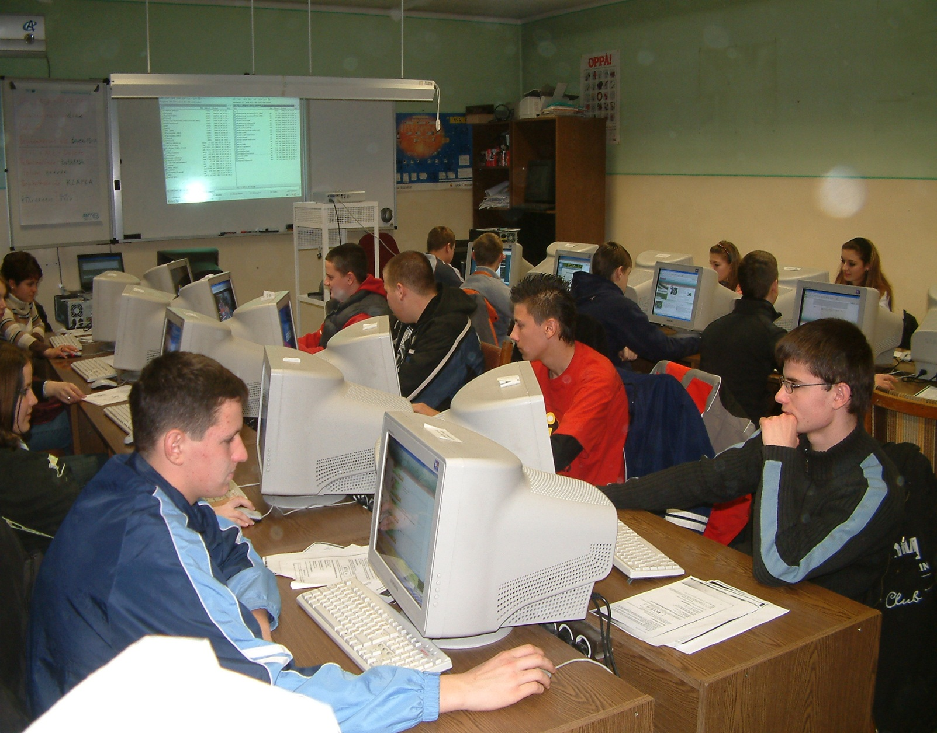
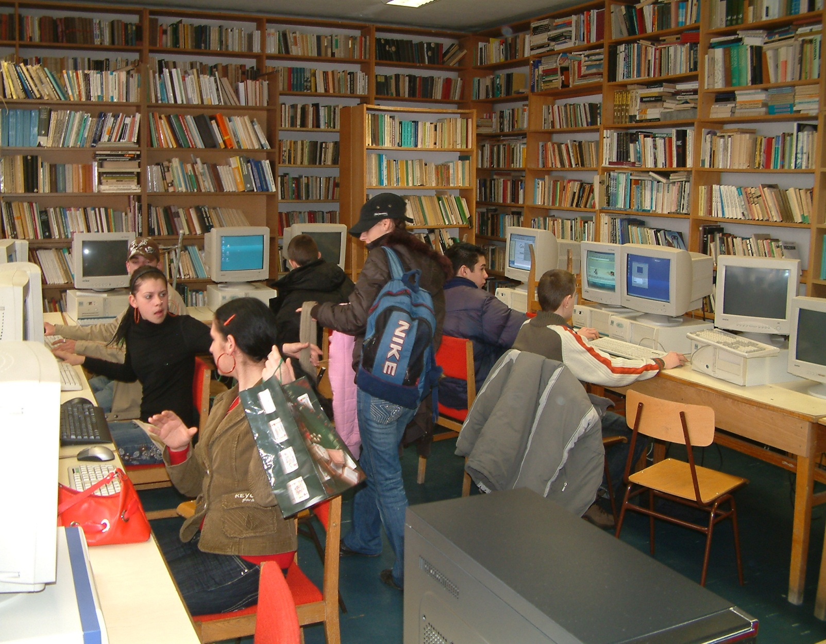
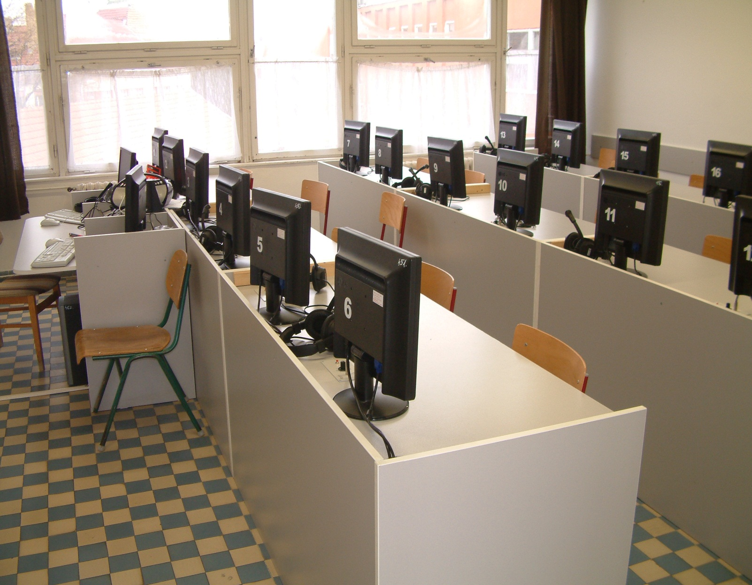
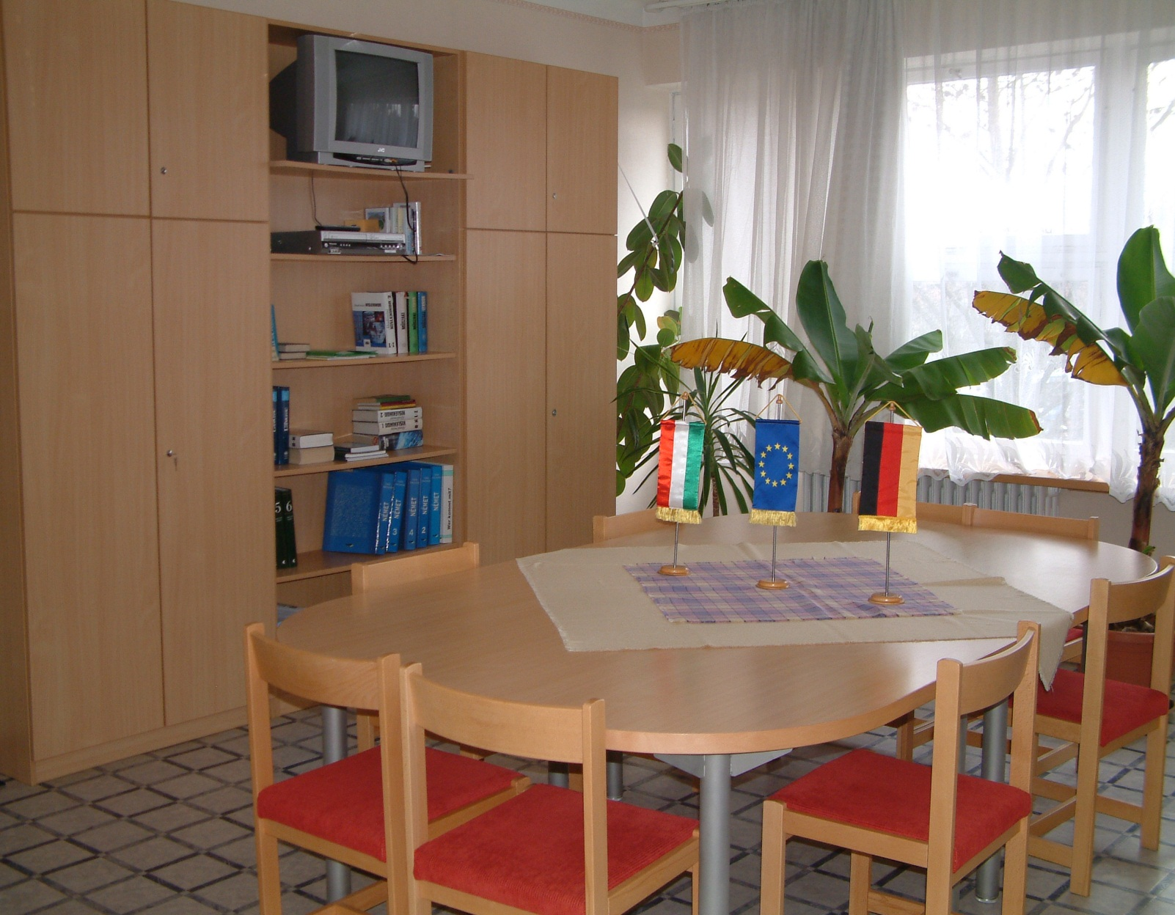
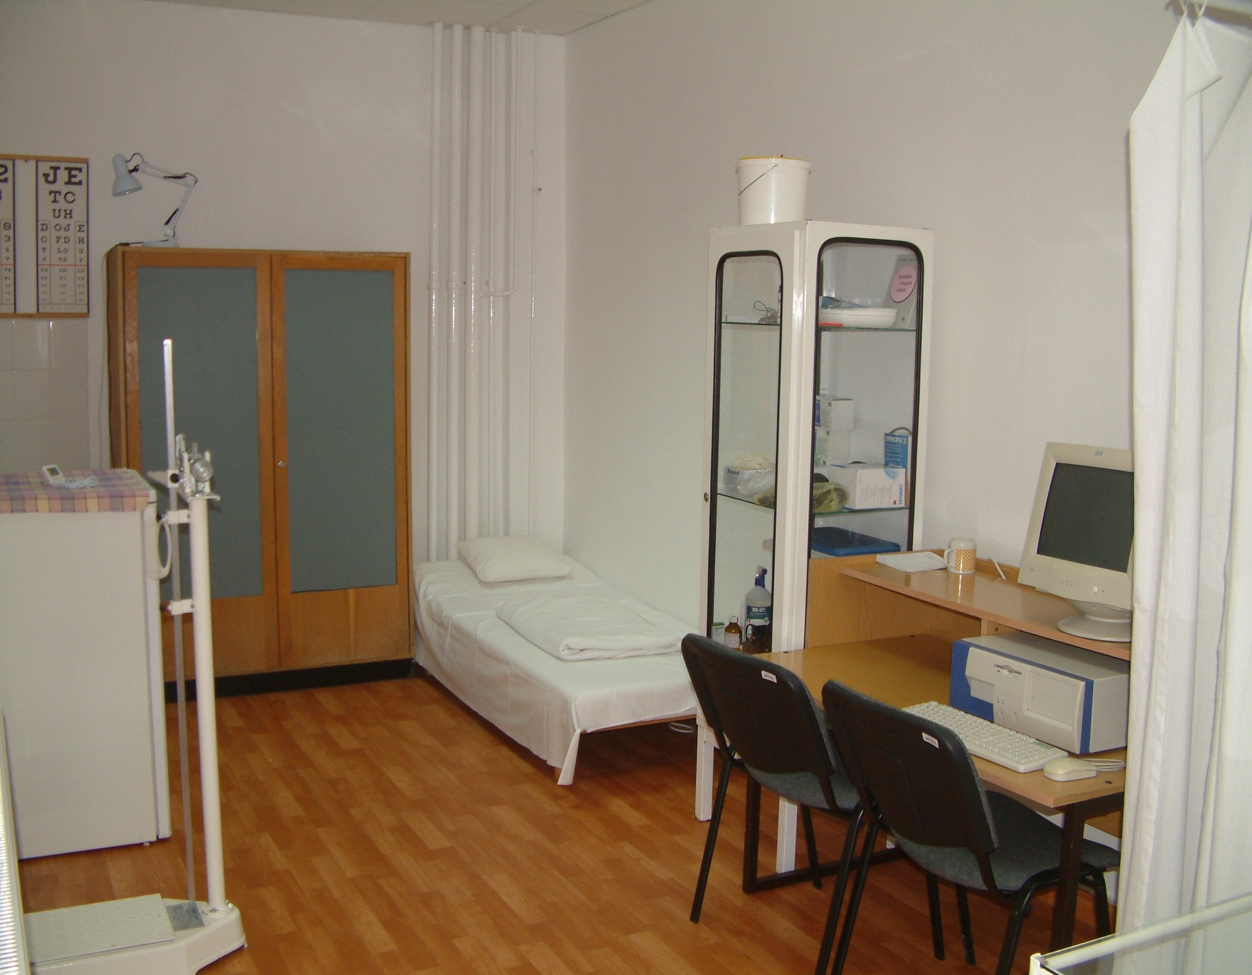
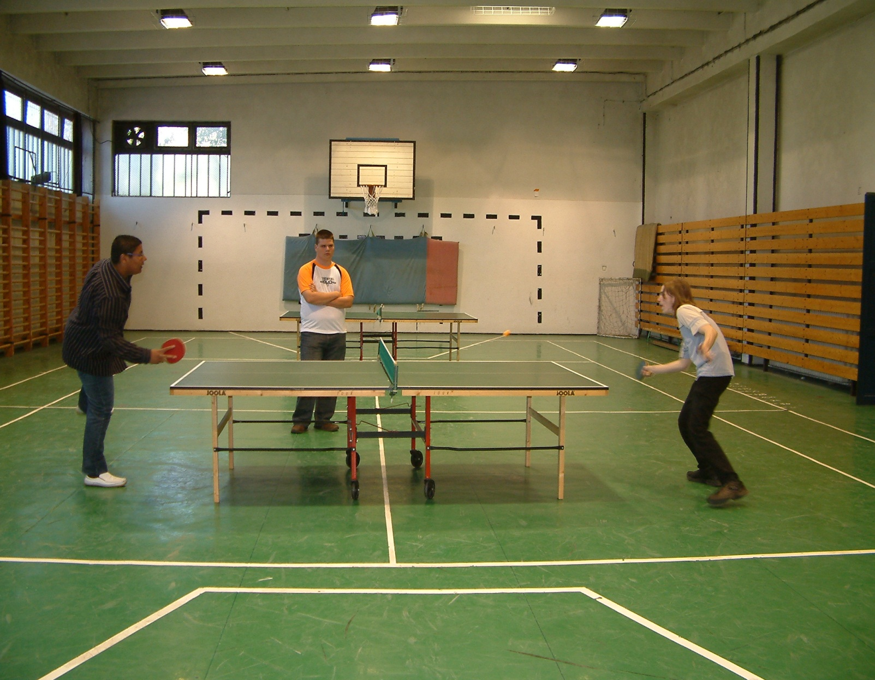
Photos of the school
Computer science classrooms
Libraray
Interactive
classroom
Communication room
Medical consulting room
6. Gym

Slide 13
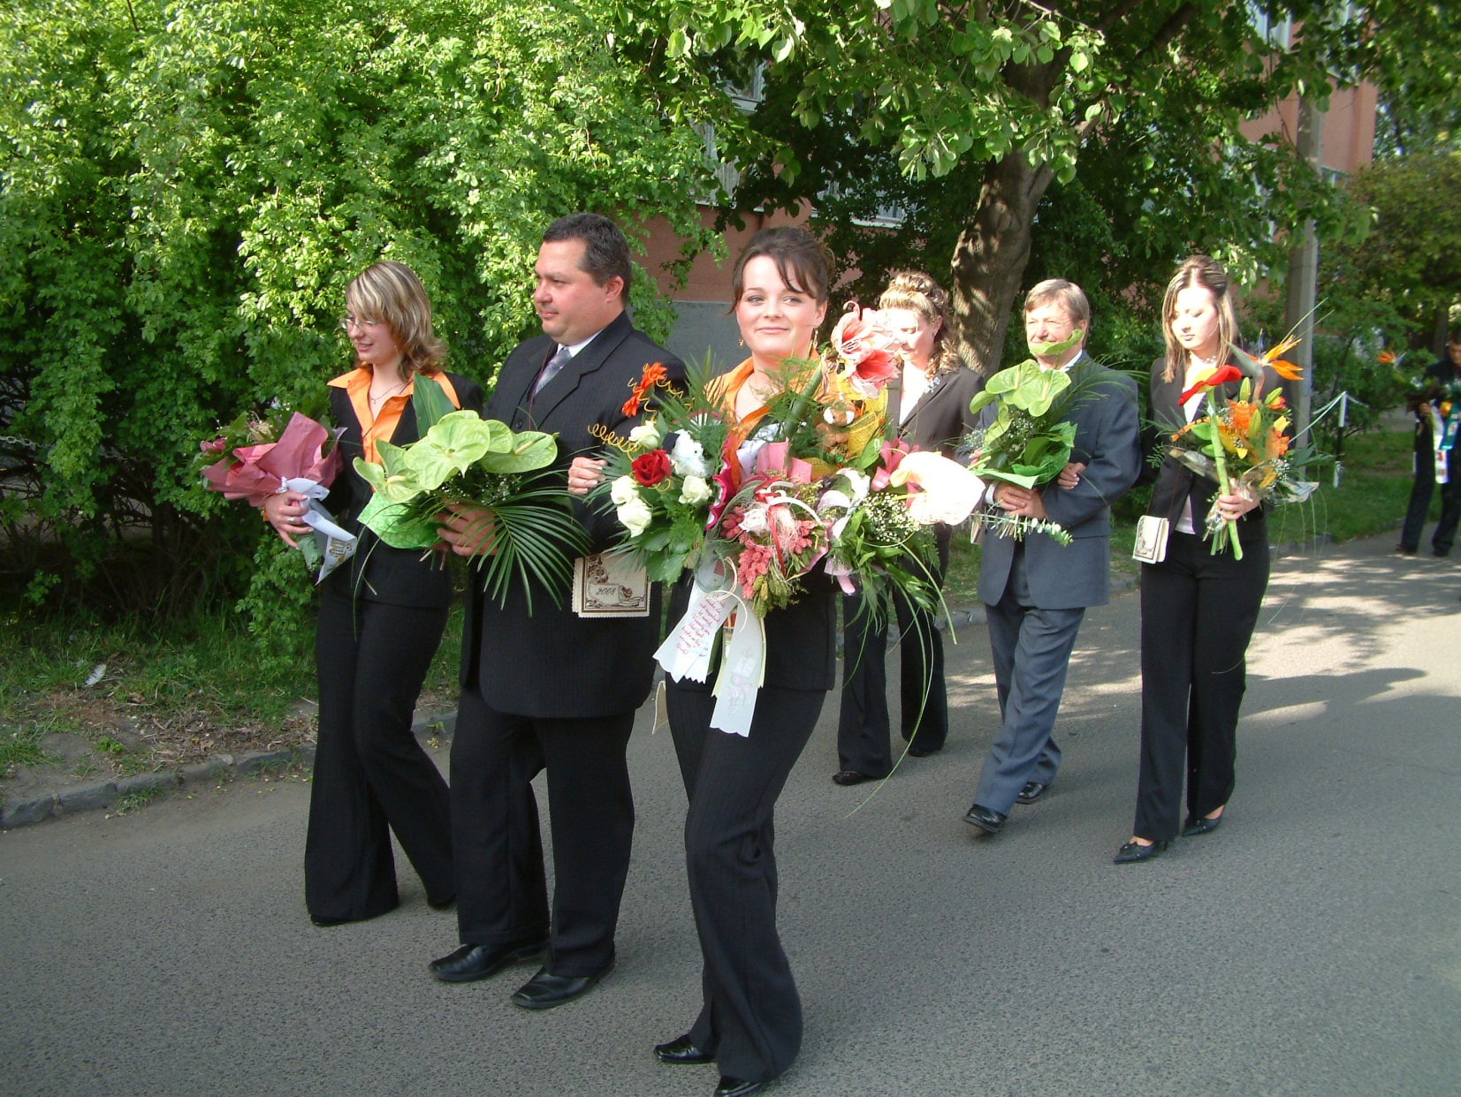
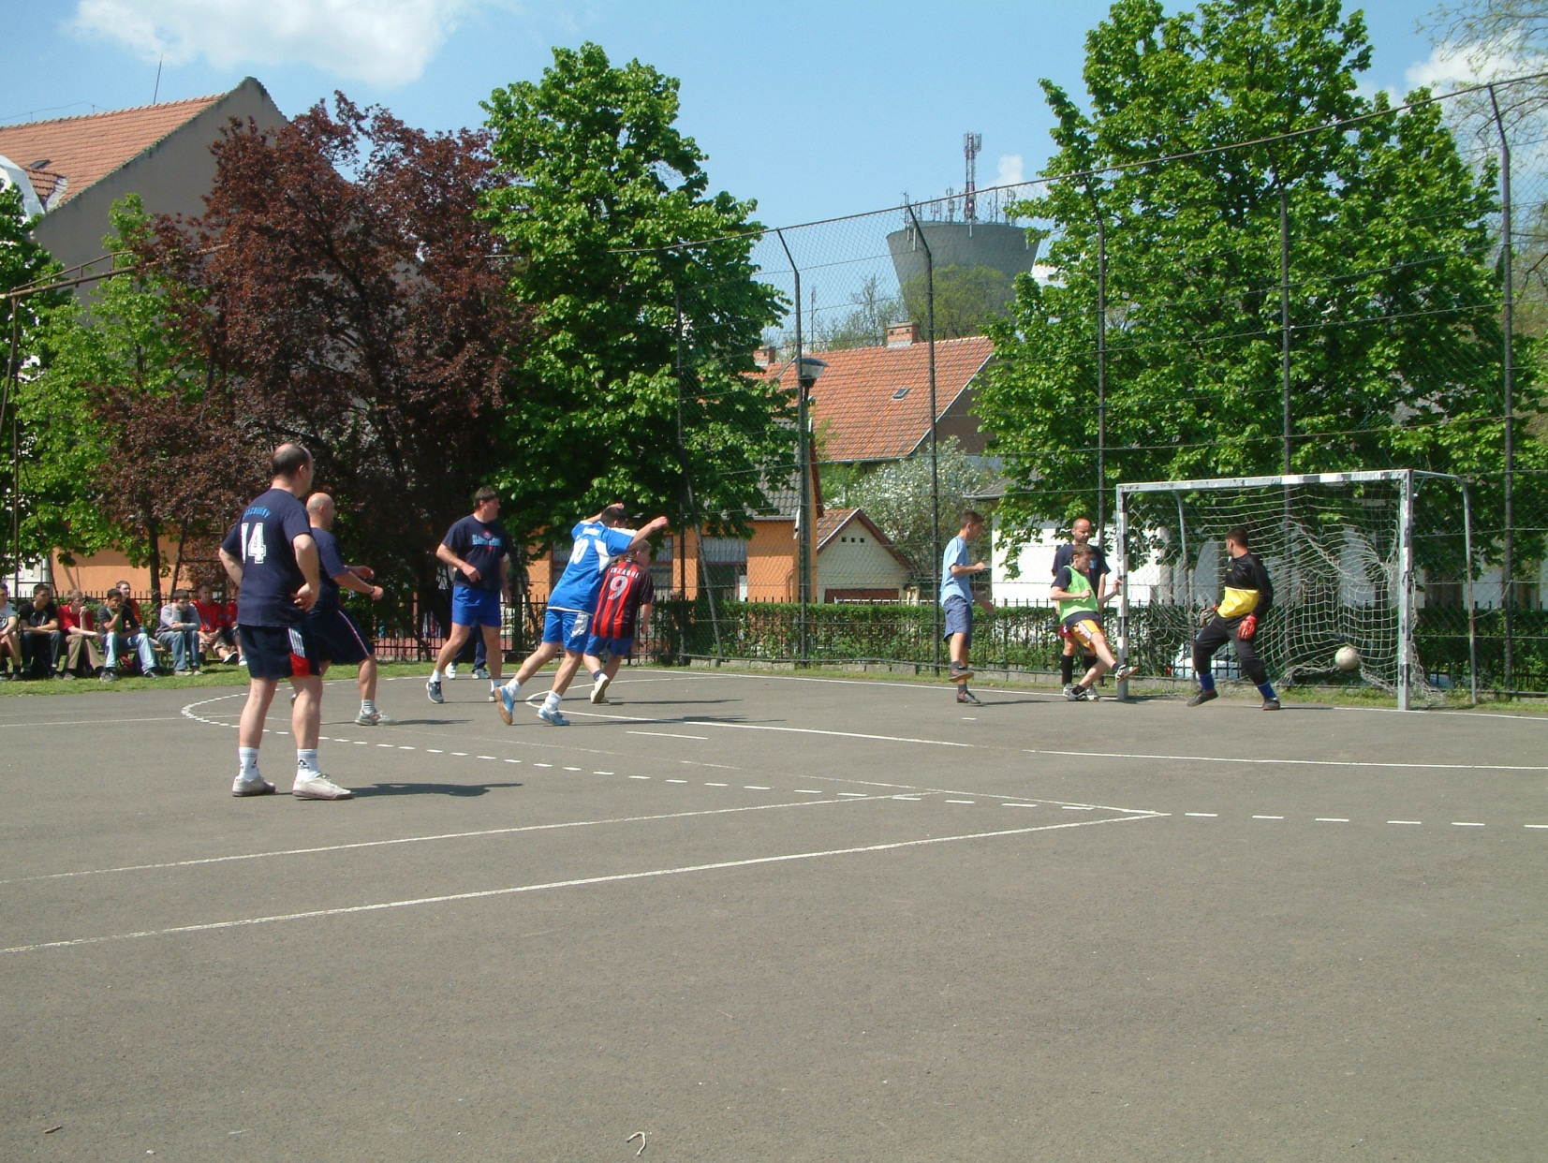
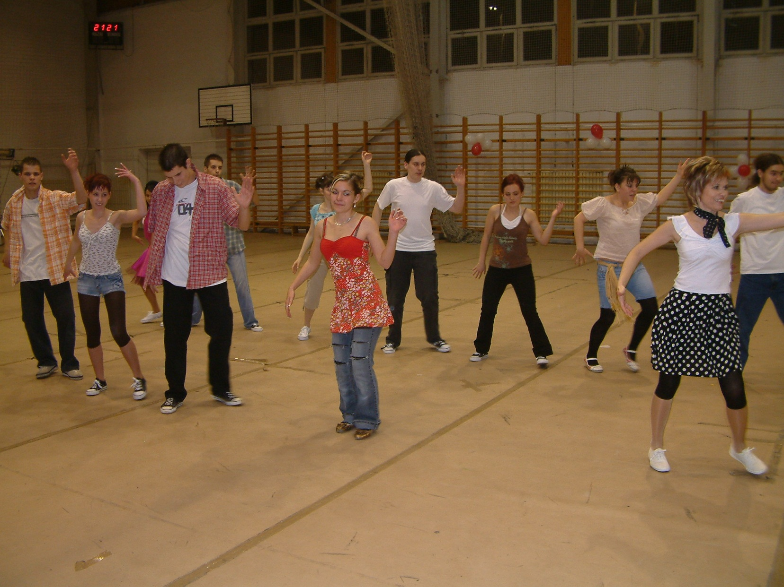
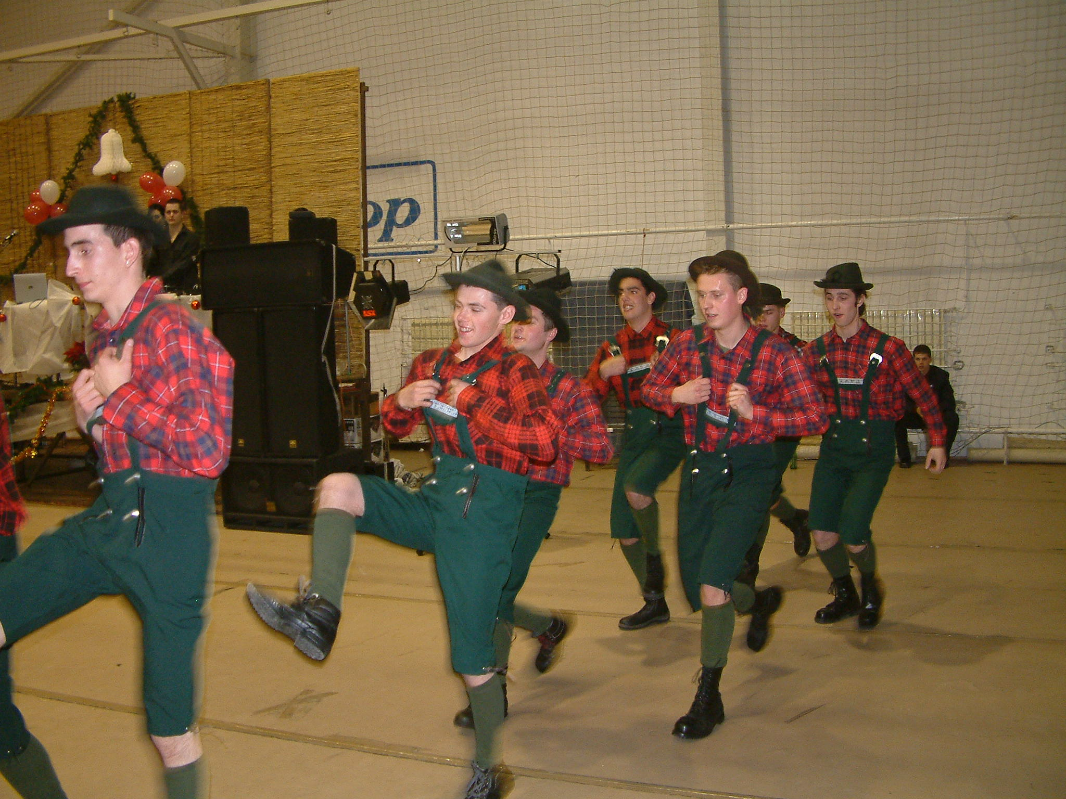
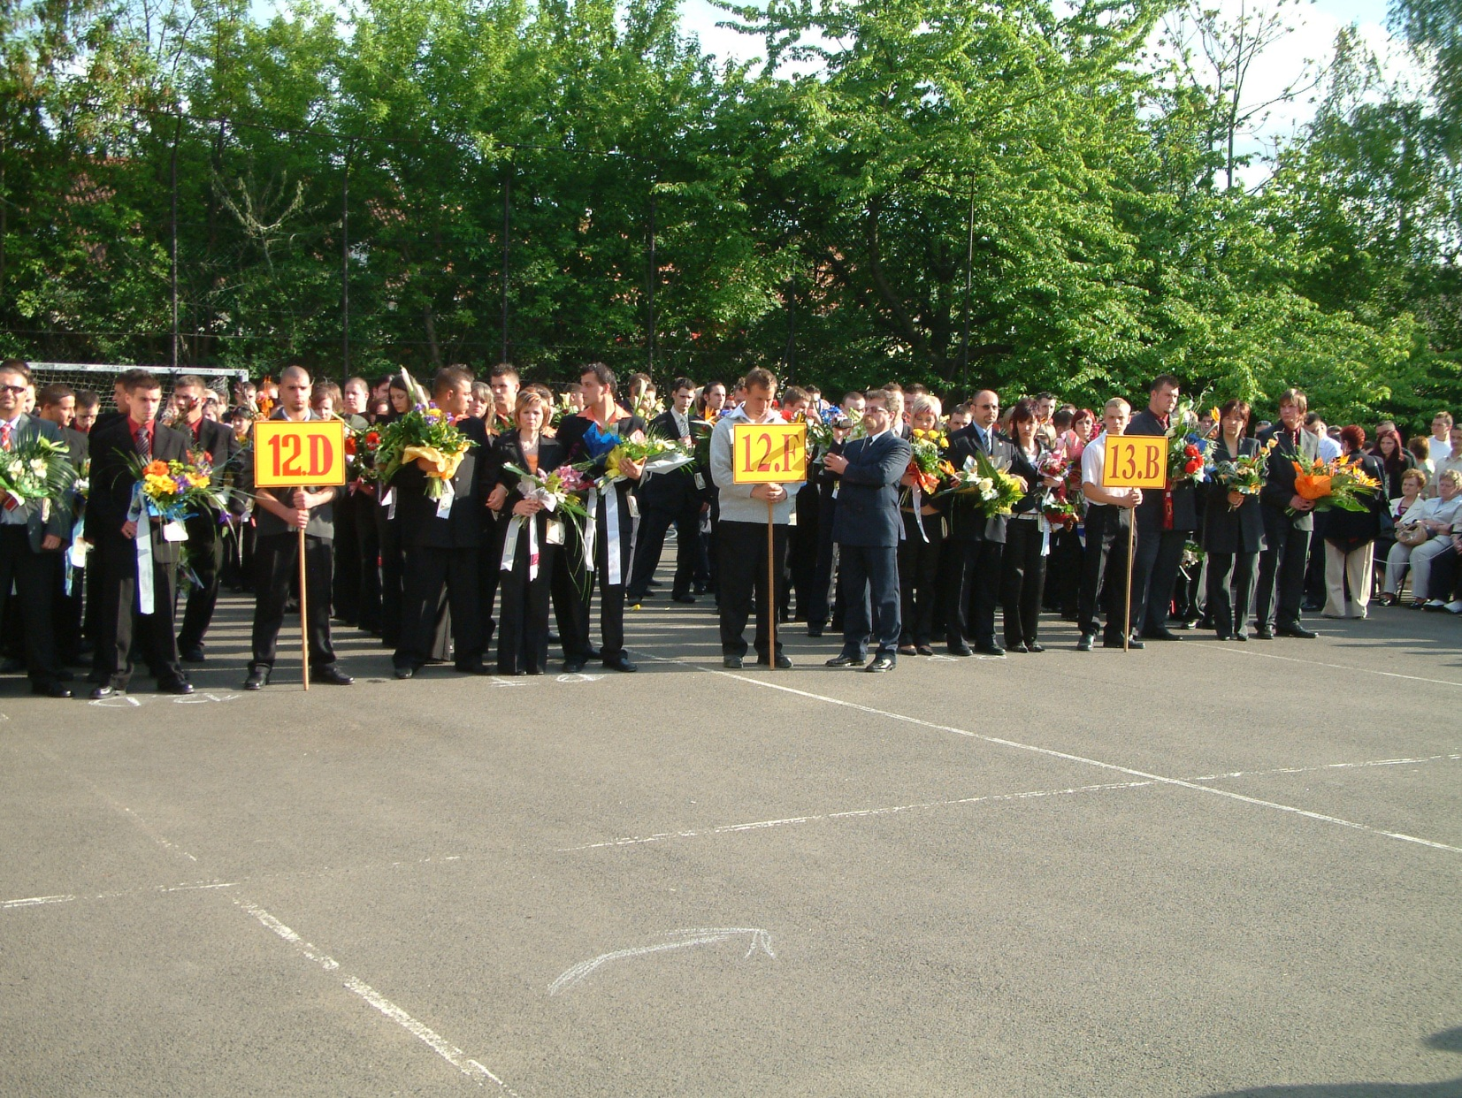
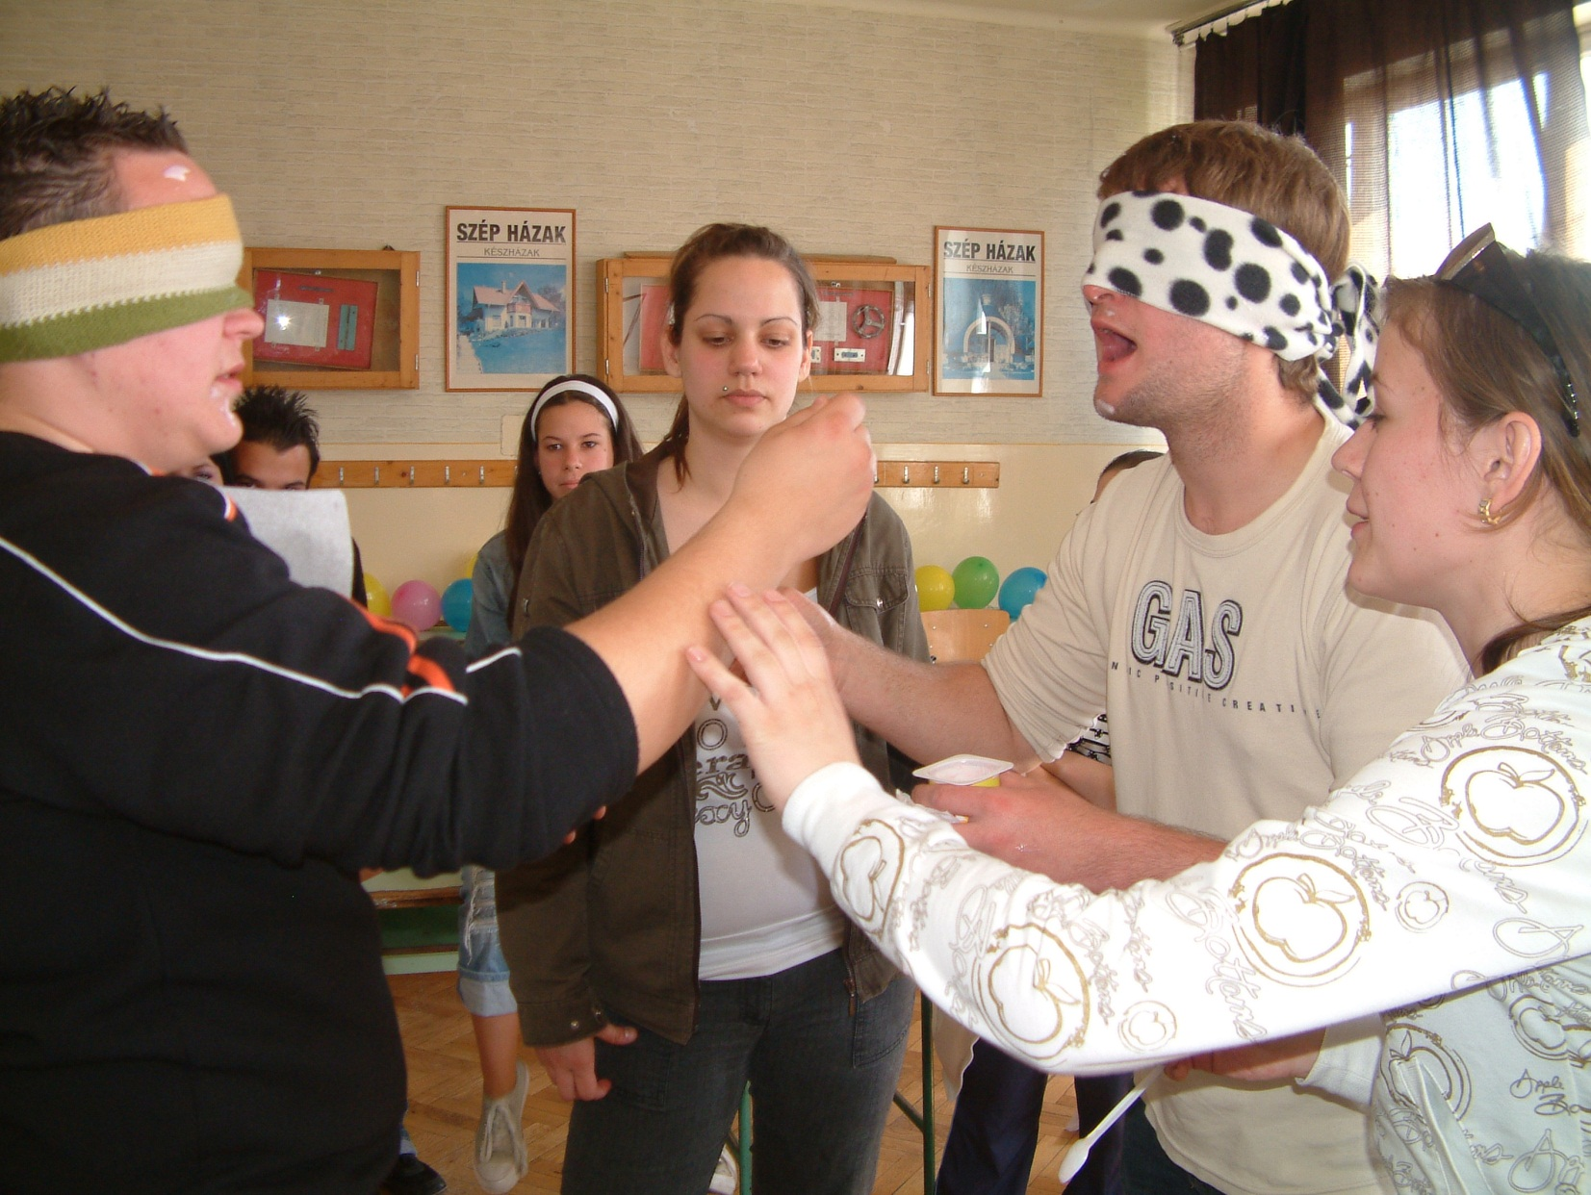
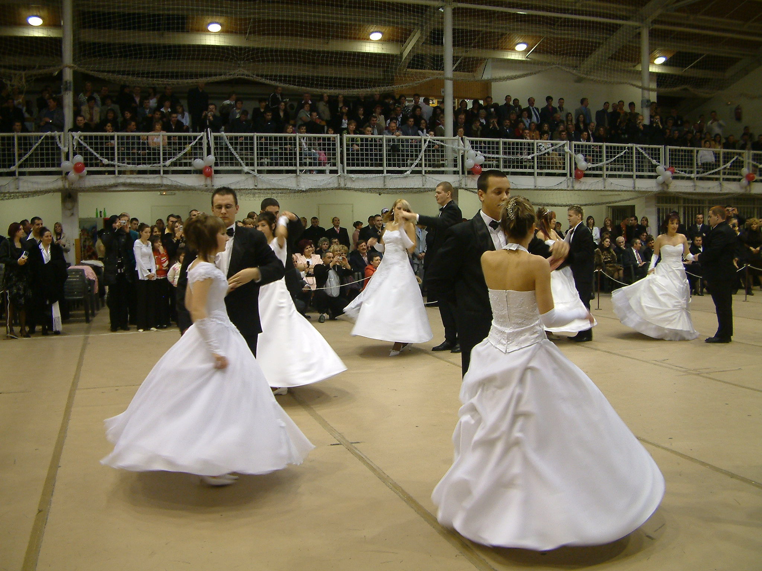
Our traditions
Ball for school-leaver students
School-leaving ceremony
Students’ Day

Slide 14
The availability of our school is the following:
Adress: 2 Hatvani street Jászberény 5100 Hungary
59 Kossuth street Jászberény 5100 Hungary
Telefon/fax: 00- 36-57-502-750
E-mail: klapkagyorgyszki@gmail.com
Web: http://klapkagy.sulinet.hu

Slide 15
For ages we have been participating in the European Union’s educational programs

