Slide 1
4th VOCATIONAL HIGH SCHOOL (EVENING)
Heraklion
Study in step with your obligations and change your life!
Address: Eleftheriou Skepetzi 31, Kipoupoli
Tel: 2810-320770, e-mail: mail@4tee-esp-irakl.ira.sch.gr

Slide 2
CRETE
Biggest island of Greece.

Slide 3
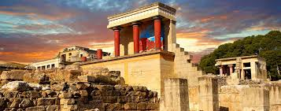
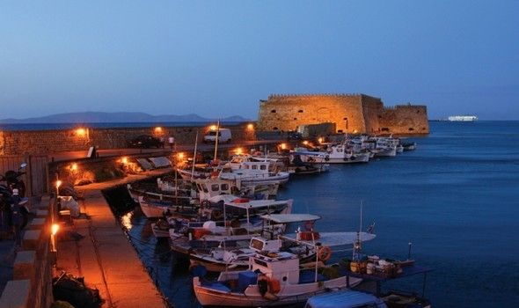
HERAKLION
The capital of Crete

Slide 4
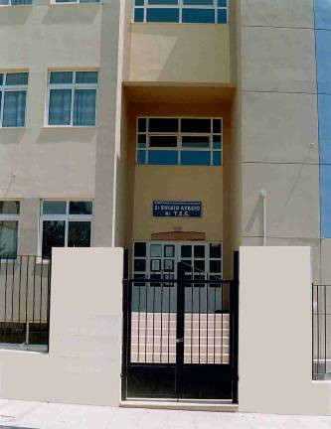
HISTORY OF SCHOOL
4th Vocational High School (Evening) of Heraklion serves consequently technique vocational education for the last thirty (30) years.
Totally, more than 3.500 students have graduated from our school.

Slide 5
6 Sectors and Specialities
In 4th Vocational High School the following six (6) sectors operate with the following specialities :
COMPUTER SCIENCE
Speciality of Computer and Network Technician
Speciality of Software Applicator

Slide 6
SECTOR OF FINANCIAL AND ADMINISTRATIVE SERVICES
Specialities:
Employees of Administration and Economic Services
Employees of Tourist Enterprises

Slide 7
SECTOR OF MECHANICAL ENGINEERING
Specialities of
Mechanical Installation and construction Technician
Technical Engineer of Thermal Installations, Oil and Gas
Technical cooling installations, Ventilation and Air Conditioning
Vehicle

Slide 8
Sectors and Specialities
ELECTRICAL ENGINEERING
Speciality of Electrical Systems, Installations and NetworksTechnician
STRUCTURAL PROJECTS
Speciality of Designer Structural Engineering and Geomatics
HEALTH & PROVIDENCE Specialities of
Nurse's Assistant
Child Carers Assistant

Slide 9
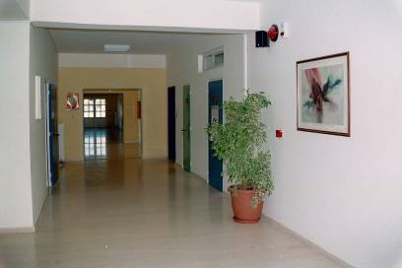
WORKING HOURS OF SCHOOL
The evening hours that our school operates (19:10-22:45), offer to help those who are not able to attend a morning school, because of their own professional or family obligations.
Every day our students attend courses for five (5) hours.

Slide 10
STRUCTURE OF PROGRAM STUDIES
1st class (Duration: 1 year)
Students choose optional courses related to the sector they are going to attend in 2nd class
2nd class (Duration: 1 year)
Students choose one of the six (6) sectors of studies
3rd class (Duration: 1 year)
Student choose speciality in
their sector of studies
4th class (Duration: 1 year)
It leads to acquisition of
Degree Level 3
and Certificate of Studies, that is equal with the certificate of studies from High School.
The Degree offers the possibility of having
License Professional Practicing
(under conditions accordingly the speciality)

Slide 11
PROSPECTS OF STUDENTS
Possibility of admission to University and Technological Institutes through exams, under favourable conditions.
Possibility of participating in Public Exams in their speciality, but equally to the graduates of High School with the certificate of Vocational High School.
Our school distinguishes for the great acceptance of its graduates in Labor Market in the object of their speciality.
Work as self employed.

Slide 12
REGISTRATION RIGHT
Everyone, who has at least certificate of Secondary School, is able to register in Vocational High School (Evening):
Workers in the Private Sector
Workers in the Public Sector, who want to upgrade their position
Unemployed
Graduates of previous years
Everyone, who hasn’t finished his studies in High School.

Slide 13
INSTALLATIONS OF OUR SCHOOL
The 4th Vocational High School (Evening) is now located in the modern building of El. Skepetzi street in Kipoupoli. Our School has:
24 classes for teaching
Multi-Purpose room
Borrowing Library
3 Computer labs
2 Drawing desks
Chemistry laboratory – Physics laboratory
Installations for basketball, volleyball and football.

Slide 14
LABORATORIAL CENTER
The laboratorial courses of the sectors: Computer Science, Mechanical and Electrical Engineering are carried out in the modern installations of 1st School Laboratorial Center of Heraklion, that allocates for the needs of courses of our School :
6 Computer labs
8 Mechanical Engineering Laboratories
5 Electrical Engineering Laboratories

Slide 15
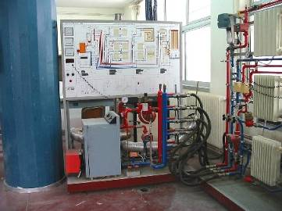
Sector of Mechanical Engineering
Laboratory of Hydraulic Installations

Slide 16
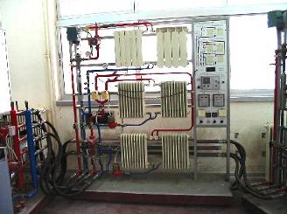
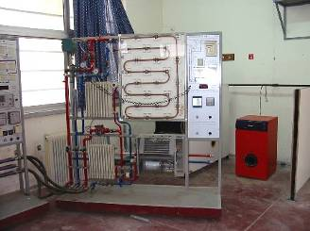
Sector of Mechanical Engineering
Laboratory of Thermic Installations

Slide 17
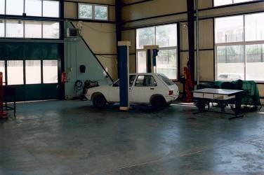
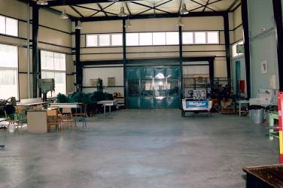
Sector of Mechanical Engineering
Laboratory of Conventional Technology

Slide 18
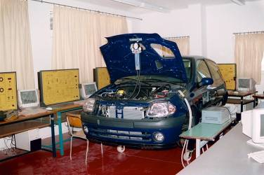
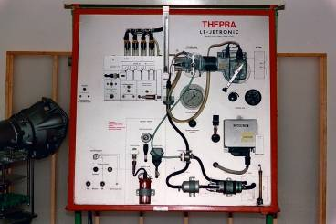
Sector of Mechanical Engineering
Laboratory of New Technology

Slide 19
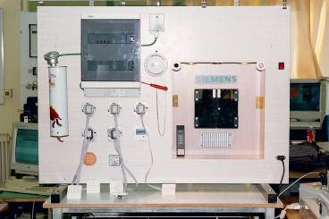
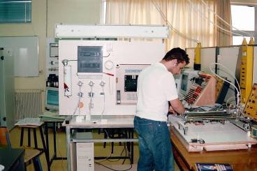
Electrical Engineering Sector
Laboratory of Electrical Installations

Slide 20
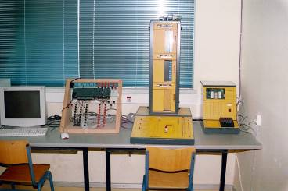
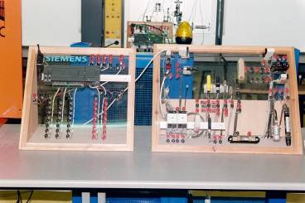
Electrical Engineering Sector
Laboratory of Automatism

Slide 21
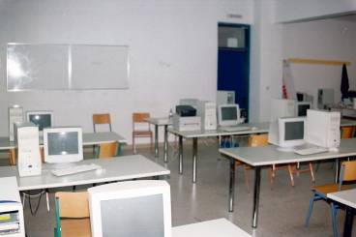
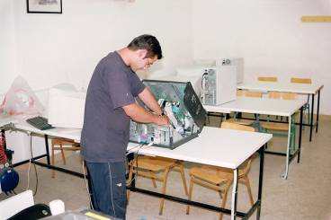
SECTOR OF COMPUTERS
Laboratory of Computer Hardware & Maintenance

Slide 22
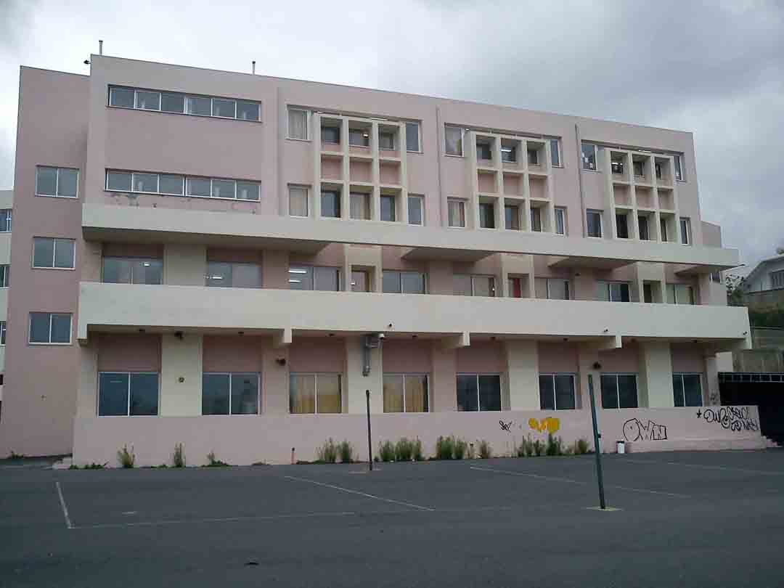
LABORATORIAL CENTER
The laboratorial courses of the sectors: Structural Projects and Health & Providence are carried out in 2nd School Laboratorial Center, that allocates for the needs of courses:
4 Structural Project Laboratories
2 Health and Providence Laboratories

Slide 23
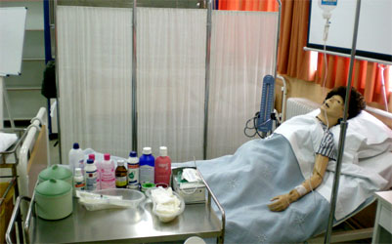
Sector of Health & Providence
Laboratory of Health & Providence

Slide 24
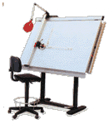
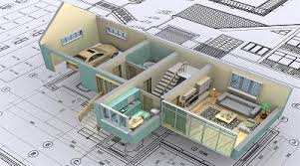
Sector of Structural Work
Laboratory of Structural Work

Slide 25
INSTRUCTIONAL STAFF
In our School 58 professors of Secondary Education teach 12 different specialities with multiannual experience in the Technical and Professional Education.

Slide 26
STUDENT PROFILE
This year about 500 students are attending our courses.
The average age of students is 24 years.
Students of our school are workers or unemployed.

Slide 27
European Programmes
EU Programme | Year | Project Identification | Applicant/Beneficiary Name
Comenius Multilateral Project | 2009 | 2009-1-BG1-COM06-01574 | Cultural Mosaic of Europe – Past, Present and Future
Leonardo Da Vinci IVT | 2012 | 2011-GR1-LEO01-06475 | The use of information and communication technology (ICT) in tourism and hospitality management
Leonardo Da Vinci VETPRO | 2012 | 2012-GR1-LEO03-09907 | Training Adult Trainers: Train the Trainer

Slide 28
European Programmes
EU Programme | Year | Project Identification | Applicant/Beneficiary Name
Erasmus+ KA1 for School Education Staff | 2015 | 2015-1-EL01-KA101-013542 | Using e-learning in Education
Erasmus+ KA1 for VET learners | 2015 | 2015-1-EL01-KA102-013590 | Automation/ PLC-programming for students of mechanical sector

Slide 29
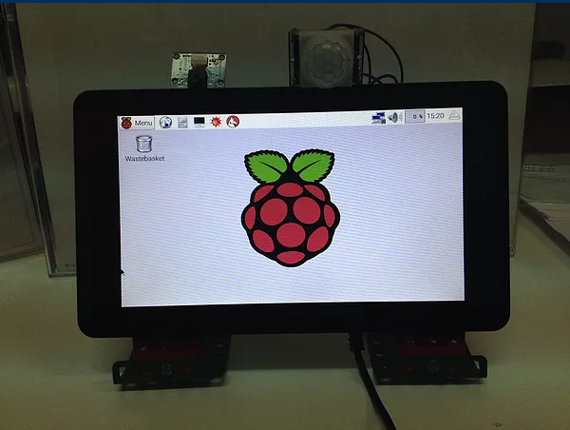
Participation in Digital Artist Festival
The last two years our school participated in Digital Artist Festival where students presented their digital creations:
System Security with Raspberry Pi 2
Websites

Slide 30
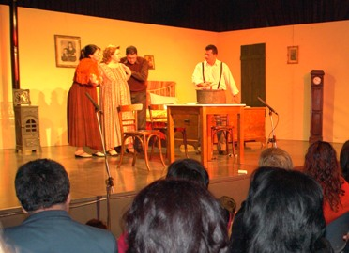
SCHOOL EVENTS
Theater student Group

Slide 31
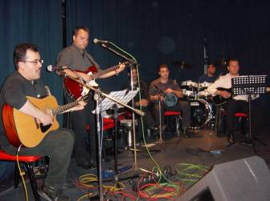
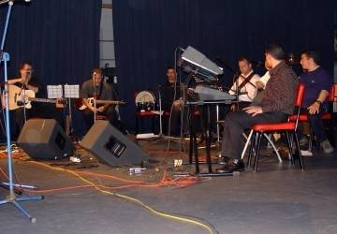
SCHOOL EVENTS
Music student group

Slide 32
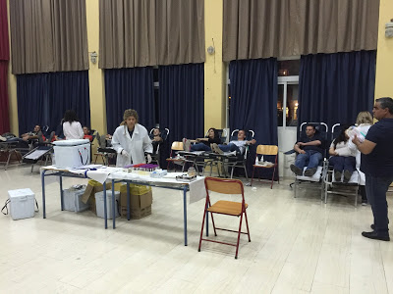
SCHOOL BLOOD BANK
In the School functions Bank of Voluntary Blood donation with the attendance of teachers, students and friends.

Slide 33
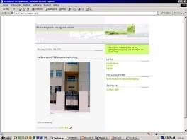
WEB PAGES OF SCHOOL
Our School has established the following websites :
http://www.esperino.gr
https://teach4epal.wordpress.com/

Slide 34
Our school is not an ordinary school!
Every student who has graduated from our school has loved and has been thinking of it for ever!

