Slide 1
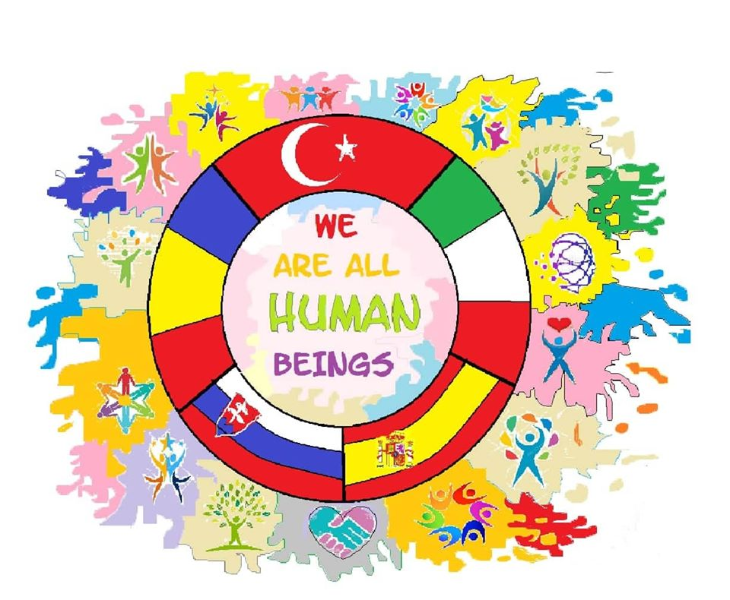

Slide 2
First day
Welcoming by the mayor of trnava
Celebrating of End of First World War

Slide 3
Interview with the war veterans who fought in Balkan wars

Slide 4
Second Day
Streets of Bratislava

Slide 5
Dunau
“Čumiľ”

Slide 6
Third day
Museum of slovak national uprising

Slide 7
Medals of slovak generals
Czech tank in banská bystrica

Slide 8
Fourth day
Concrentation camp in sereď
Train Vagon used to transport Jews

Slide 9
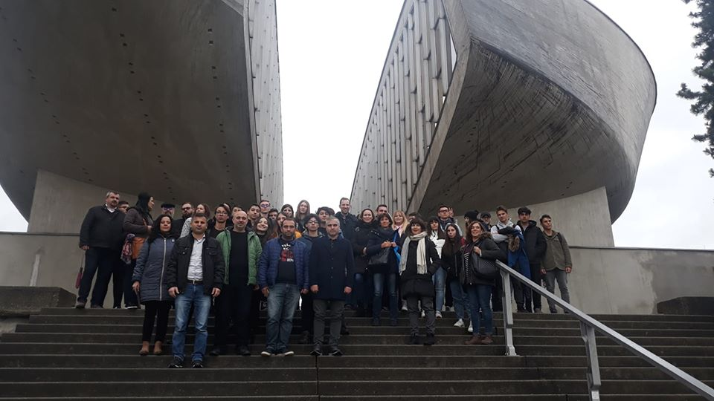
“We are all human beings”

Slide 10
Thank you for the attention İzlediğiniz için teşekkürler Multumesc pentru atentie Gracias por la atención Grazie per l'attenzione Ďakujem za pozornost

