Slide 1
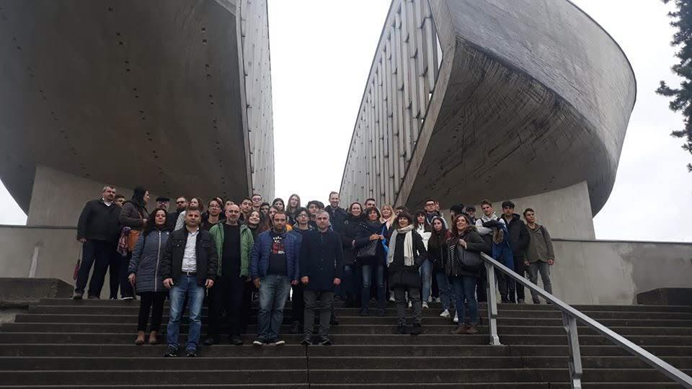

One week in slovakia
PINK TEAM

Slide 2
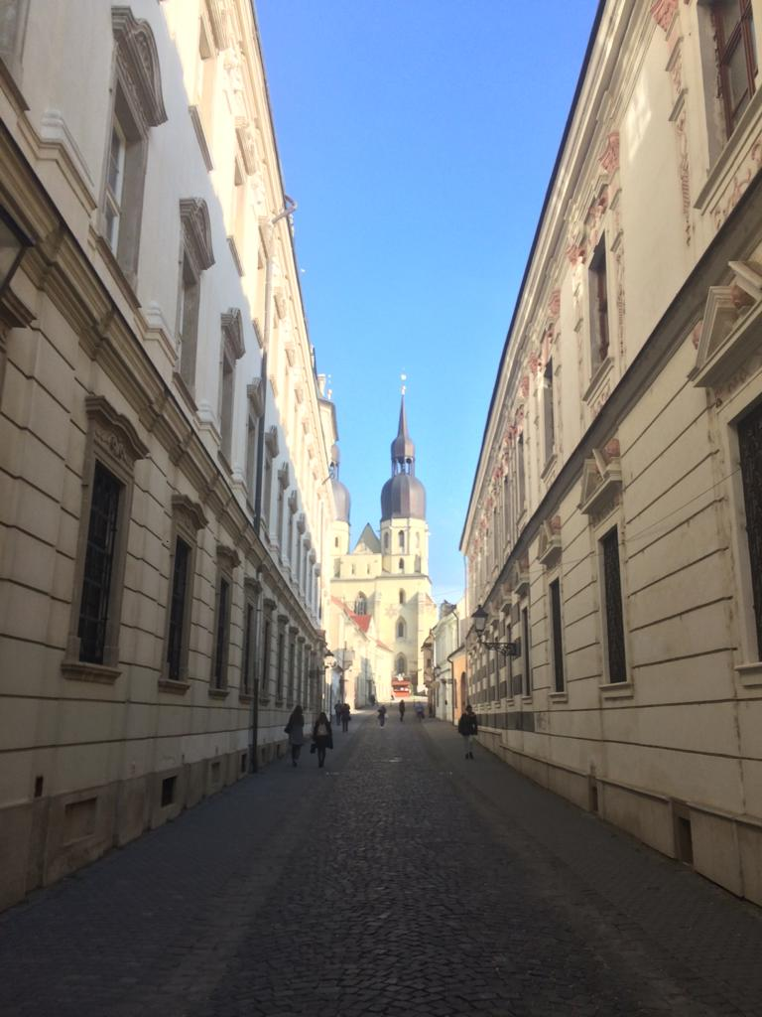
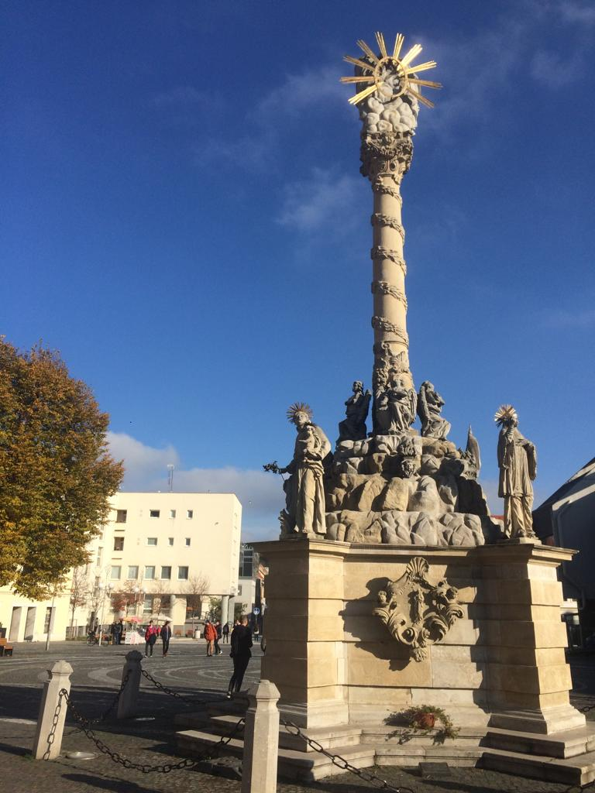
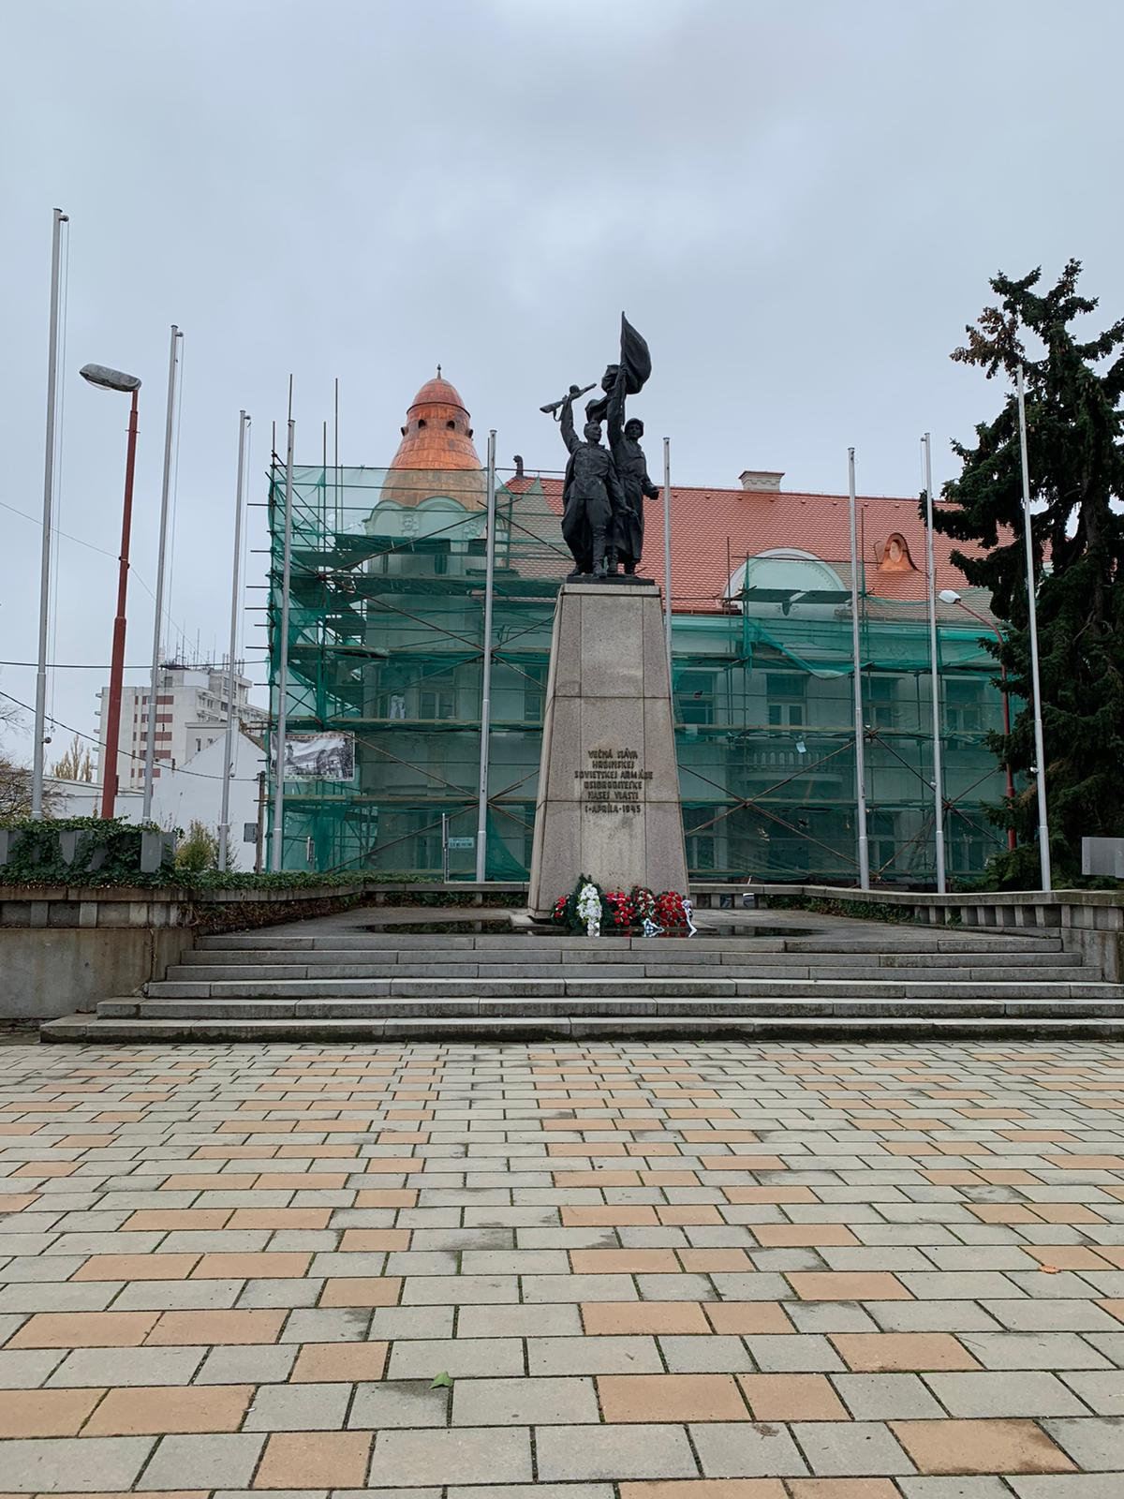
TRNAVA
At the first day we saw Trnava. It is a very beautiful historical city. It is called „little Rome“ because there are many churches in there.

Slide 3
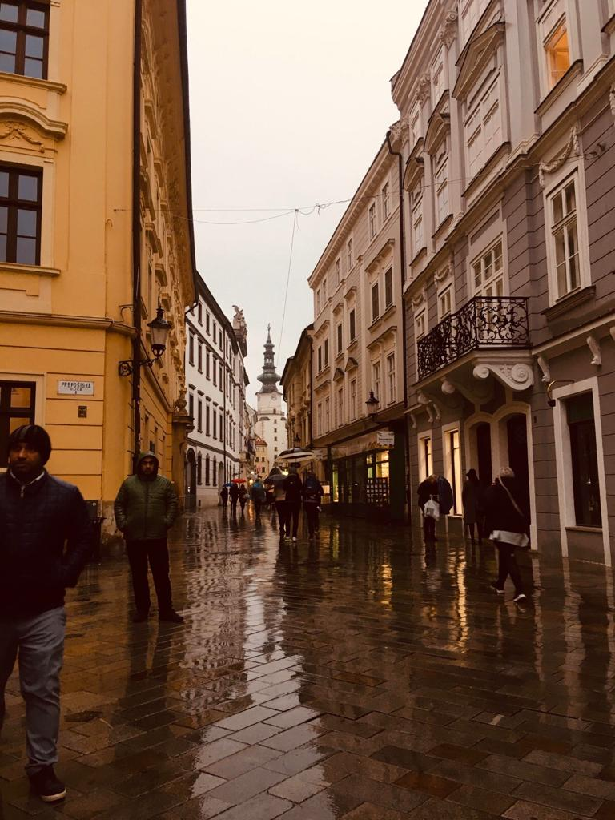
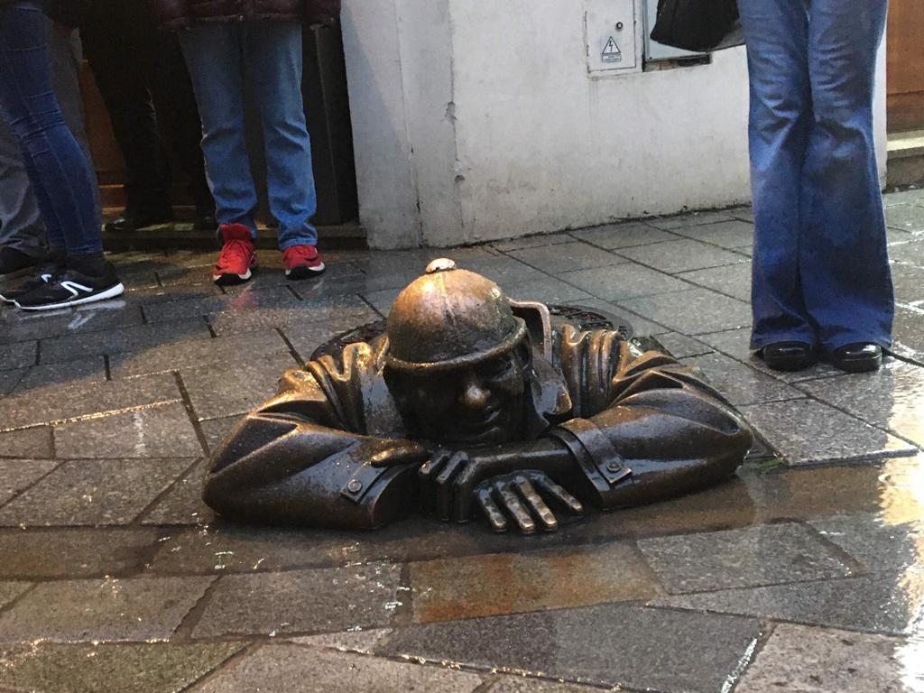
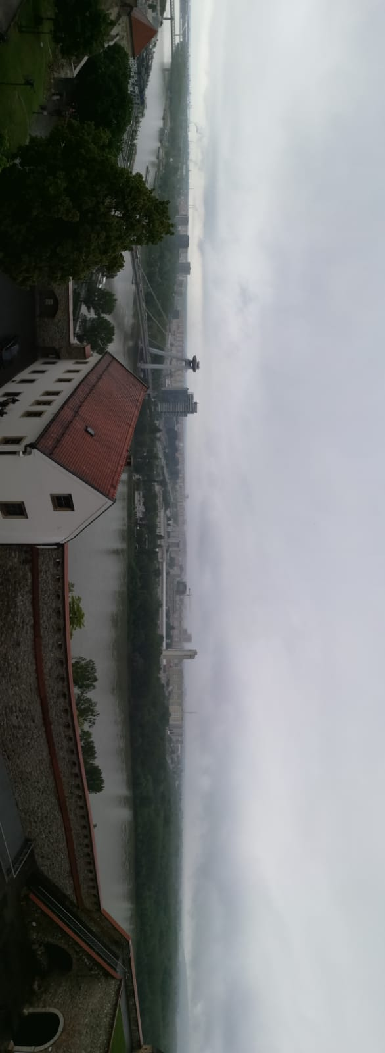
BRATISLAVA
The next day we visited Bratislava. Bratislava is the capital city of Slovakia

Slide 4
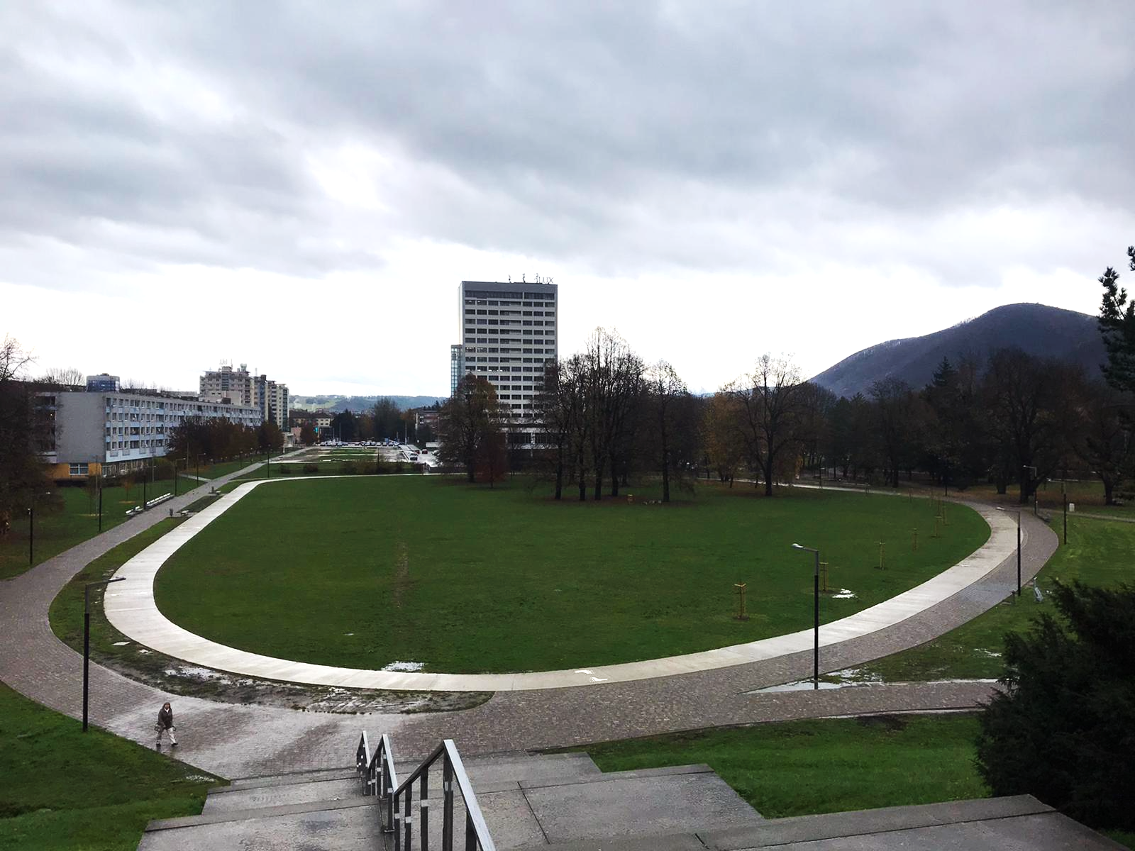
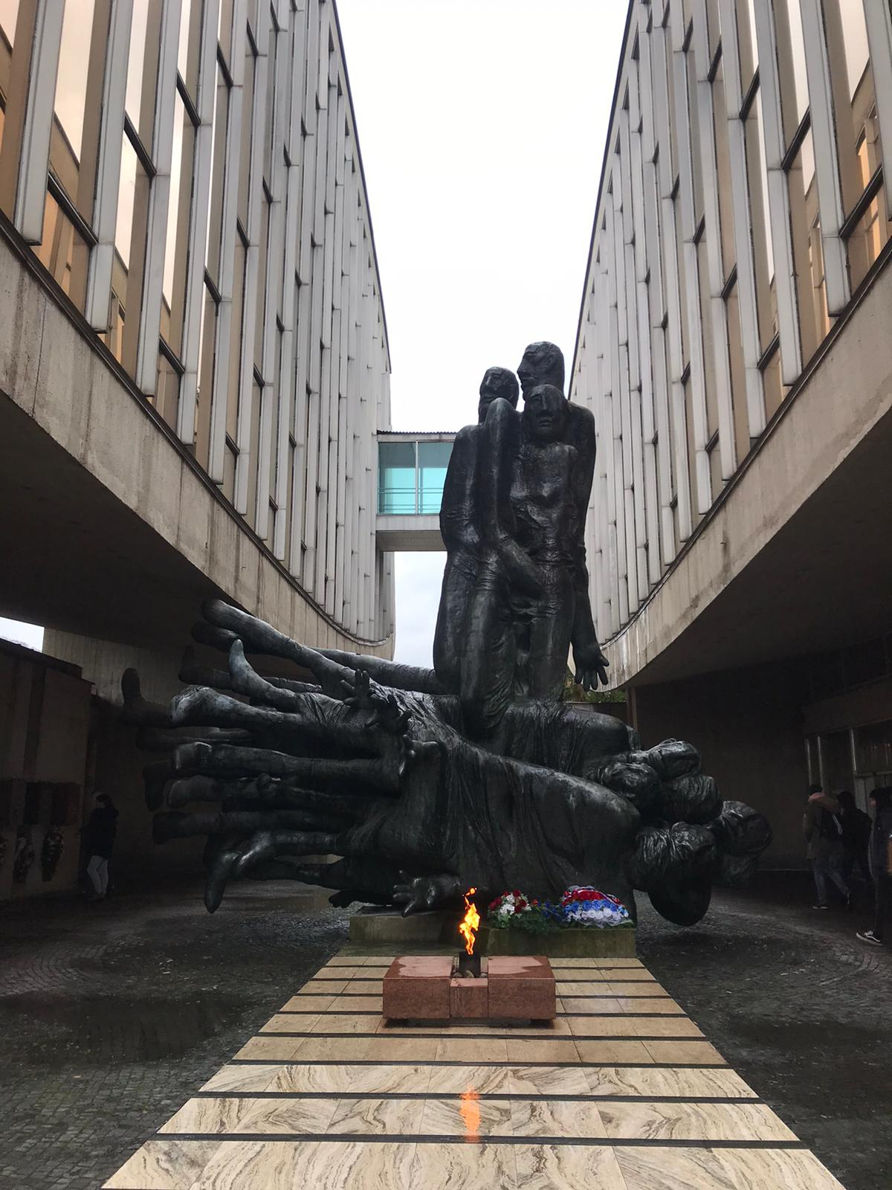
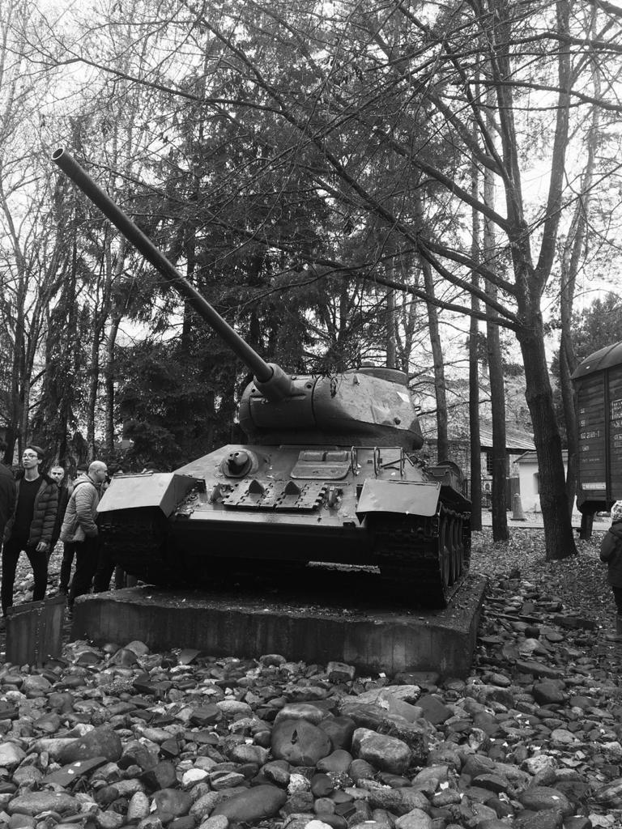
BANSKÁ BYSTRICA
Then we visited Banská Bystrica where we visited the square and the museum of Slovak National Uprising.

Slide 5
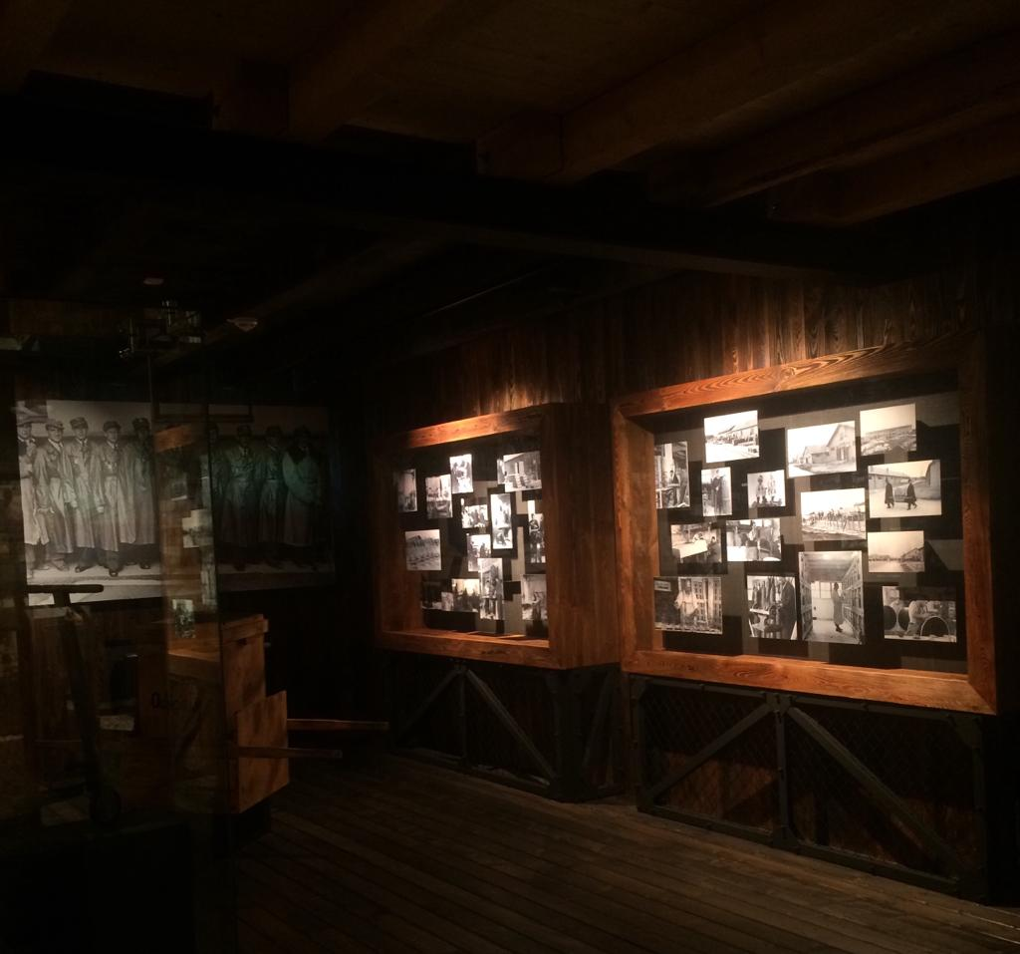
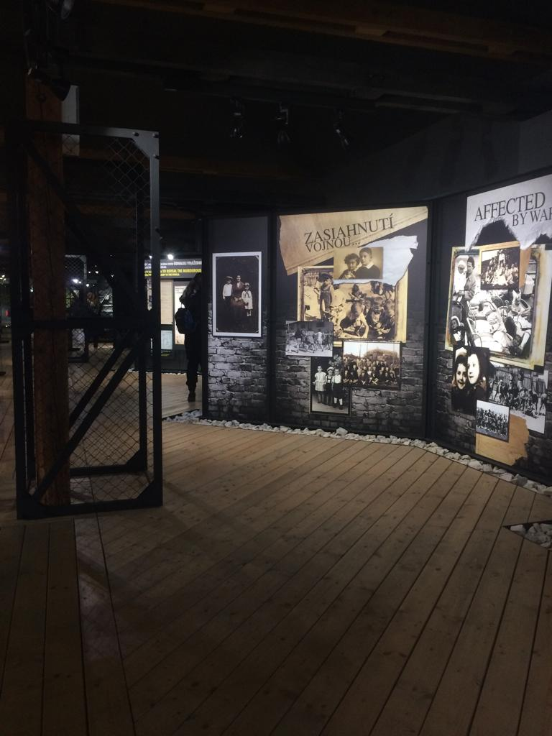
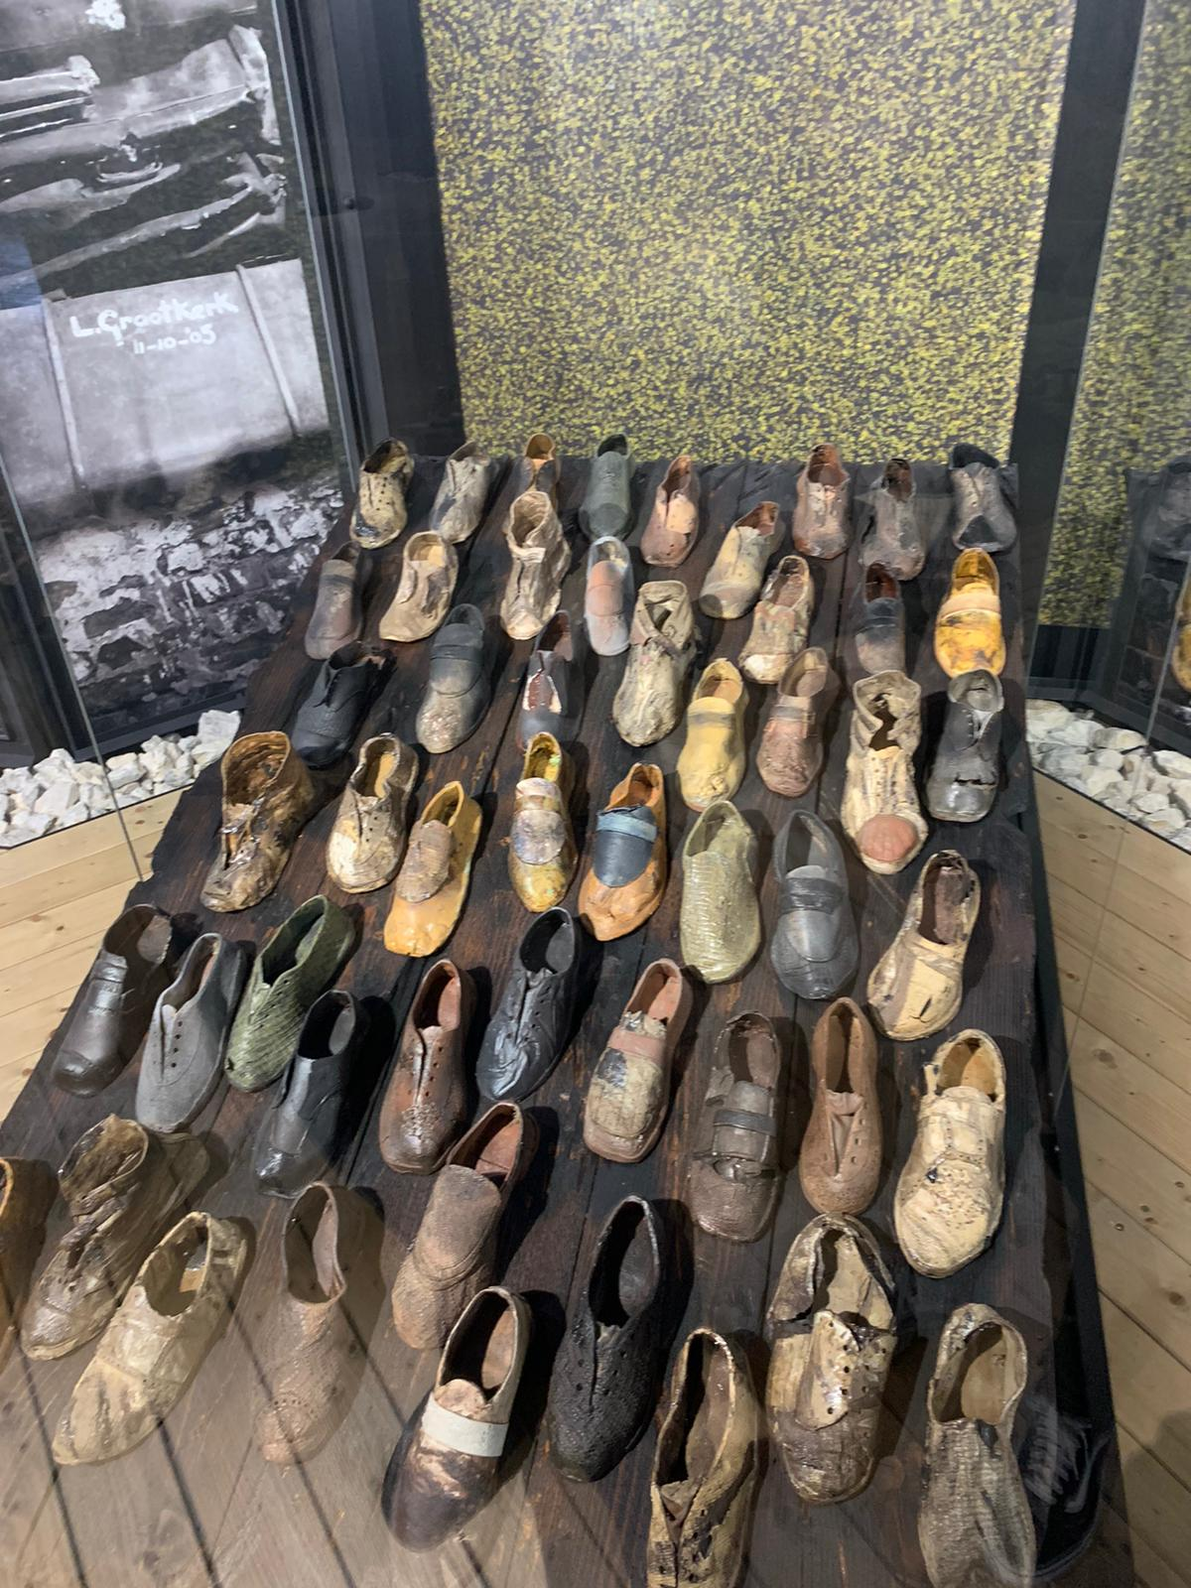
SEREĎ
Then we visited the Museum of Holocaust in Sereď. It is a very sad place . A lot of people died there.

Slide 6
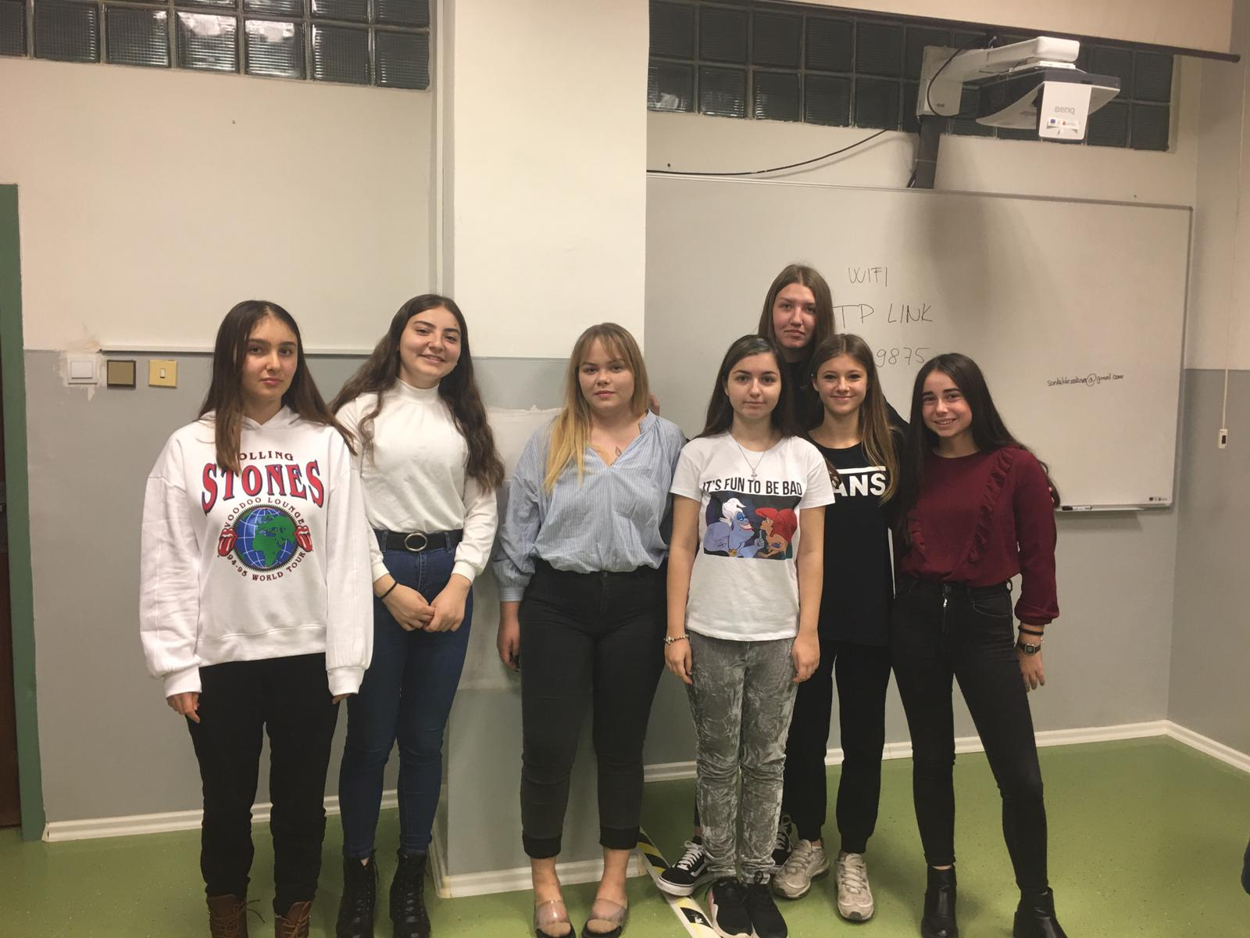
OUR SCHOOL
The secondary vocational
school of electrotechnics.
This presentation was
made by pink team.

Slide 7
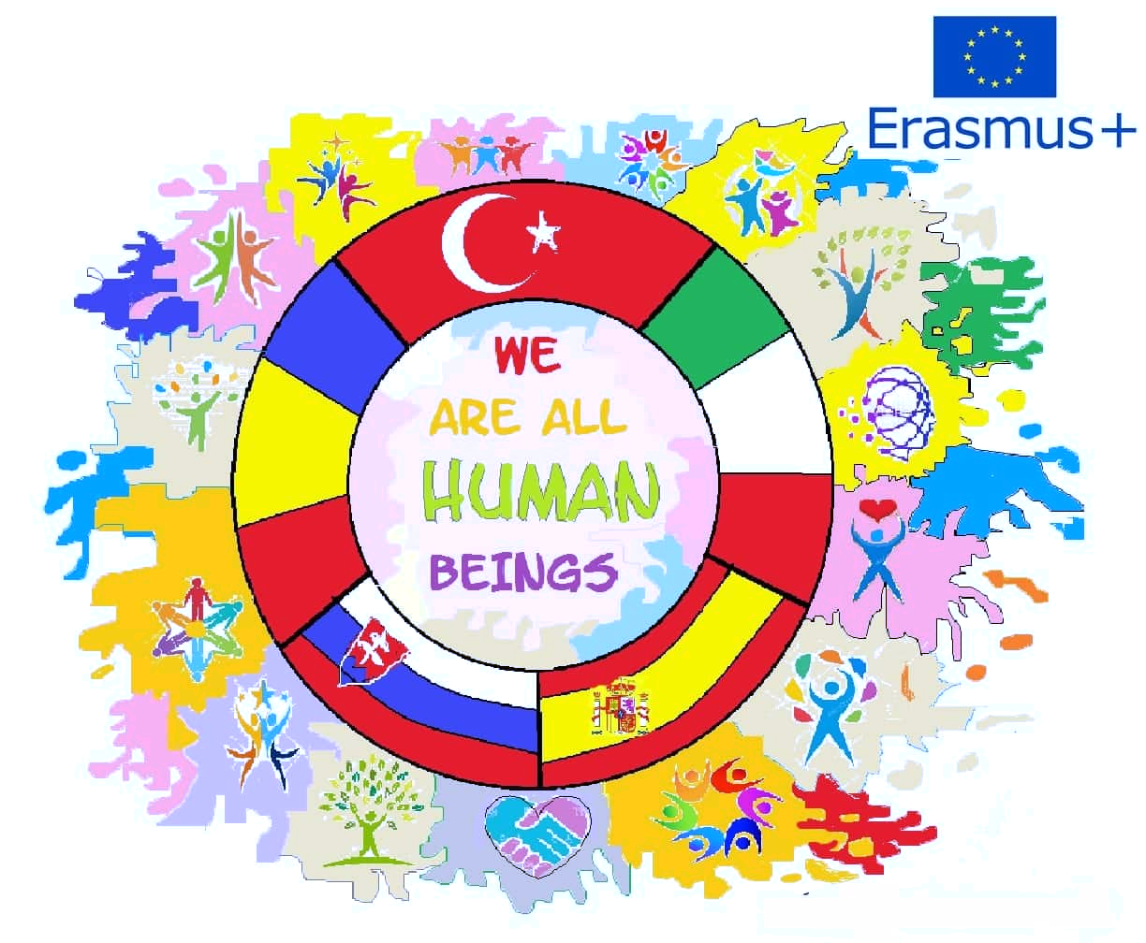
THANKS!

