Slide 1
Facts and numbers about migrants in Slovakia
Erasmus+
We all are human beings

Slide 2
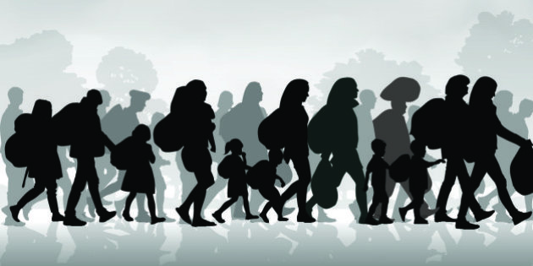
FACTS
104 451 foreigners with residence permit in Slovakia = 1,92% of the population
since Slovakia joined EU in 2004 the number of legal foreigners grew almost fivefold
6x less migrants than other EU countries
only 5 countries with less migrants
of all foreigners 51.8% are citizens of the European Union

Slide 3
FACTS
from Ukraine (15,4%), Czech Republic (10,2%), Hungary (7,7%), Romania (6.8%), Poland (5,5%), Germany (4,4%), Italy (2,8%) and Austria (2,3%)
Ukrainians have the most numerous representation of citizens from both EU and non-EU countries in Slovakia
among foreigners from outside the largest representation in Slovakia have migrants from Serbia, Russia, Vietnam, China and South Korea
the number of employed foreigners has increased 14 times - from 3 351 persons in 2004 to 49 478, of which 21 752 were non-EU nationals

Slide 4
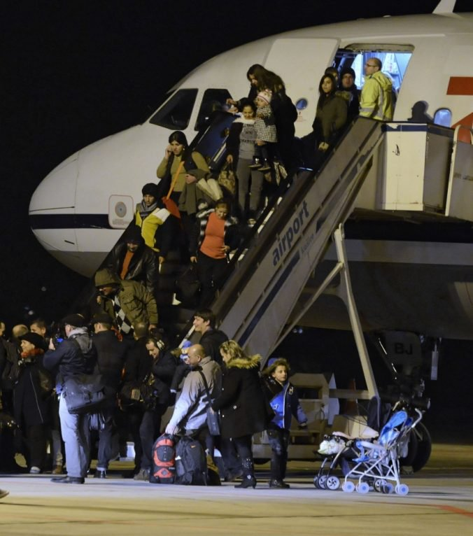
IMMIGRANTS
since Slovakia joined the European Union until 2014, illegal migration has dropped eightfold:
from 10,946 illegal migrants in 2004 to 1,304 migrants in 2014
in 2016, the number of foreigners illegally crossing the border or illegally staying on the territory of the Slovak Republic, rose to 2,706 in 2017

Slide 5
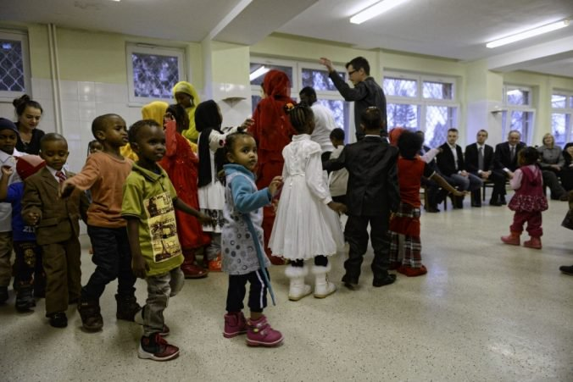
ASYLUM APPLICATIONS
in 2004, 11,395 people applied for asylum in the Slovak Republic; in recent years the number of asylum applications has stabilized to several hundred years a year
in 2017, the Slovak Republic granted asylum to 29 people
asylum seekers are most often from Afghanistan, Vietnam, Iraq, Syria and Pakistan
out of 58 633 applications since 1993, 849 were granted asylum and 709 were granted supplementary protection as another form of international protection

Slide 6
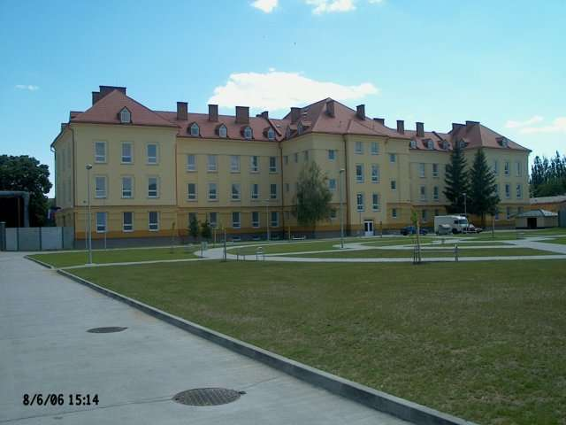
ASYLUM HOMES
immigrants live in asylum homes at the Eastern Slovakia town Humenne
2 buildings with 250 and 300 beds
there live 149 Asyrian cristians and 85 people from Somalia and Libanon
immigrants are learning Slovak language and various skills
immigration process longs from 6 months to 4 years

Slide 7
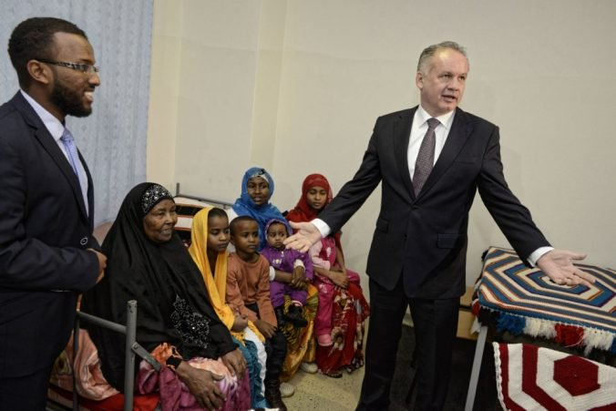
ASYLUM HOMES
another homes are on the villages near Nitra
all except one are state buildings
one home provides catholic church
on the photo is The President of Slovakia visiting asylum home in Humenne
many villages refused asylum homes because of fear from criminality and cultural/religion differences

Slide 8
CONLUSION 1
Slovakia isn’t a target country for many migrants
until recently Slovakia was a country which created immigrants rather than accepted migrants
more significant changes were brought to Slovakia's entry into the European Union and the Schengen area
despite the fact that the growth of the population of foreigners in Slovakia in 2004-2008 was second highest among all EU Member States, the representation of foreigners in the population - compared to other EU countries - remains low
with this information we don’t believe in migrant crisis since Slovakia is usually just a transit country for them

Slide 9
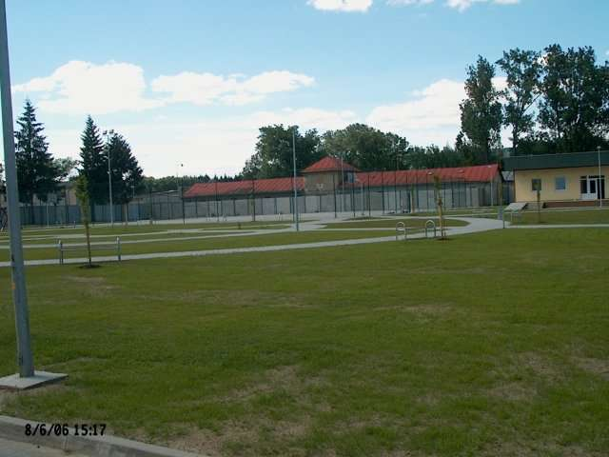
CONLUSION 2
Slovakia is just a TRANSIT country, because:
living conditions under the average of EU
average income in Slovakia 800Eur
not such rich social system
bad fame of “home” people
SO THE QUESTION IS:
are these reasons good enough for REAL IMMIGRANTS?

Slide 10
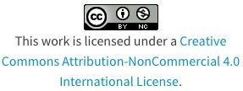
Thank You for your attention.
Erasmus+
We all are human beings

