Slide 1
BROJURE-ERASMUS

Slide 2
WIEN

Slide 3
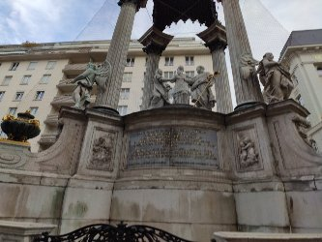

Slide 4
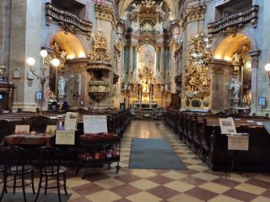

Slide 5
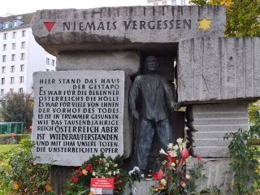

Slide 6
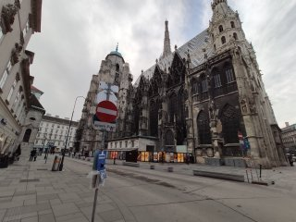

Slide 7
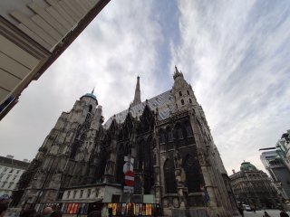

Slide 8
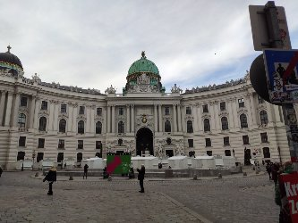

Slide 9
BRATISLAVA

Slide 10
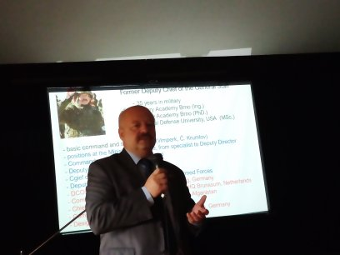

Slide 11
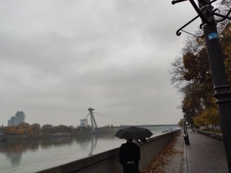

Slide 12
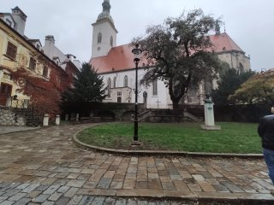

Slide 13
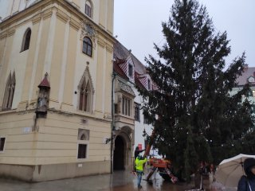

Slide 14
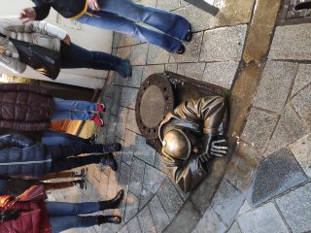

Slide 15
TRNAVA

Slide 16
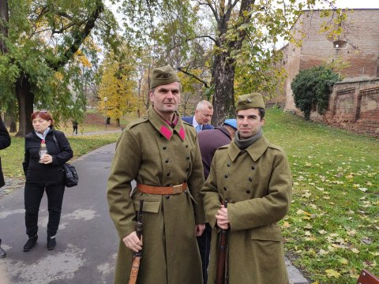

Slide 17
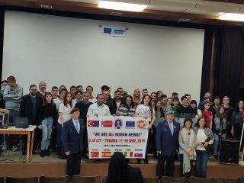

Slide 18
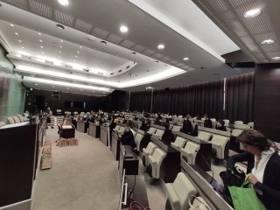

Slide 19
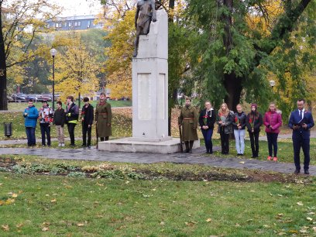

Slide 20
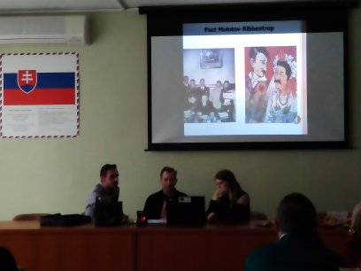

Slide 21
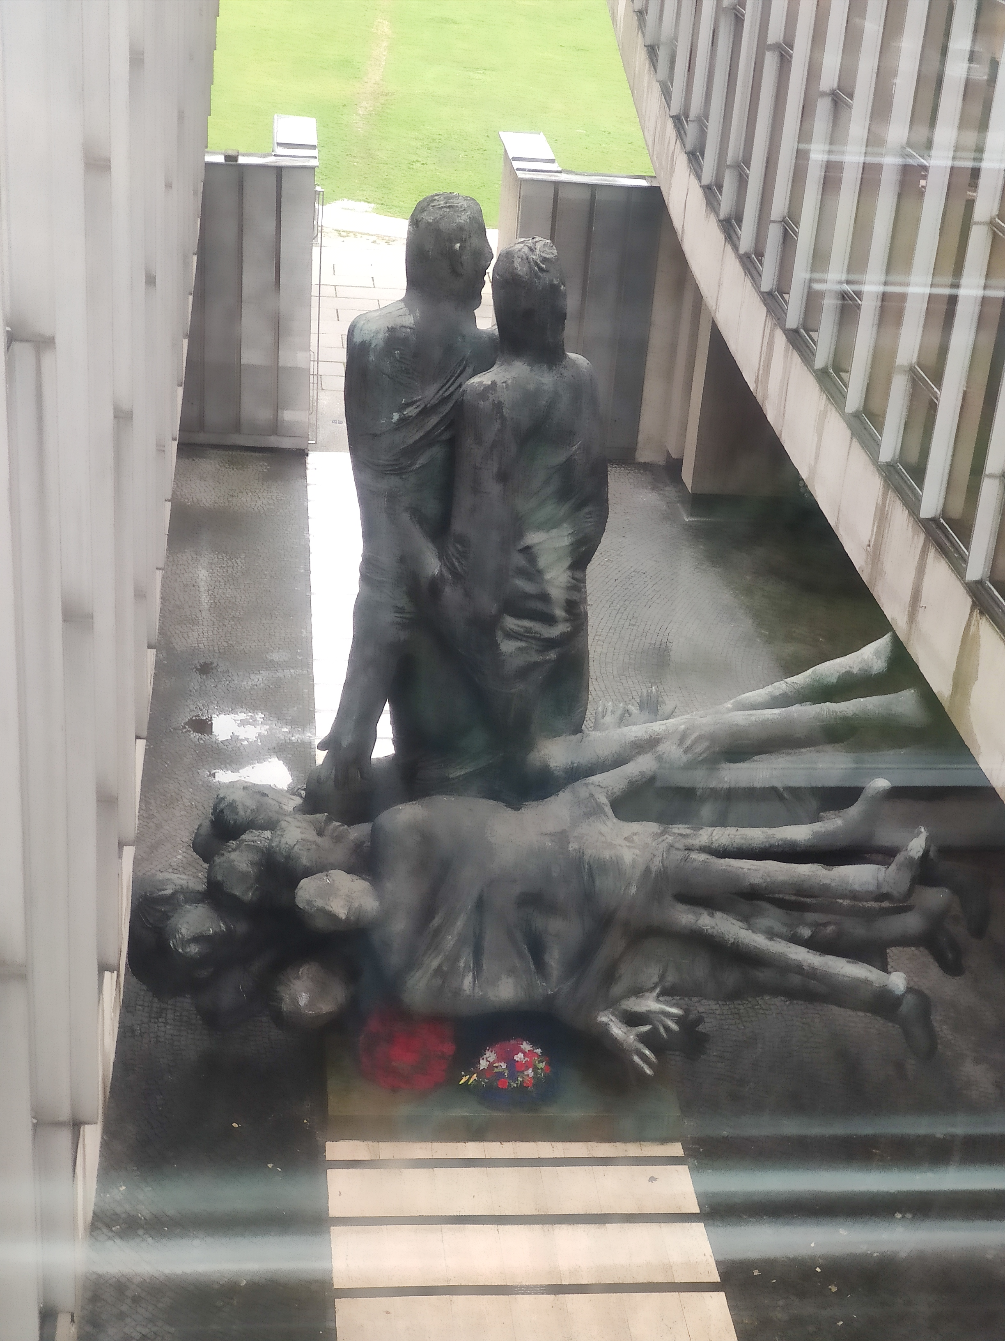
BANSKA BYSTRICA

Slide 22
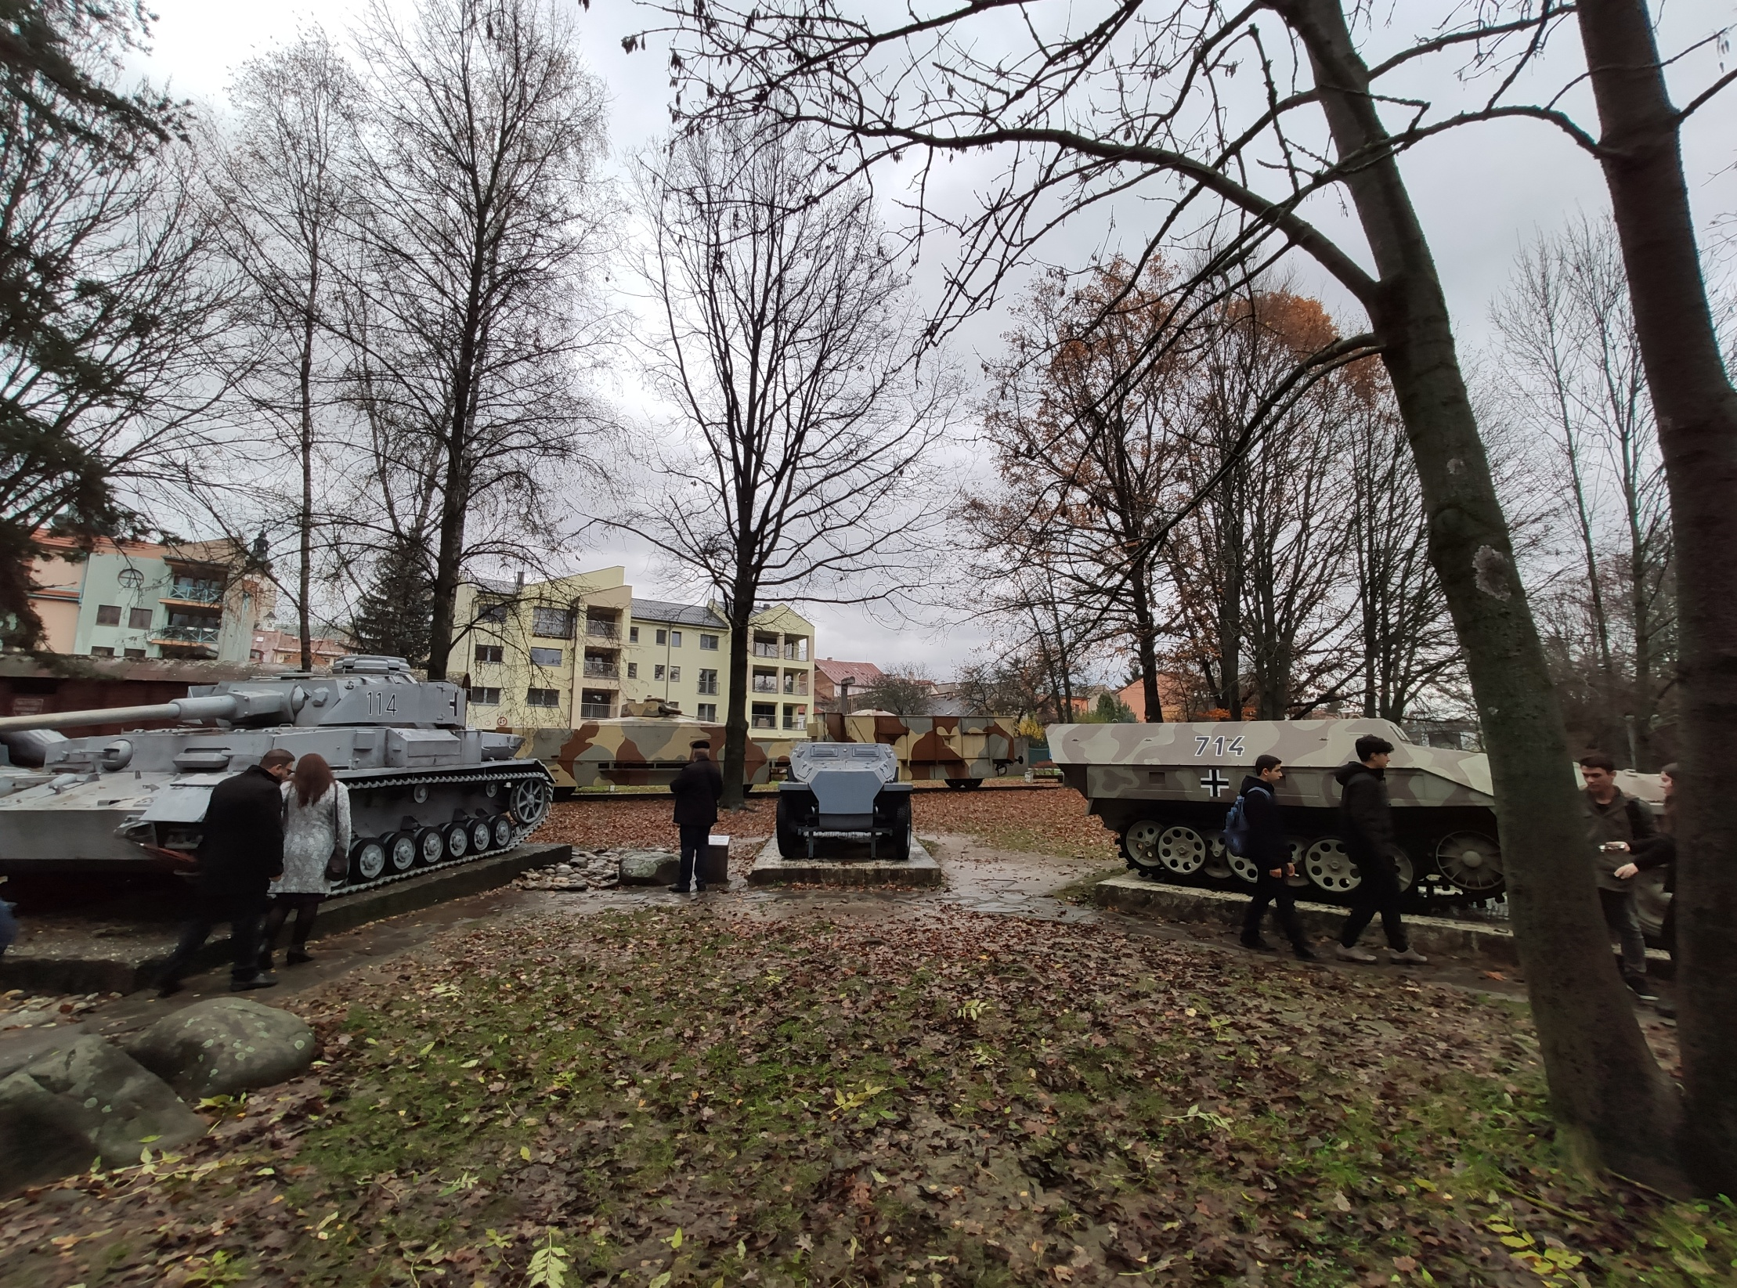

Slide 24
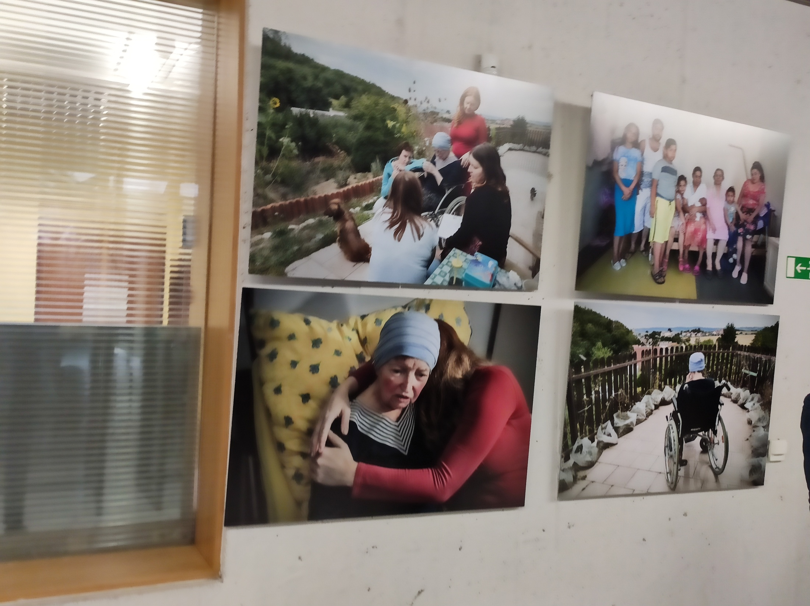

Slide 25
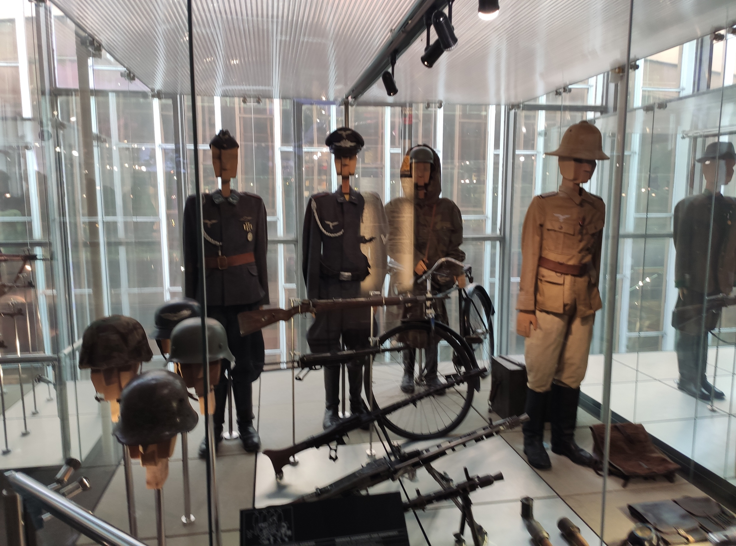

Slide 26
SERED NATIONAL HOLOCOUT MUSEUM

Slide 27
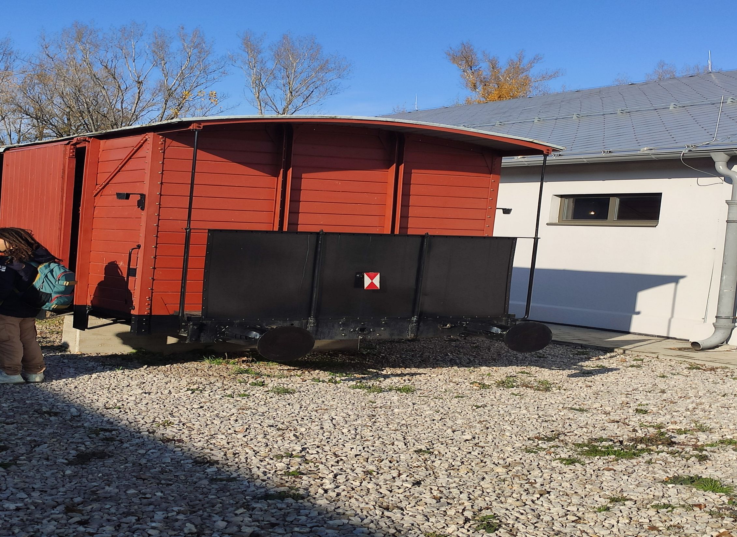

Slide 28
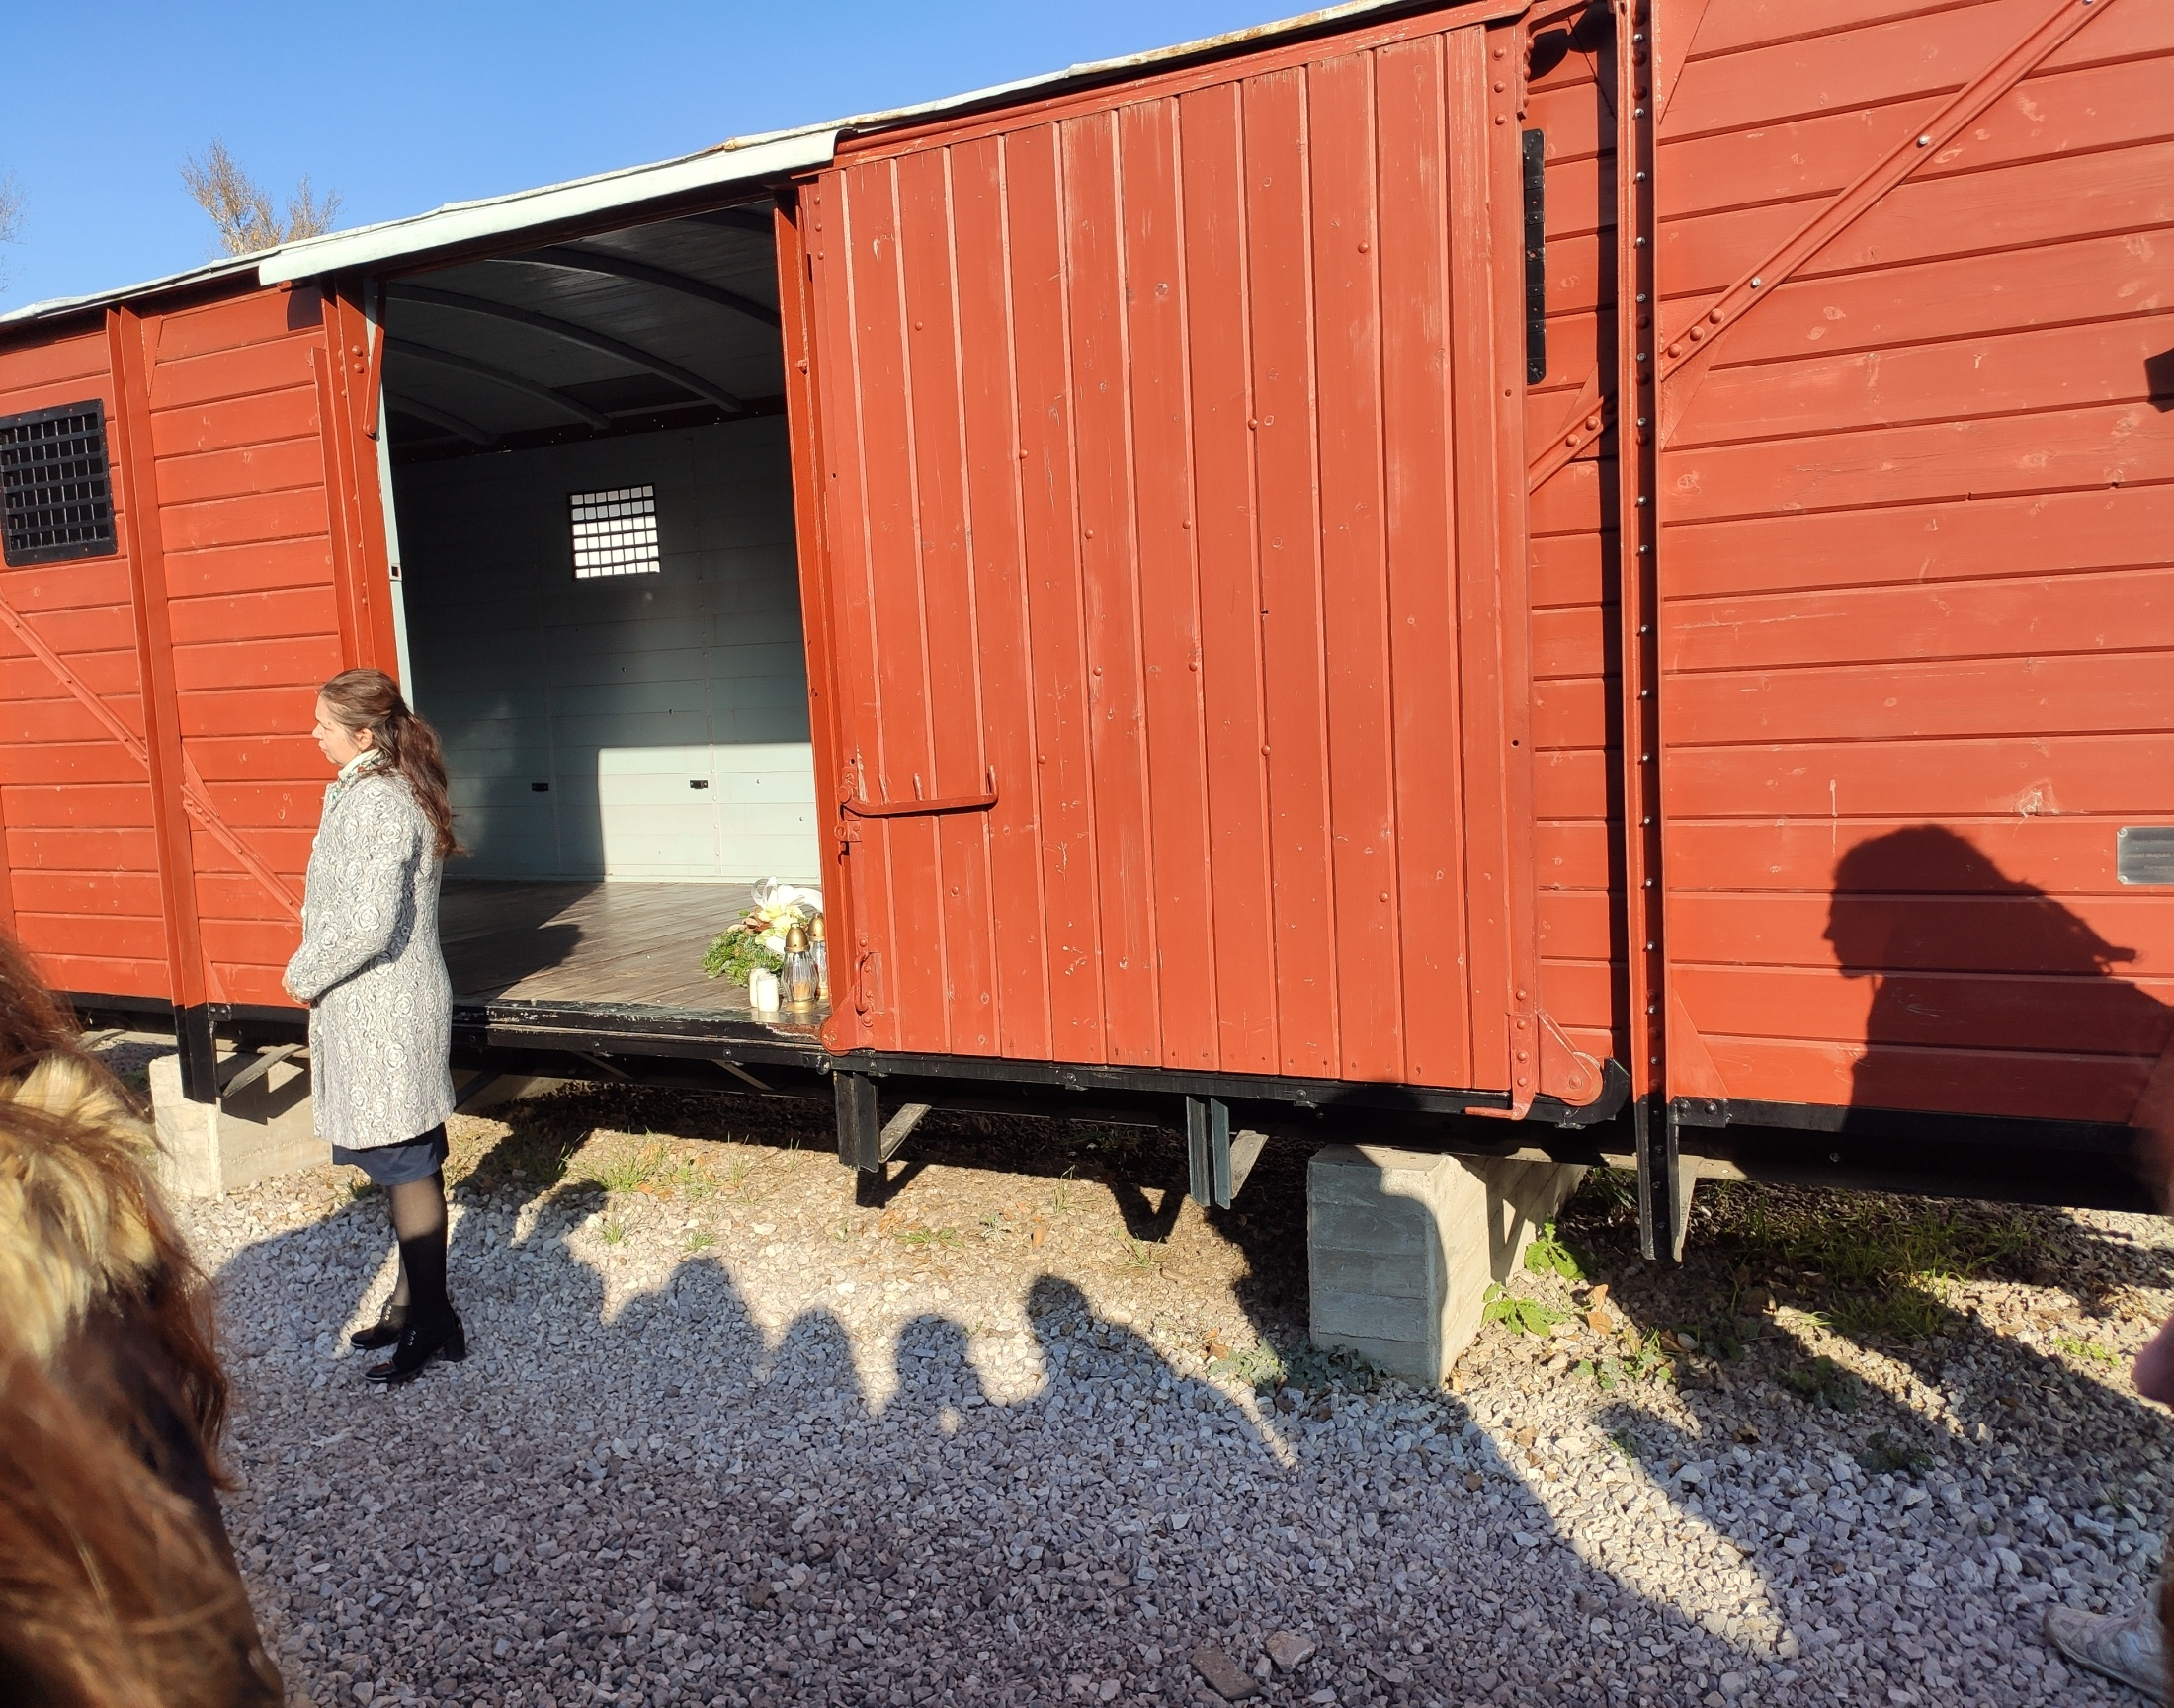

Slide 29
BLUE TEAM: ZEKI UGUR YILDIZ ABDULKADIR AYKUN OLAIA PENA FERNANDEZ ANICULAESEI ALEXSANDRU FERRARA ALESSIA MAJA BISTAKOVA STEVO MORONG PATRIK BRATEK ADAM ZAVIS

