Slide 1
WE ARE ALL HUMAN-BEINGS
Team Black

Slide 2
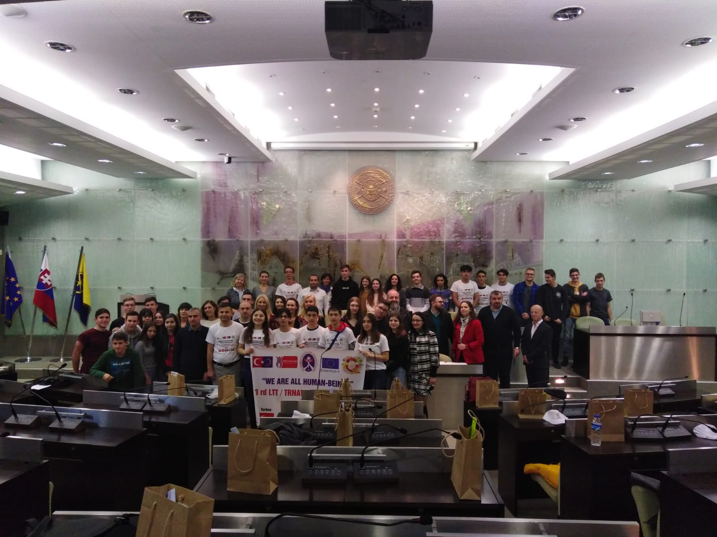
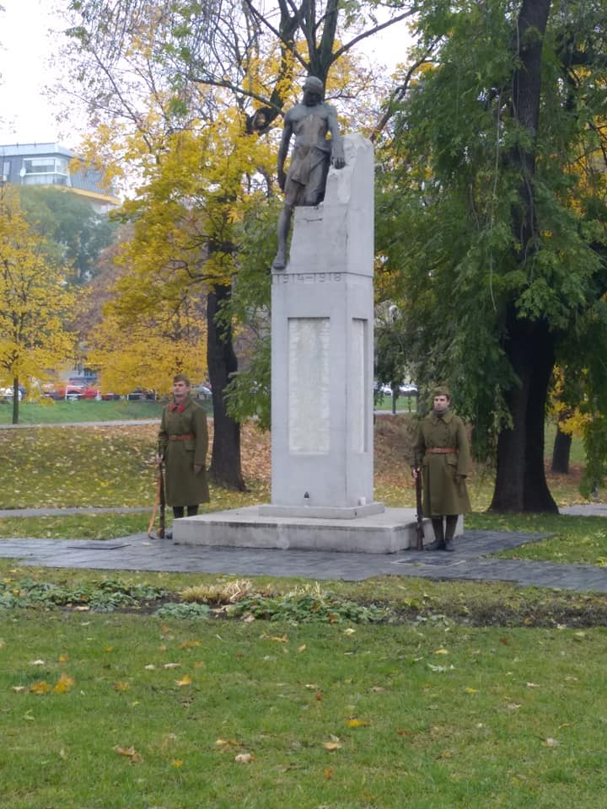
MONDAY
we were welcomed by the mayor of Trnava
Went to antifashist celebration
Had a school presentation with veterans
And had a welcoming party

Slide 3
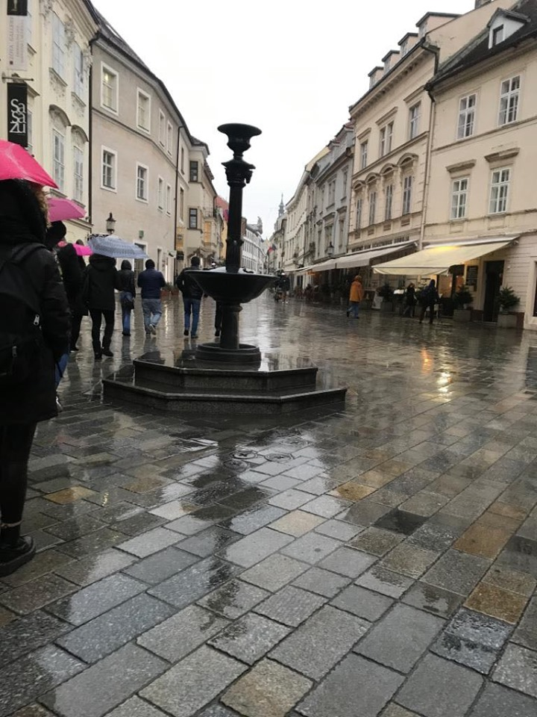
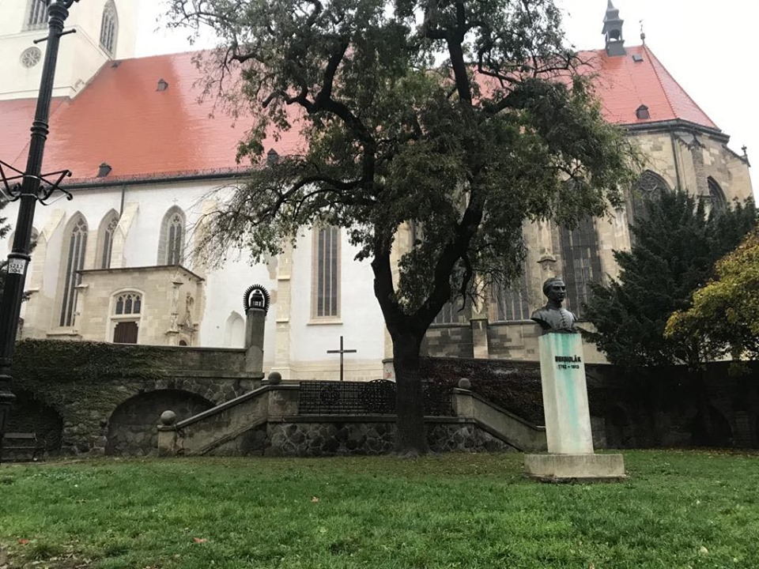
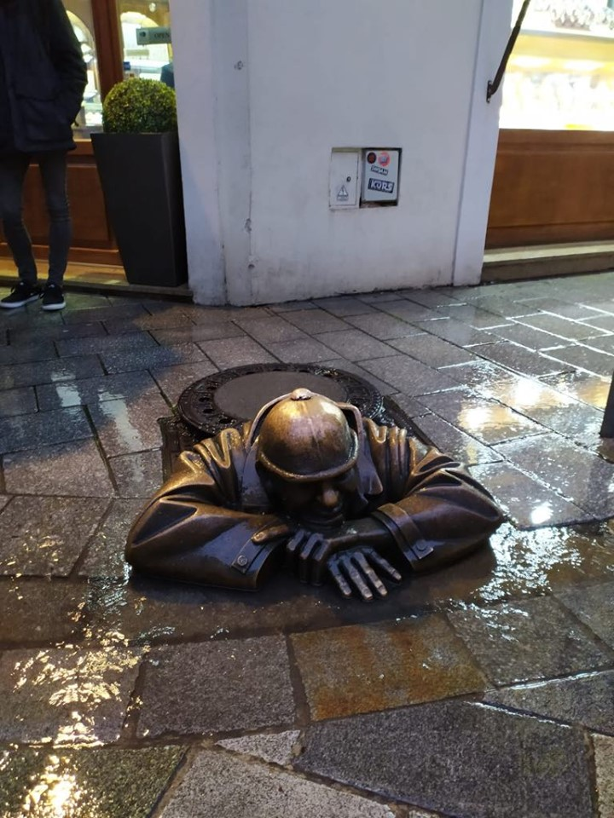
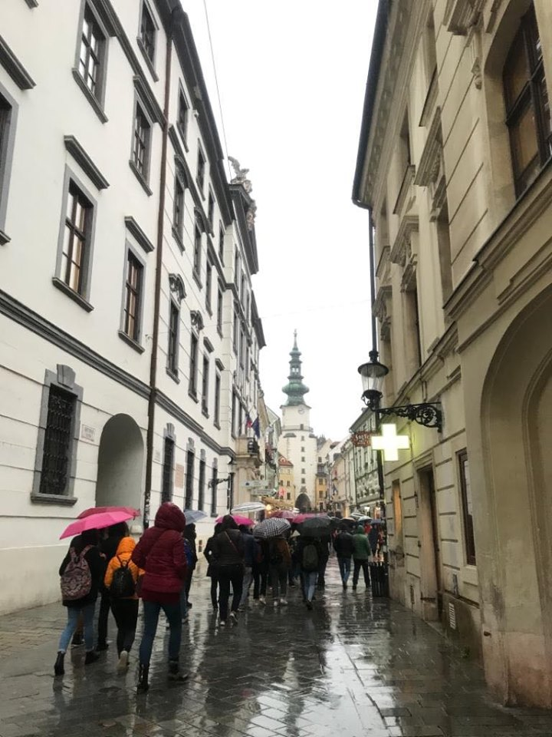
TUESDAY
We went to Bratislava
Had a meeting with General Pavel Macko
Had a sightseeing tour in Bratislava

Slide 4
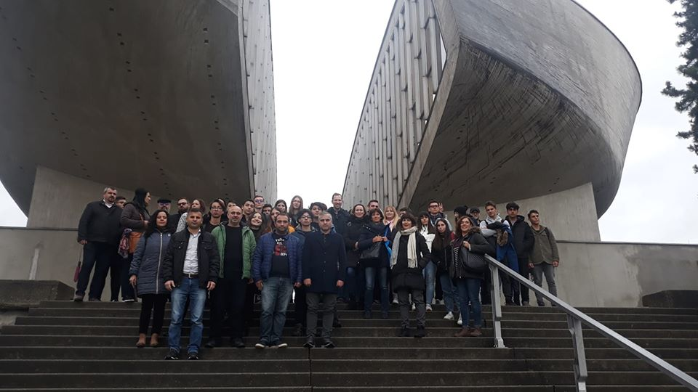
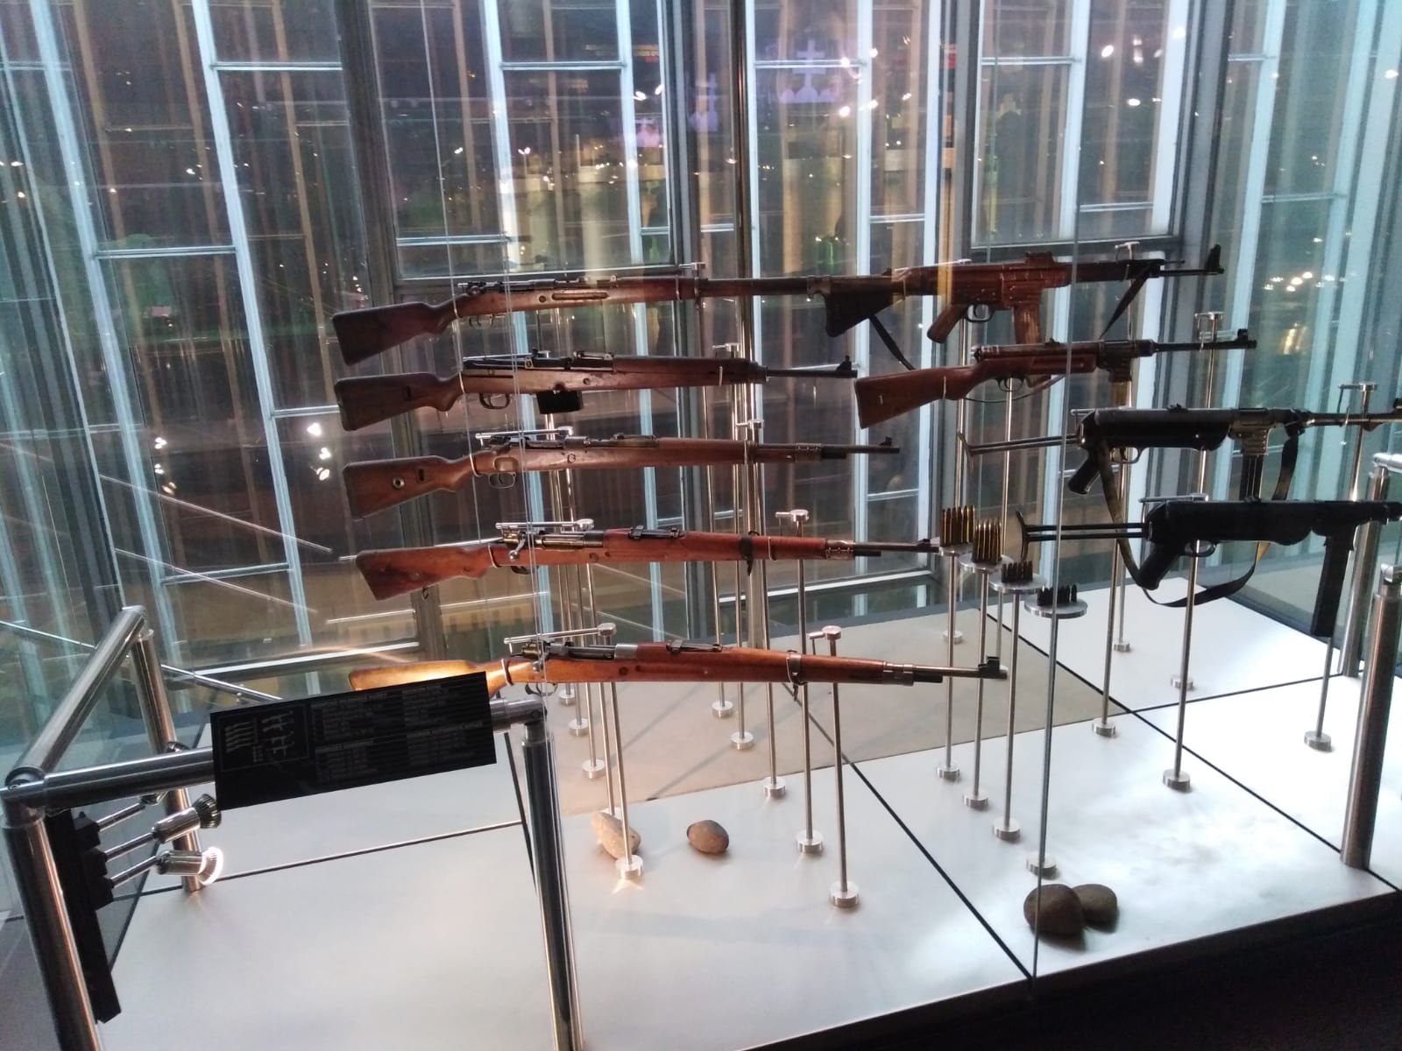
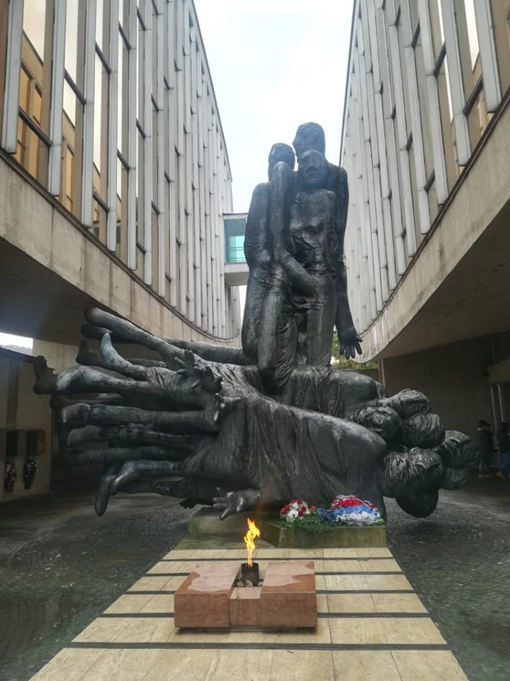
WEDNESDAY
We went to Banská Bystrica
We went to Museum of National uprising
We then had lunch at Eurovea

Slide 5
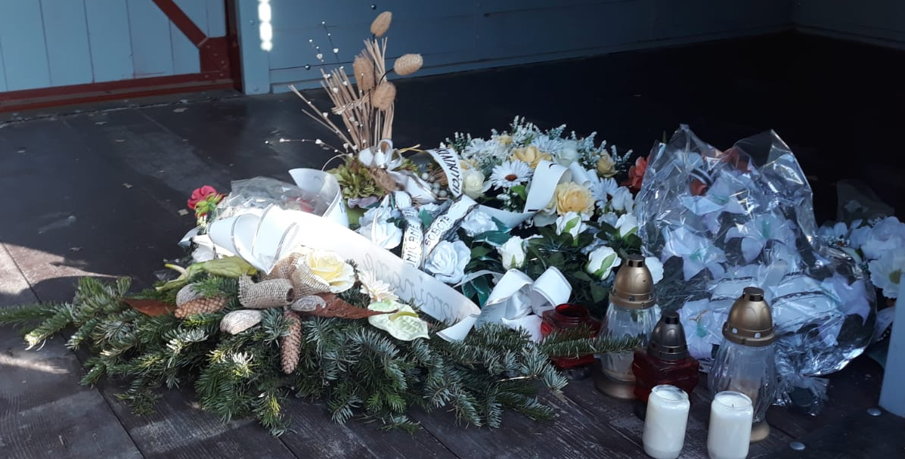
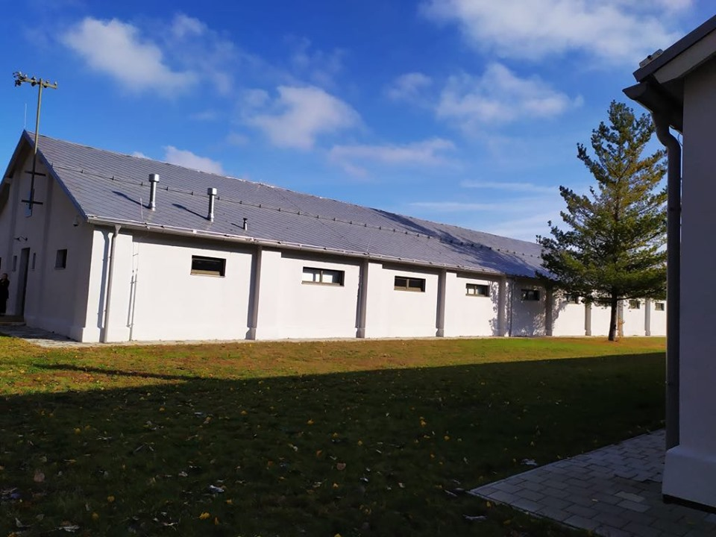
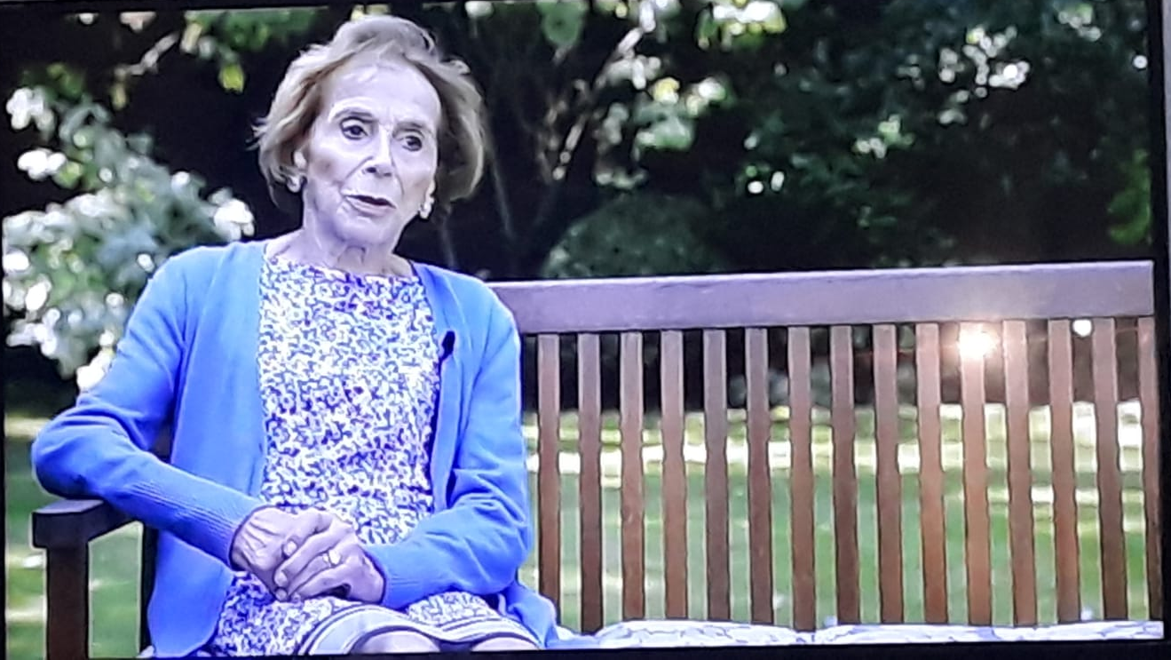
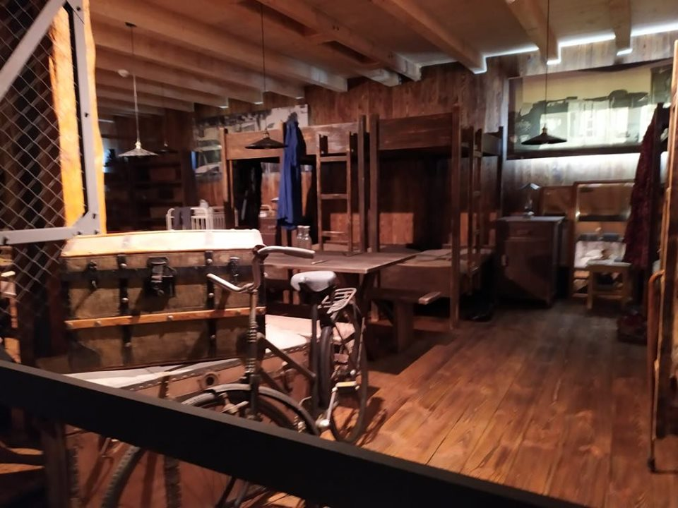
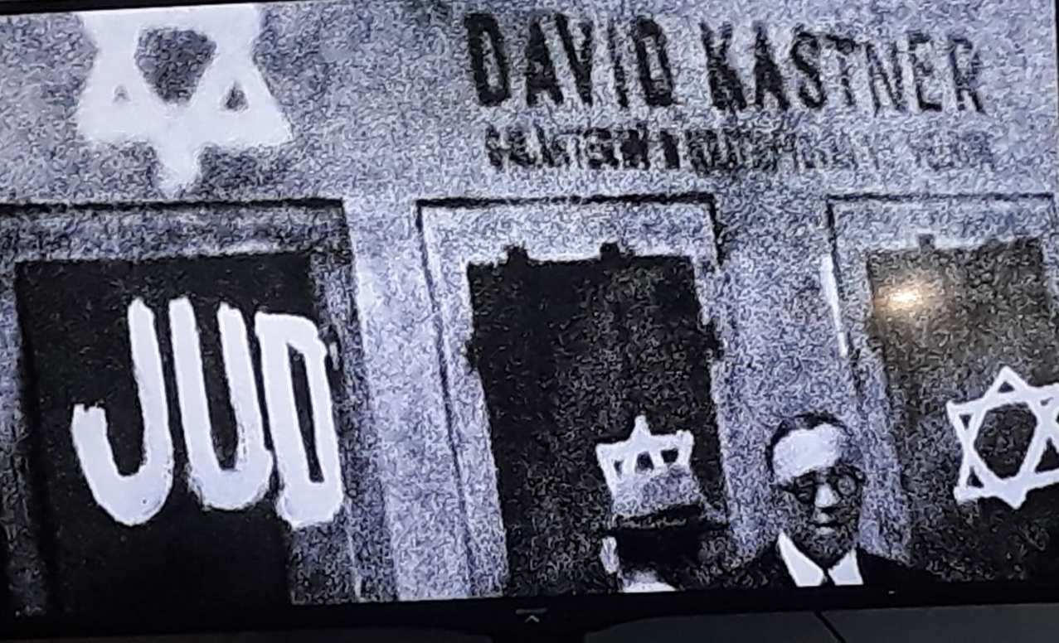
THURSDAY
We went to Sereď
To the National Holocaust Museum
Returned to Trnava
We then had sport activities in the school

Slide 6
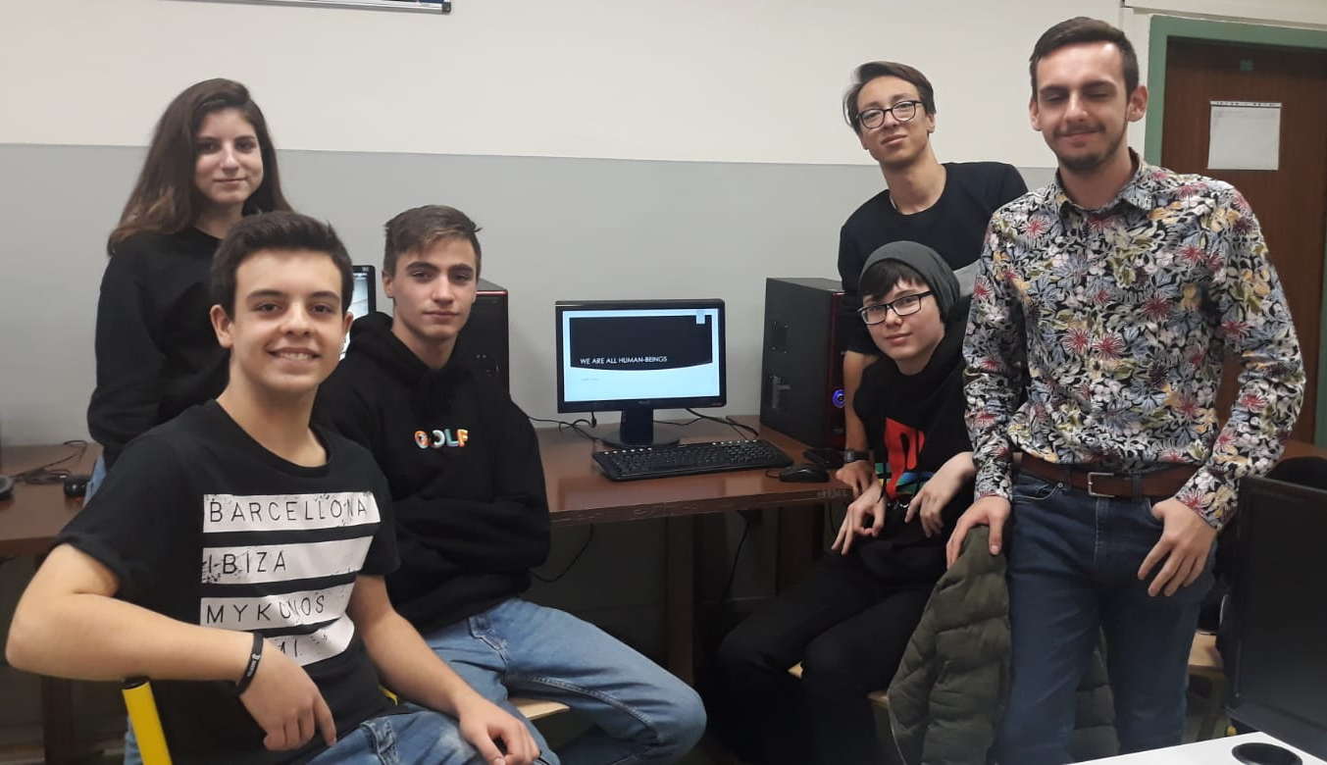
FRIDAY
Today we are making brochures

