Slide 1
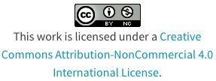
Education and School system in Slovakia

Slide 2
School types in Slovakia
State schools
Schools owned by Church
Private schools

Slide 3
Slovakia school types by levels
Kindergartens or pre-school education
(3-6 years)
Primary schools (6-15 years)
Secondary schools (15-19 years)
Universities (from 19)

Slide 4
Primary schools in Slovakia
Primary school education starts at the age of 6 years and is free and compulsory.
Primary school is divided into two stages. First stage lasts for four years (1st – 4th year of study). Second stage lasts for five years (5th – 9th year of study).
After graduating from the primary school children continue their study at secondary school after passing the entrance exam.
Students go to school five days a week, from Monday until Friday.
Marks are 1 to 5, 1 is the best.
Summer holiday in primary and secondary schools in Slovakia is from the 1st of July until the 31st of August. There is a few days holiday around Christmas and Easter, and on national holidays

Slide 5
Secondary School
There are a few types of secondary schools in Slovakia.
1. Grammar school: 4-8 years; provides general secondary education and prepares for further study at universities and other higher education institutions.
2. Specialized Secondary School: 4-5 years; provides specialized education and usually prepares students for further study at higher education institutions.
3. Conservatories: 4-5 years; special type of professional school providing specializing in fields such as Music, Singing, Dancing and Dramatic Arts.
4. Vocational School: 2-4 years; prepares students for careers that are based in manual or practical occupations.

Slide 6
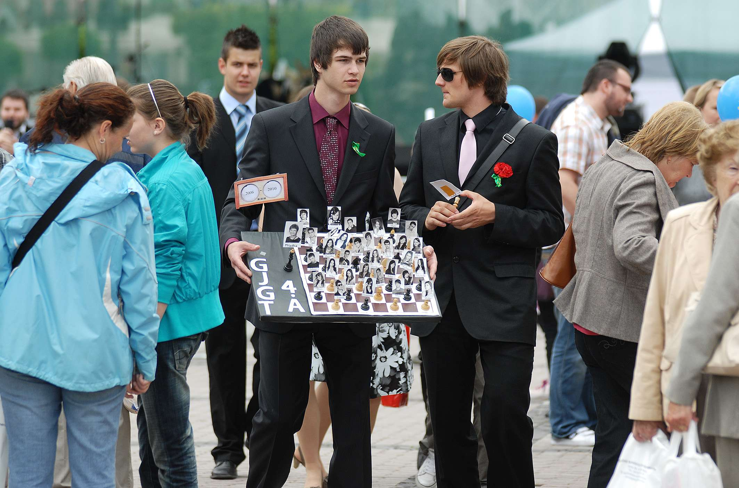
Learning system at secondary schools is similar to primary schools.
Lessons last 45 minutes and there are breaks between the lessons though usually longer than at primary school.
Students at secondary schools usually have 6 or 7 lessons per day.
Study at secondary school finishes with school leaving examination and students obtain maturita certificate.
School leaving examination consists of two parts, written and oral exam. After obtaining the maturita certificate, students can apply for higher education including University study.

Slide 7
Secondary Vocational School
There are two types of secondary vocational schools: secondary vocational schools and secondary specialised schools.
Secondary vocational schools consist of general education and vocational training and students regularly attend practical classes, training centre and real working places to learn practical skills in the given profession. Vocational education in Slovakia is offered in two, three or four years of study.
Secondary specialized schools specialize in branches such as health, economy, sport, art, agriculture, wood industry, pharmacy, chemistry, pedagogy, industry, hotel academies etc.

Slide 8
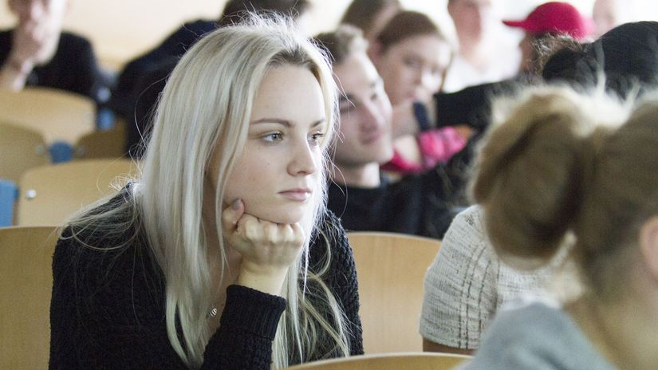
Universities in Slovakia
After secondary school graduation students can apply for a university study. To enter a university, students have to pass an entrance exam. Students are chosen based on the secondary study results and entrance exam results.
Full university education in Slovakia lasts five year, some faculties are organized in 6 year study, e.g. human medicine (MUDr.).

Slide 9
University study in Slovakia is organized in the following stages:
Stage one, bachelor study lasts 3-4 years and graduates obtain Bachelor title (abb. Bc.).
Stage two usually lasts 2 years and graduates obtain the following titles:
Master (abb. Mgr.)
Engineer (abb. Ing.)
Doctor title is based on studied branch (MUDr...)

Slide 10
List of universities in Bratislava:
Comenius University in Bratislava –13 faculties, main university in Slovakia - www.uniba.sk
University of Economics in Bratislava - economics and business studies - www.euba.sk
Slovak University of Technology in Bratislava – technology studies - www.stuba.sk
Slovak Medical University in Bratislava - www.szu.sk
Academy of Fine Arts and Design in Bratislava - drawing and sculpturing school studies - www.afad.sk
Academy of Performing Arts in Bratislava - theatre and music studies - www.vsmu.sk
Police academy in Bratislava - apz.minv.sk

Slide 11
Thank You for your Attention
Slovak team

