Slide 1




‘
Welcome

Slide 2
Me
Us
Danny Lyttle
Willie O Donnell
Martin Peoples
Head of Technology Enhanced Learning & Support

Slide 3




You
Clydie Loza
Daniel Lagier
Loredana Matarrese
Giovanna Vurro
Lilian Boniface
Kemuel Mothomora
Mirna Dantin
Camilla Gentile
Martina Meo
Rossana Valenzano
Małgorzata Szpakowska
Mariola Plaugo
Monika Kucerkova
Peter Baranik
Martyna Musiał
Aleksandra Szpakowska
Szymon Kolendo
Matej Kopecký
Róbert Čapla

Slide 4
Me
Move people around

Slide 5
Me
Turn to the person on your right
Find out 3 things about them
Favourite hobby
Favourite app
Something that annoys them/Pet hate
Google Translate

Slide 6
Who will start?
https://wheelofnames.com/

Slide 7
Me
WiFi
Guest usernames

Slide 8
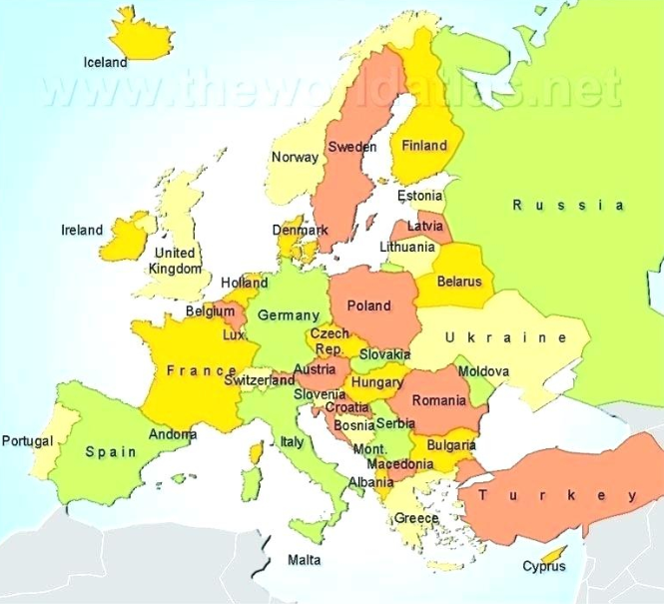
Professional & Technical Education and Training
We are here

Slide 9

Where we are
1
2
1. Limavady – 2 campuses
3
2. Derry/Londonderry – 2 campuses
3. Strabane
Derry/Londonderry

Slide 10

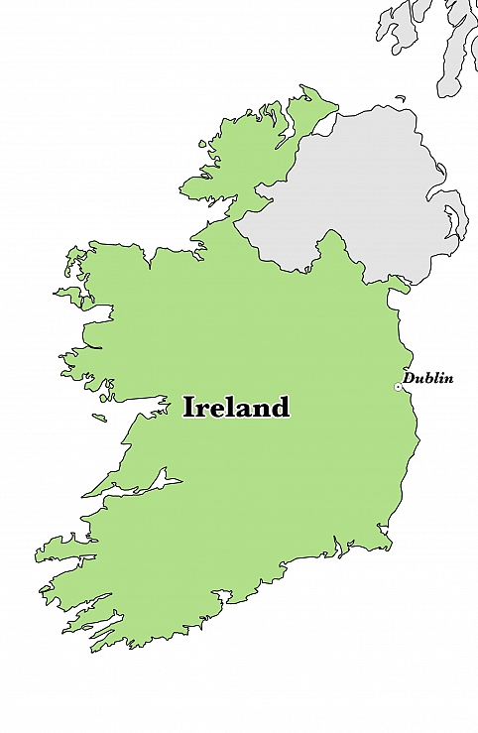
Brexit

Slide 11
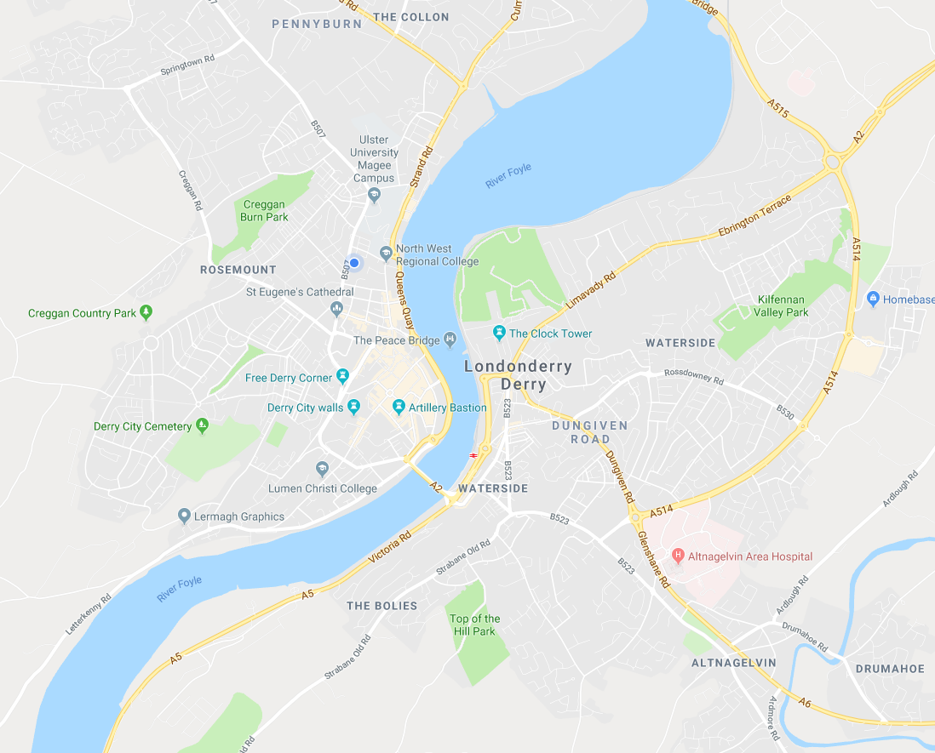

Slide 12
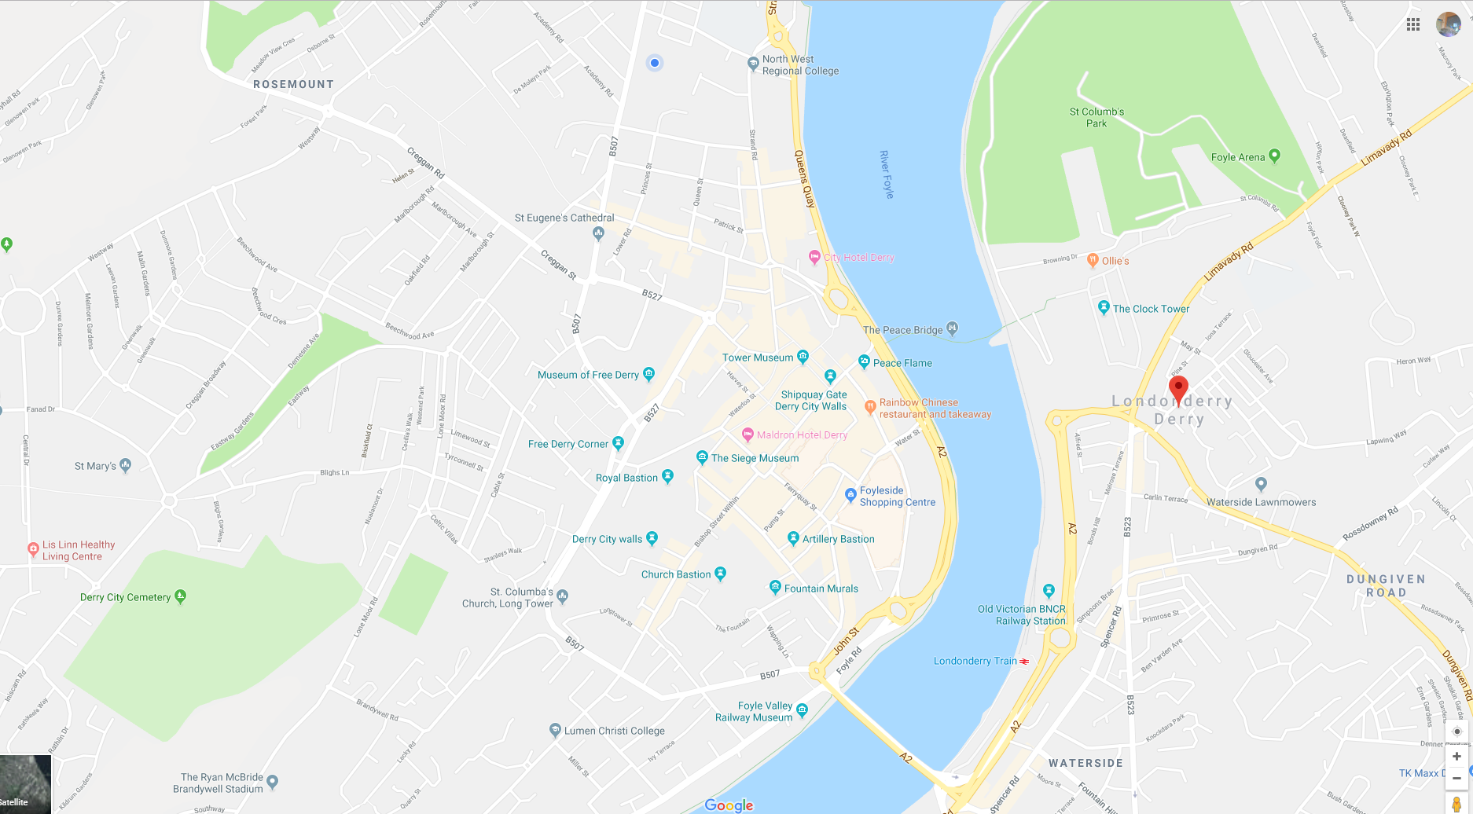
Cityside
Waterside

Slide 13
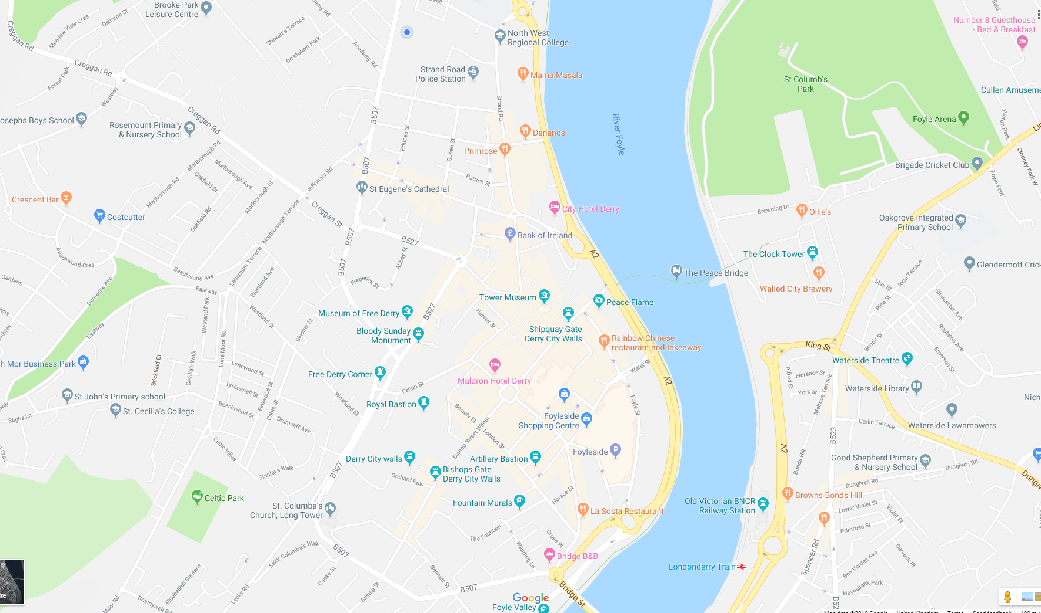

Slide 14
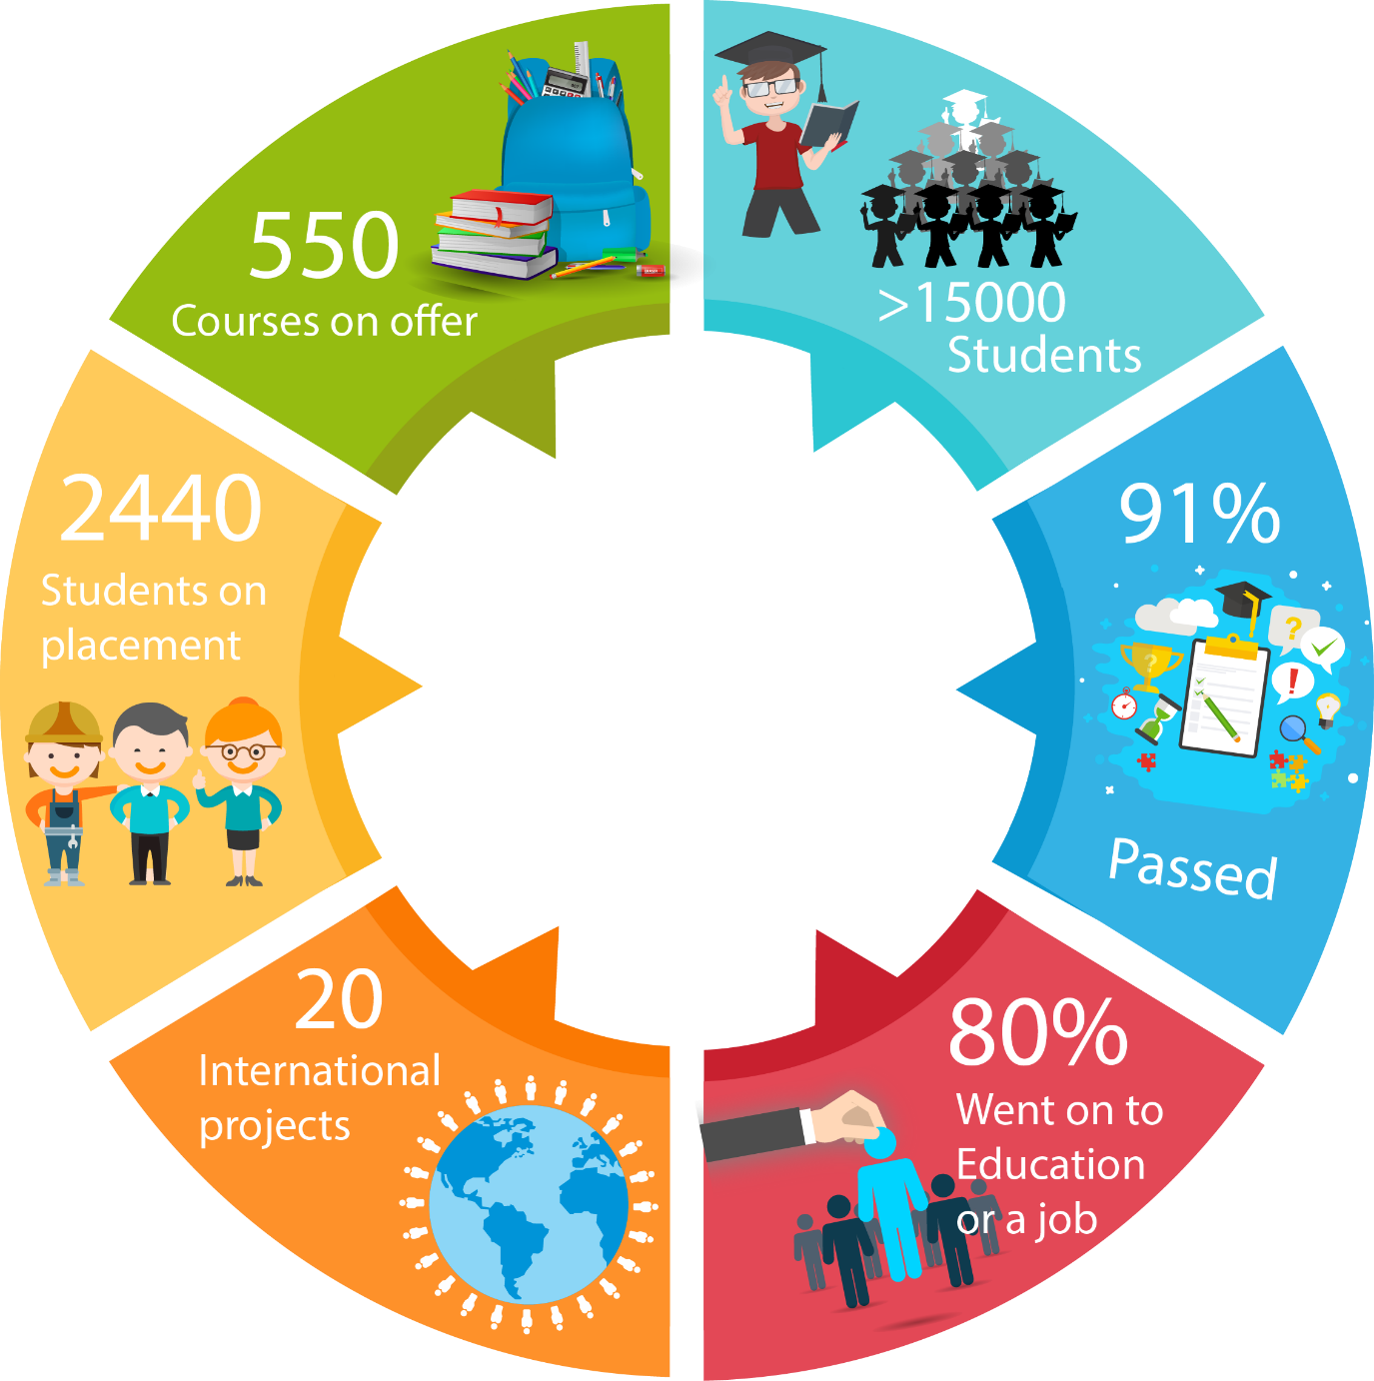
Us

Slide 15
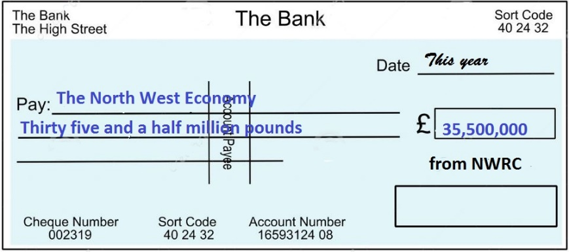


What We Give Locally
790
Jobs
£18m
in wages into local economy
4,000 full-time
11000 part-time

Slide 16
Student Options - Subjects
Business and Administration Catering, Hospitality and Tourism
Computing Health and Social Care
Mechanical Engineering Electrical & Electronic Engineering
Early Childhood Studies Interactive Media
Fashion and Textiles Fine Art
Hairdressing and Beauty
Music, Music Production, Performing Arts
A range of Professional Qualifications, many part-time
Construction and the Built Environment, Construction (Civil Engineering)
Creative Media Production (moving image or journalism options)

Slide 17
Student Options - Education Pathway
Honours Degree
Foundation Degree
Higher Level Apprenticeship
HND/C
Level 2 or 3 Diploma
Apprenticeship
Traineeship
NVQs

Slide 18
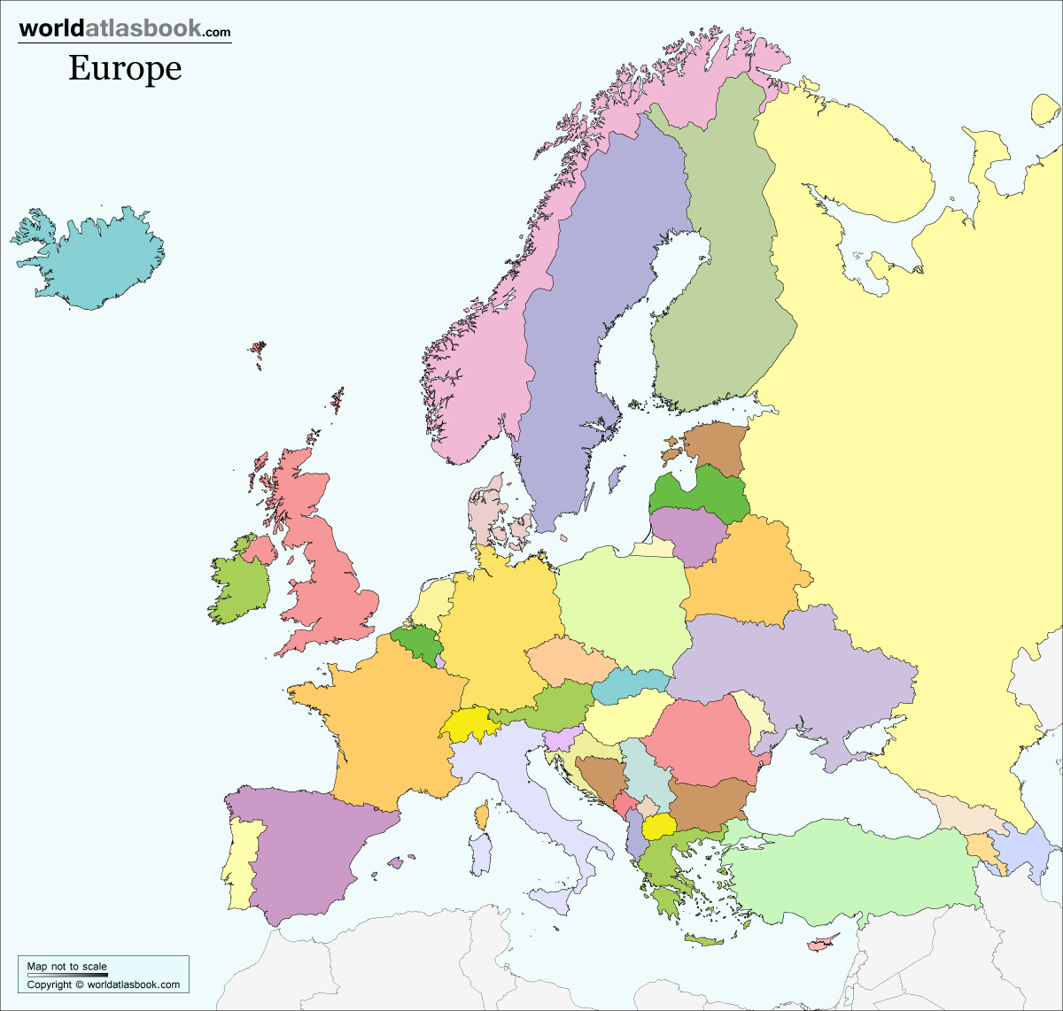

We Excel at Collaborating – NWRC Global
Projects Across Europe
1m annually
Internationally…
US – Boston &
Philadelphia
India (Gujarat)
China (Dalian)
South East Asia

Slide 19

Supporting the Economy in the North West
500+
Companies supported annually
£1.9m
Funding in innovation projects
Innovation vouchers
KTP
Fusion
Developing Academies:
First Source
Bemis
Welding Academy
Software Testers
Innovation

Slide 20
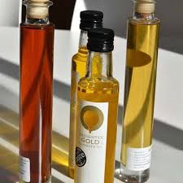
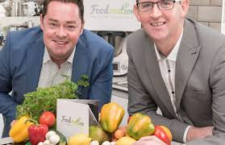


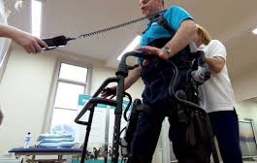

Real Support for Business
We help Businesses - Innovation Campus
Design and Innovation
for Assistive Living

Slide 21




Our Technologies
20 technology staff
4000+ computers
Driving excellence in learning, teaching and management, through technology
120 servers
500+ tablets

Slide 22





Creating More and Better Jobs
Excellent Preparation for the World of Work
workshops
Mentoring
Training

Slide 23
What Can We Do For You?
Our Experience

Slide 24




What Can We Do For You?
Global and local

Slide 25
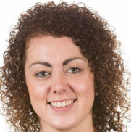
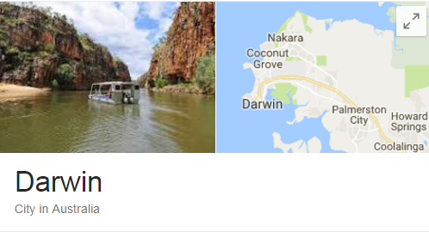
Aspired, Experienced, Achieved
HND Building Studies, NWRC
BSc Civil Eng, Open University
Sinead Deeney
Civil Engineer
Varied exciting projects
Chair – Women in Engineering
Sinead says:
“Every module I studied at NWRC I have used in some respect in my career, many on a regular basis. The HND was such a good stepping stone for me.”

Slide 26
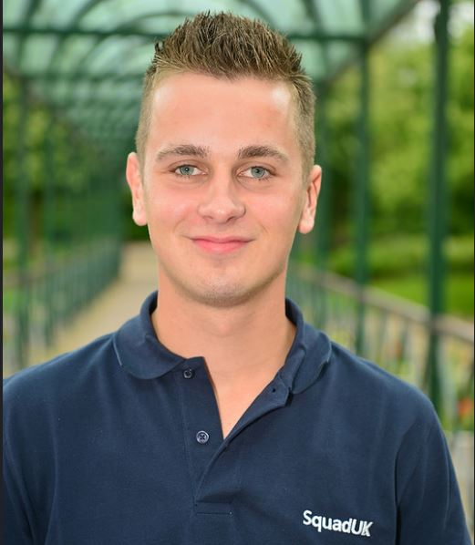

Aspired, Experienced, Achieved
NVQ L3 Wood Occupations at NWRC
Employed by J&R Snodgrass
Photo
Cameron Nutt
Won “UK’s Best Young Carpenter”
Representing Team UK, Worldskills
Image

Slide 27
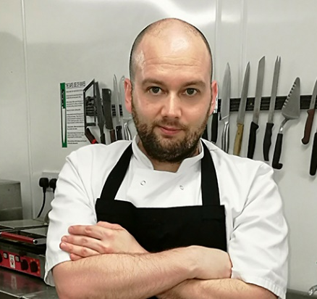

Aspired, Experienced, Achieved
Foundation Degree Hospitality & Tourism Mgt
Photo
BSc International Hospitality Mgt (Ulster)
Aaron Mc Devitt
Head Chef at The Lazy Gardener
N
O
W
PT Lecturer at NWRC
Image
Aaron said that his life changed forever when he discovered the Foundation Degree in Hospitality and Tourism Management at NWRC.
“You’re never too old to return to education. You are never finished learning. I always knew that I wanted more and that’s what I got.”

Slide 28
What to see in Derry

Slide 29
Questions

Slide 30
Thank you

Slide 31
Test –
what do you know about us
Go to https://kahoot.it/

Slide 32
Tell us your story
Using Adobe Spark
Spark example

Slide 33
Mirna
Kemeul
Lilian
Martyna
Aleksandra
Szymon
Camilla
Martina
Rosanna
Matej
Robert

