Slide 1
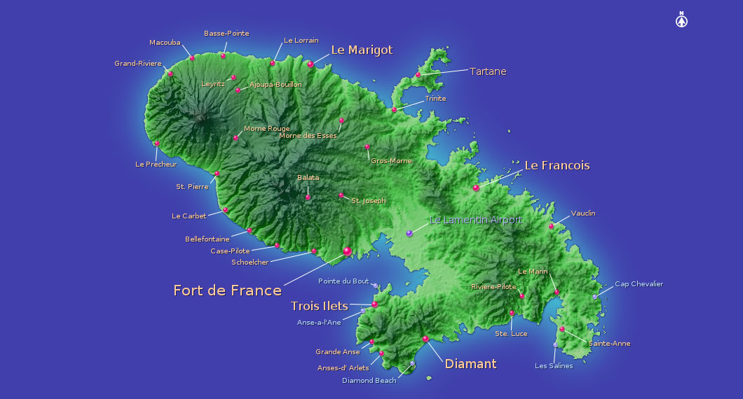
History of Martinique

Slide 2
SUMMARY
GEOGRAPHICAL LOCATION
ORIGINS AND FORMATION
POPULATION
SETTLEMENT
REVOLTS
DEPARTEMENTALIZATION

Slide 3
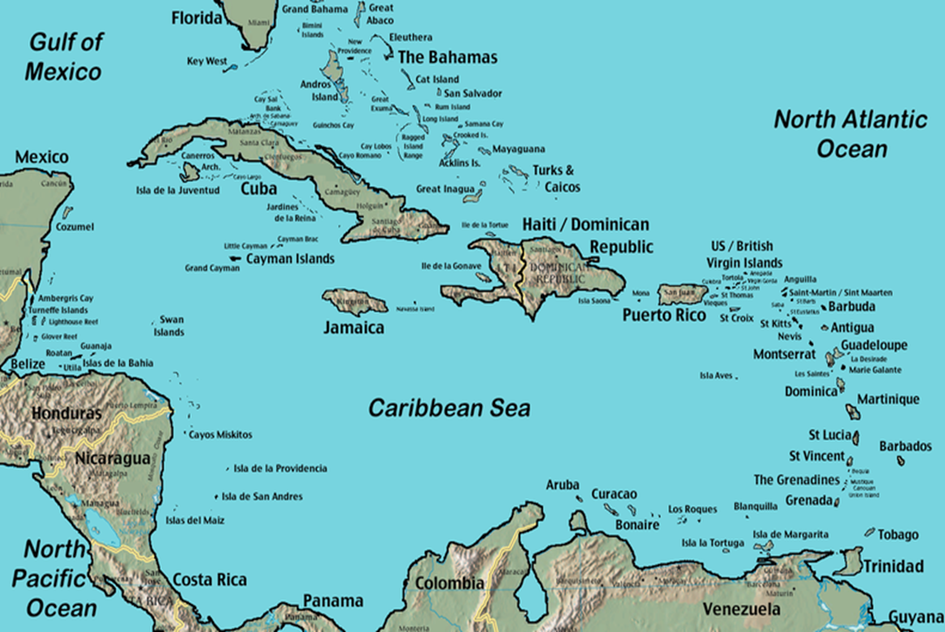
GEOGRAPHICAL LOCATION
Martinique is a part of the West Indian archipelago which consists of Greater and Lesser Antilles. We say that Martinique is well located in the West Indian Bow, because it is in the center.

Slide 4
Martinique is a volcanic island, it surfaced because of a submarine volcanic eruption.
ORIGINS AND FORMATION

Slide 5
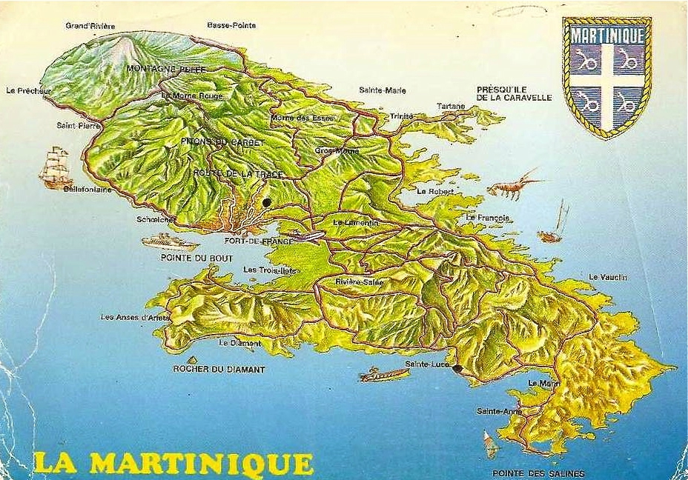
It subsided at the level of the Caribbean Sea. So formed the North (of the Prêcheur in the Gros-Morne), the center (Lamentin, Fort-de-France and Robert) and the South (of Rivière-Salée to saint-Anne).

Slide 6
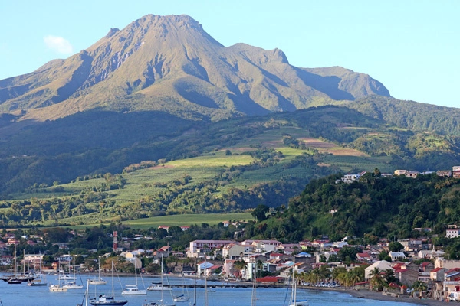
Here is a classification of the mountains of Martinique, from the oldest to the youngest.
The old Mount Pelée of 392 000 000 million years and measures 4583 meters.

Slide 7
Mountain of Vauclin 9 000 000 of years

Slide 8
Pitons of Carbet 16 000 000 of years

Slide 9
And finally the Rock of the Diamond 3 000 000 of years

Slide 10
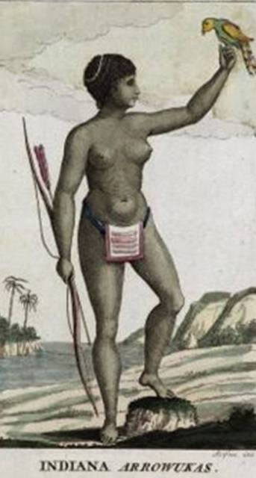
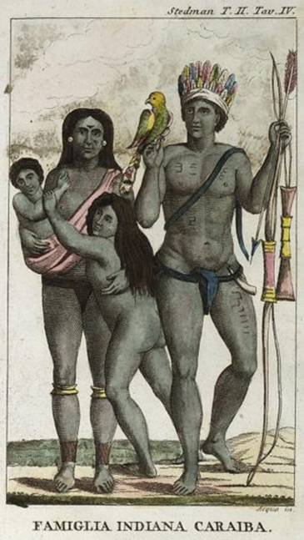
The first population of Martinique were the Amerindians, called “The Arawacks ". They were peace-loving people(that is they were farmers, hunters(fighters), ect).
POPULATION

Slide 11
Then came the Carib Indians (coming from the Americas), who were warriors.

Slide 12
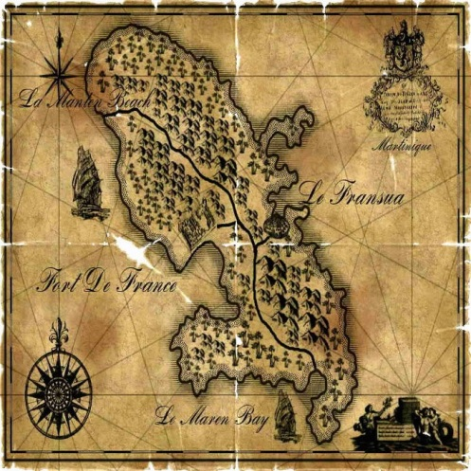
The Carib Indians exterminated the Arawacks men and kept the women and female children . That's why Martinique was called before " the island of the women ". And it was the reason why Christopher Colombus called it "the island of the flowers " (flowers symbolized the women).

Slide 13
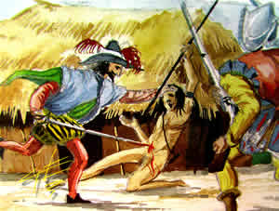
In 1635 the first Europeans settled down durably in Martinique and exterminated the Carib Indians, because these last ones did not want to work.
SETTLEMENT

Slide 14
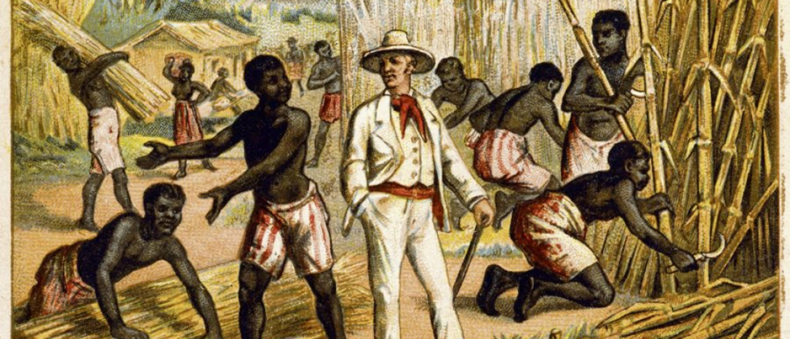
Then a slave trade began that will last 400 years.
During this period black people were under the authority of the colonists and their life expectancy was depending on them.
Black people were cultivating, serving the colonists and were only mistreated in return.

Slide 15
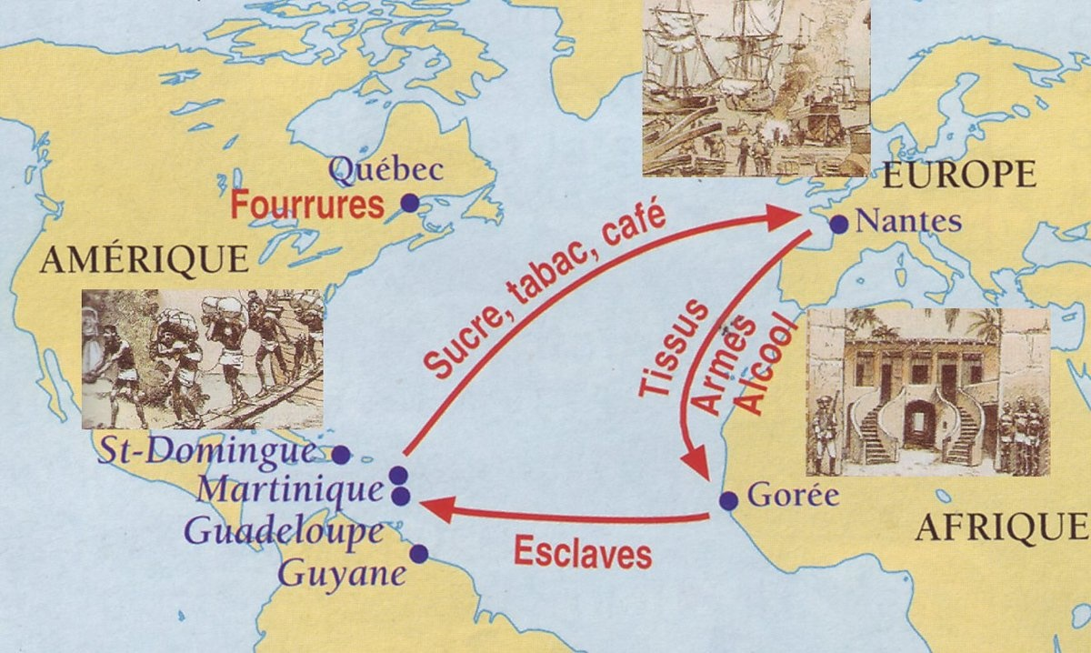
This trade / business consisted for France to exchange weapons and jewels against African people. Those African were sent to the Caribbean and worked as slaves. They produced sugar cane, cocoa which were sent back to France.
THE TRIANGULAR
TRADE

Slide 16
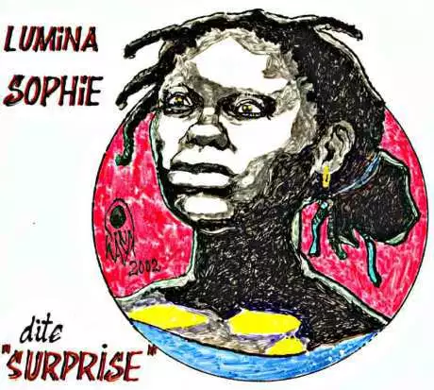
However, some black revolted as:
Lumina Sophie (1848-1879): she rebelled against the segregation and the racism persisting in Martinique after the abolition of slavery.
REVOLTS

Slide 17
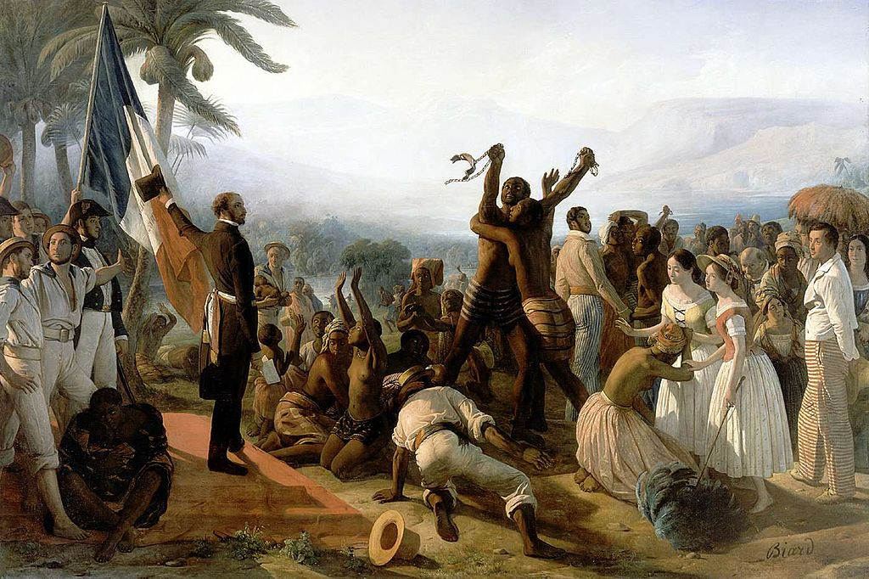
The affair big Handle Between 1831 and 1833: Evolution of the men(people) of free colors
The affair Romain between May 20th and 22nd
And finally, The decree of Vicor Schoelcher which ended slavery on May, 22nd 1848.
May 22nd is a national holiday for us.

Slide 18
French oversea department Special territory of the European Unions
DEPARTEMENTALIZATION
. In 1946 Martinique stopped being a colony and became a French department .
We have the same status as any other department on the French territory: la Loire, la Moselle, la Bretagne etc…
So we are also part of the European Union

Slide 19
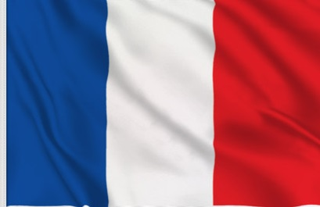
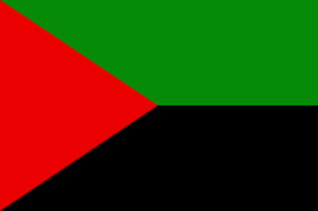
Martinique has several regional flags, but only the french national flag has official status

