Slide 1
Using Cardboard
GOAL Erasmus+

Slide 2
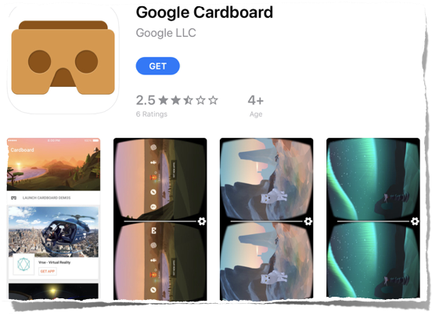
Step 1: find an app
on Play Store
on App Store
install it

Slide 3
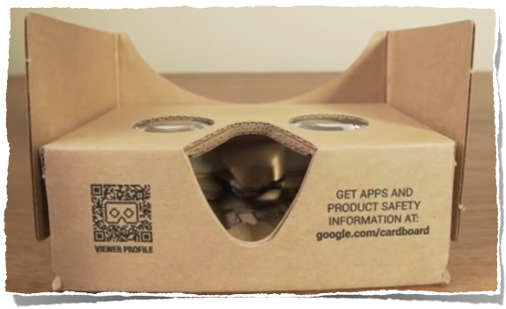
Step 2: buy Cardboard
from Google
or any VR glasses

Slide 4
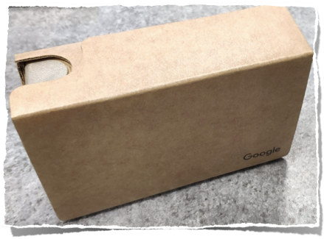
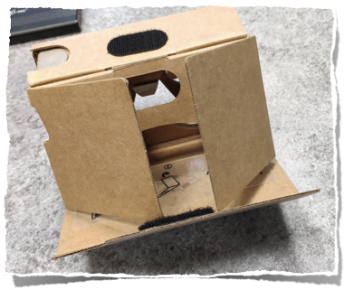
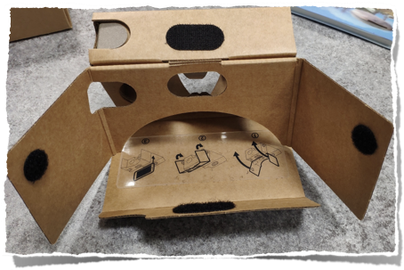
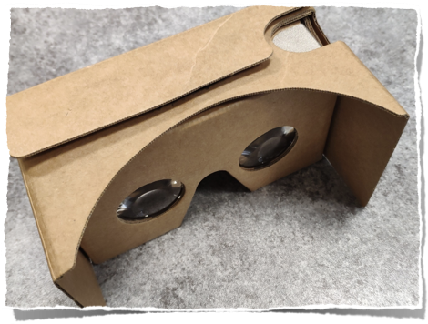
Step 3: built it

Slide 5
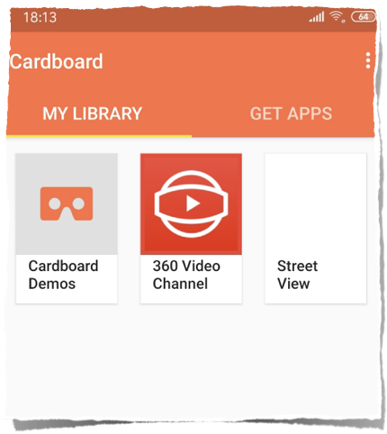
Step 4: run app
choose from 3
Demos
360 Video channel
Street view

Slide 6
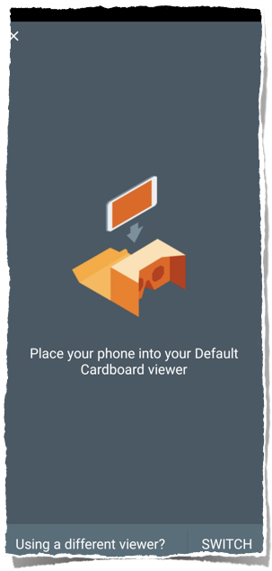
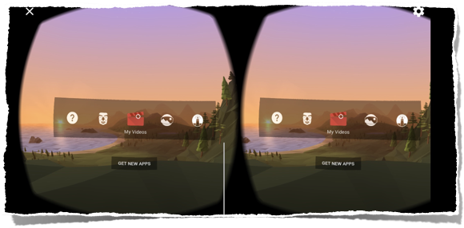
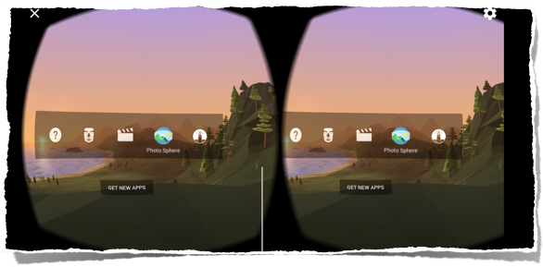
Demos
put phone inside
you can see your photos or videos in VR
or Arctic Journey

Slide 7
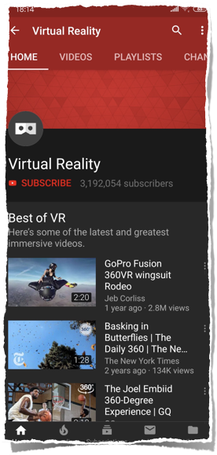
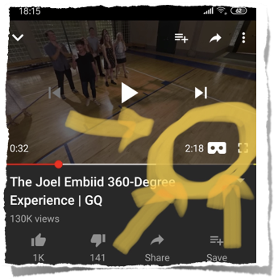
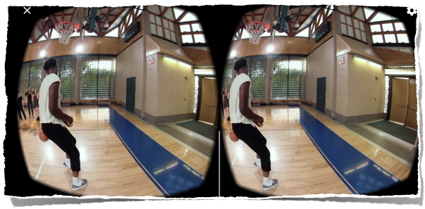
360 Video Channel
is in fact Youtube channel with VR videos
choose video
activate Cardboard mode
put phone inside
enjoy

Slide 8
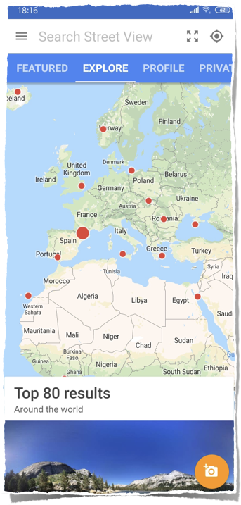
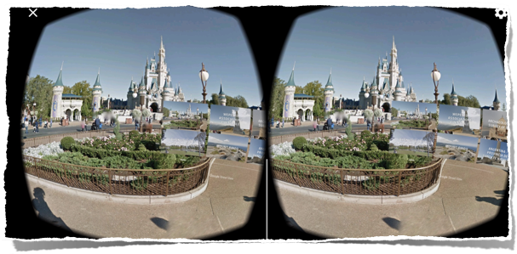
Street view
is in fact from Google Maps
Not all places for now
choose and Go!

Slide 9
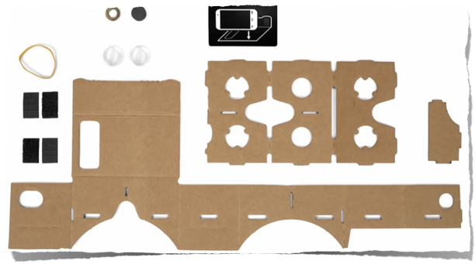
Other sites
You can use Cardboard on every
website with VR or 360 videos or photos.
Just activate Cardboard Mode, choose your phone and Go!

Slide 10
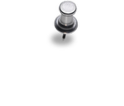
Thanx 4 watching.
Slovak Goal Team.

