Slide 1
GOOGLE NEWS 2019

Slide 2
Google conference 2019
Starts 7 May
Ends 9 May
Opening keynote is the most exciting part
Google makes these big announcements:

Slide 3
Google News
News results will soon begin to show a "story timeline"
When you search for the recent black hole news story that went viral, you'll see how it was covered from day one
The point of this is to give you more context and visually show you how the story evolved over time

Slide 4
Google
search
Adding 3D images to search results
You can even place these 3D images in your real world via augmented reality
Google showed how you could search for a Great White shark with your phone, then see it in 3D in your search results, and using your device, place it in a physical space at scale

Slide 5
Google Lens
Will also be available directly from the Google Search bar
Language translations:
Able to access it to take a picture
Get a real-time translation in a different language
Also hear a text-to-speech translation live

Slide 6
Google
Lens
Restaurant menus:
Can search for exact dishes on a menu and surface photos of that dish
Based on Google Maps information
Show you just how it looks before you order
Hovering Google Lens over magazines can also bring images to life, such as a recipe
You can also point the camera at the receipt to bring up a calculator

Slide 7
Google Duplex
Do stuff for you on the web
From booking rental cars
To getting movie tickets
Just ask Google
It will fill out the form
And do everything

Slide 8
Google Assistant
Needs less data to process voice commands
Moved to the device, rather than in the cloud
Lower latency
Without delay - and without saying "OK Google" every time
Opening a range of apps
Getting information
Happening instantly as part of one conversation
Use voice to reply to a message, send it, open photos, search, pick a new image, and send that over to the person you're messaging

Slide 9
Driving Mode
Google Assistant is also getting a driving mode
To any phone that has Google Assistant

Slide 10
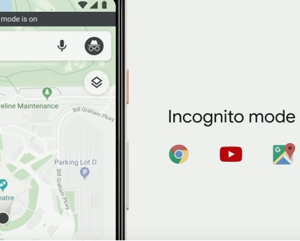
Google Maps
Soon gain an Incognito mode
For more private searches
Available for both the web and on the app
It will allow users to automatically delete their location, web, and app activity between periods of every three to 18 months

Slide 11
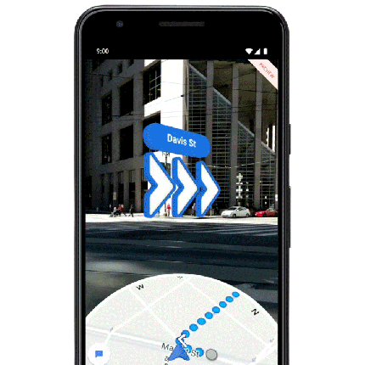
Google Maps
Augmented Reality (AR) on navigation
On Street View

Slide 12
Live Caption
To all videos
When you watch a video, whether it’s on your camera roll, on an app / the web, or even video chats
Google can soon begin adding subtitles to what is being said right underneath
For people who are deaf or hard of hearing, but some people might also use this when they’re watching videos in public and want to keep the volume low or while they’re on a call
Added also to phone calls
Adding a live transcription of the current conversation to help those who may be hard of hearing clearly understand what’s being said

Slide 13
And more …
Android Q
Dark Mode
Google Nest
Pixel 3a and 3a XL
Better Google Podcast
Project Euphonia

Slide 14
Thanx 4 watching
–Slovak Goal Erasmus+ Team

